Slide 1



The Power of N1
Kate Stanton-Davies
Water Loss Research & Analysis Ltd
katesdavies@wlranda.com
ALTA SCUOLA DI Formazione sulla Gestione dei Sistemi Idrici
Best Practice Internazionali - Monitoraggio Tecnologie - Casi di studio
VII Edizione - Ravenna, 17-18-19 Maggio 2023
Notes:
Good afternoon, Buongiorno
I am honoured to present to you during this 3 day event. Thank you to Marco for inviting me, and for translating this presentation today.

Slide 2

Introduction
For simplicity, the N1 value for a zone / DMA is normally assumed to be a fixed value –
  However, N1 can vary significantly with pressure
This is particularly important in systems operating at either low or high average pressures –
  For accurate modelling of the impact of pressure management on leakage levels
This presentation will –
  Review the concepts of Fixed and Variable Area Discharges (FAVAD)
  Outline the progress in linking N1 with FAVAD
  Identify the range of valid values for N1
  Show the potential problems if a fixed N1 value is used
  Show how to calculate Fixed Area and Variable Area leaks from an N1 value
  Identify further calculations possible with a reliable N1 value
Notes:
For simplicity, many practitioners use fixed values of N1 in their leakage calculations; however, this approach can cause problems, as N1 can vary significantly with pressure.
If a Zone or DMA operates at very low or higher than average AZP, it is very important to understand the N1:AZP relationship, so that you can more accurately model the impact of pressure management on leakage levels..
This presentation has two main sections:
The first section reviews the concepts of Fixed and Variable Area Discharges, shows the development of understanding N1 and FAVAD, and identifies the range of valid N1 values.
The second section shows some problems of using a fixed N1 particularly at lower pressures, how to calculate Fixed and Variable Area leaks from an N1 value, and identifies further calculations that are possible once a reliable N1 value at a specific AZP is known.

Slide 3
FAVAD* concept provides a deeper understanding of
Pressure: Leak Flow Rate Relationships
The FAVAD concept has been used to explain diverse results from pressure:leak flow rate field tests in many countries
  It allows for variations in the area of leaks as a result of changes in pressure
Velocity of leakage paths V = Cd x (2gP)^{0.5}
  Cd is a discharge coefficient, typically 0.6
  g is acceleration due to gravity (9.81 m/s²)
If Area of leakage paths = A, then leak flow rate L = V x A = Cd x A x (2gP)^{0.5}
Effective area (Cd x A) of some types of leakage paths are fixed; effective areas of other types of leakage paths vary linearly with pressure
*FAVAD = Fixed and Variable Area Discharge Paths (John May, 1994)
Notes:
This concept has been used to explain results from pressure:leak flow rate tests across the world - It allows for variations in the area of leaks as a result of changes in pressure
Here is the equation to calculate the velocity (V) of leakage paths. My multiplying the Velocity by the area of Leakage Paths (A), you can calculate the leak: flow rate.
The FAVAD (Fixed and Variable Area Discharges) concept explains that the effective area of some leakage paths are fixed and others vary linearly with pressure.

Slide 4
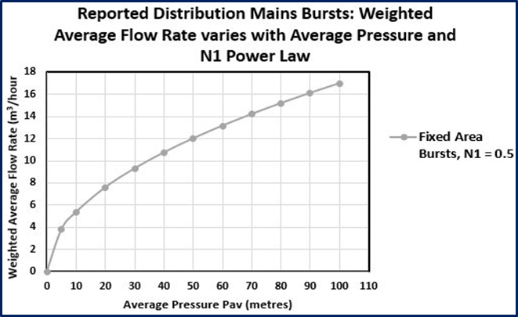
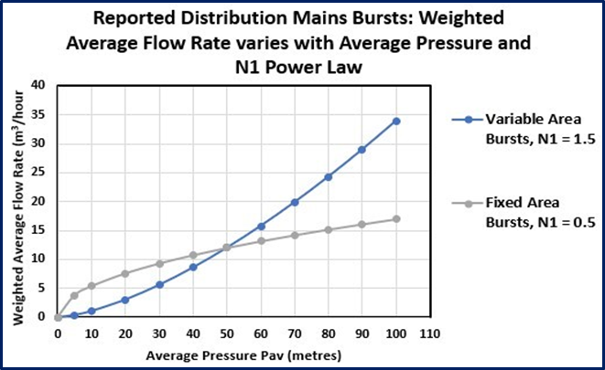




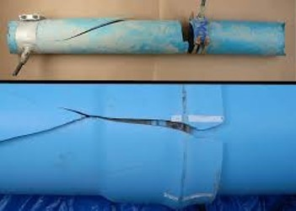

Comparison of Fixed and Variable Area Leaks
Fixed Area Leaks (rigid pipes)
Variable Area Leaks (flexible pipes and UBL)
N1 for fixed area leakage paths is 0.5 (least sensitive to changes in pressure)
N1 for variable area leakage paths is 1.5 (much more sensitive to changes in pressure)
Notes:
Fixed Area Leaks, occurring in rigid pipes, have an N1=0.5, meaning that the leak flow rate is not very sensitive to changes in pressure. We can see this from the graph on the left side of this slide which plots AZP on the X axis against Flow Rate in m3/hr on the Y axis, and here are some example of fixed area leaks in the video and photos.
Variable Area Leaks, occurring in flexible pipes, and background leakage have an N1=1.5, meaning that the leak flow rate is much more sensitive to changes in pressure. We can see this from the graph on the right side of this slide which plots AZP on the X axis against Flow Rate in m3/hr on the Y axis, , and here are some example of variable area leaks in the video and photos.

Slide 5
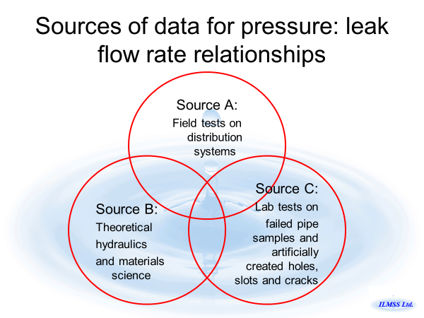
Progress in understanding, from N1 to FAVAD
Simple Power Law approach (1995 onwards)
Assume that leak flow rate (volume/hour) varies with average zone pressure AZP to the power N1
L = k x AZP^{N1}
The user assumes a fixed value for N1 between 0.5 to 1.5, preferably based on N1 tests
However, the parameter ‘k’ is not fixed but also varies with pressure. If changes in pressure are small ‘k’ can to be assumed to be approximately constant
Notes:
Our understanding of the leak flow rate and N1 relationship has evolved since the Simple Power Law approach from 1995 onwards.
This assumes that Leak Flow rate varies with AZP to the power N1, with the value of N1 begin assumed to be fixed between 0.5-1.5. The value of N1 should preferably be based on a good quality N1 test.
The value of “k” is not fixed, but can be assumed as approximately constant if changes in pressure are small

Slide 6
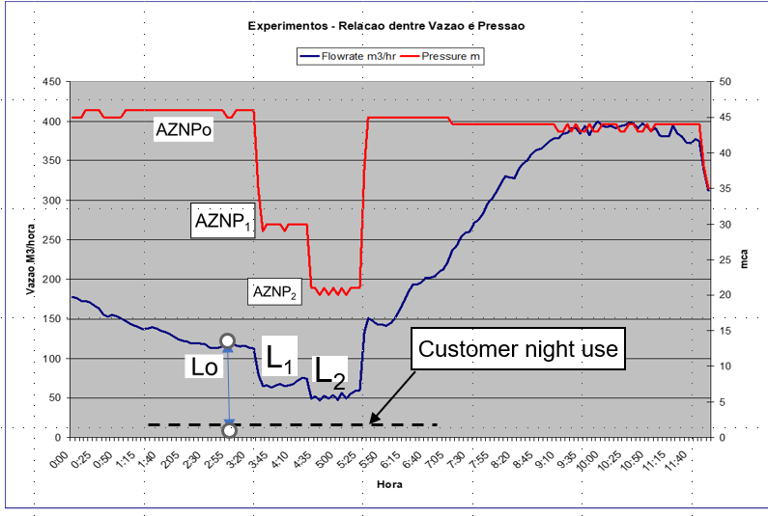
Assessing N1 from a night test
Some International N1 test values (1979-2005)
2-step N1 Night Test, SABESP, Brazil (1998)
Country | # of sectors tested | Mean N1 value | Range of N1 Values
Japan (1981) | 20 | 1.15 | 0.63 – 2.12
UK (TR154) | 17 | 1.13 | 0.70 – 1.68
Brazil (1998) | 13 | 1.15 | 0.52 – 2.79
UK (2003) | 75 | 1.01 | 0.36 – 2.95
Cyprus (2005) | 15 | 1.47 | 0.64 – 2.83
Sources of data:
OGURA, Japanese Water Works Association Journal, May 1981
Technical Report R154 data, WRC, Nov 1980, re-analysed for N1s mid=1990’s
BBL Ltda Brazil, private communication
UKWIR Report 03/WM/08
Charalambous, 2005 in Conference Proceedings of Leakage 2005, Halifax
------ Average Zone Night Pressure (m)
------ Zone inflow rate m³/hr
Pressures in the Zone are gradually reduced at night, until steady values of Average Zone Night Pressure AZNP and Leak flow rate L have been reached.
N1 values can then be calculated from pairs of values, e.g. AZNPo and Lo, and AZP1 and L₁
Notes:
On the left is an example of one of the first N1 night tests, using a 2 step approach to dropping pressure. Pressures are gradually reduced at night until the AZNP and flow rate have stabilised. N1 values can then be calculated from pairs of AZNP and Flow rate values
What has been found subsequently is that it is better to have one pressure drop slowly and steadily, as a 2 step approach could encourage transients (you could see if this was happening if you set your logging at 1 sec intervals). This 2 step approach is of historical interest and no longer best practice.
On the right are the results from some international N1 tests from 1979-2005.

Slide 7
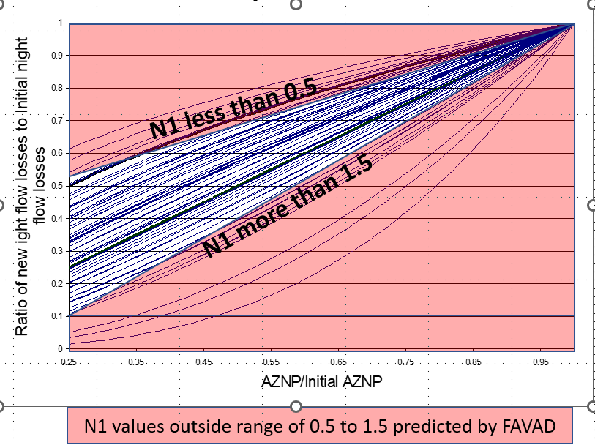
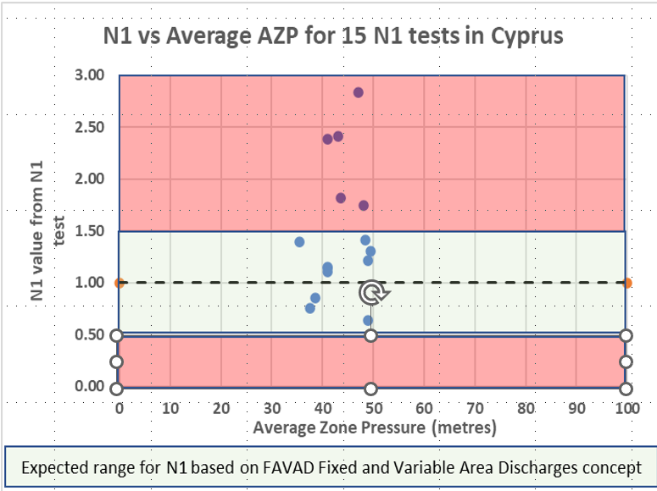
Most N1 tests yield N1 values between 0.5 and 1.5
In a 2003 UK study, only 11 out of 75 N1 values were outside FAVAD concept limits of 0.5 to 1.5
Only 5 of 15 N1 values for Cyprus (2005) were outside the FAVAD concept limits of 0.5 to 1.5
Known causes of doubtful N1 results which exceed expected FAVAD maximum N1 value of 1.5:
Don’t change night pressure before night consumption and Average Zone Night Pressure have stabilised
Don’t calculate N1 changes for increases in pressure, as pressure increases may increase storage tank inflows
If there are significant differences between AZP and lowest ground level; or failure to measure at Average Zone Point
Notes:
Most n1 tests produce N1 values of between 0.5 and 1.5 – here are some examples from the UK and Cyprus. In the UK examples, you can see the lines in the pink areas which represent values of N1 either less than 0.5 or greater than 1.5. In the example for Cyprus from 2005, the blue dots in the Green Zone represent N1 test values in the expected range of 0.5-1.5. There were 5 N1 values recorded which were greater than 1.5
Here is some guidance if you are getting N1 values greater than 1.5:
Don’t change night pressure before night inflow and Average Zone Night Pressure have stabilised
Don’t calculate N1 changes for increases in pressure, as pressure increases may increase storage tank inflows
If there are significant differences between AZP and lowest ground level; or failure to measure at Average Zone Point

Slide 8
Be aware of possible problems in using a fixed average N1 value
Most practitioners currently assume a fixed N1 value from the N1 test, which does not vary with AZP (--------- red line)
  This over-predicts N1s at lower AZPs with increasing errors at lower AZPs
Notes:
The next few slides explain how AZP influences the value of N1.
Here we have a graph showing the value of N1 on the y axis and Average Zone Pressure in metres on the x axis.
In this example we have a value of N1=1.29 – this is the horizontal dashed red line. This represents the assumption of a fixed N1 which does not vary with pressure.
But N1 is not fixed over a large range of pressures. At 40.5m, the N1 is 1.29, but if we reduce AZP to 36m, the N1 value starts to reduce, and at pressures above 40.5m the pressure starts to increase.

Slide 9
Notes:
Lets now look at what happens in this DMA is we reduce AZP below 36m.
This graph shows the predicted values of N1 in this DMA as the pressure is reduced, so at 25m AZP, N1=1.2 and at 5m AZP, the N1 would fall to 0.8.

Slide 10
Be aware of possible problems in using a fixed average N1 value
If AZPs were increased, N1 would increase to 1.40 at 100m AZP (curved ------red line), but more bursts would likely occur, further changing the N1 value)
Notes:
Lets now look at what happens in this DMA as AZP increases above 40.5m - the extrapolated valued of N1 increase as shown in the dotted red curved line.
In this example, at 100m AZP, N1 would increase to 1.4, but as the pressure increases, more bursts would be likely to occur, which would in turn change the value of N1

Slide 11
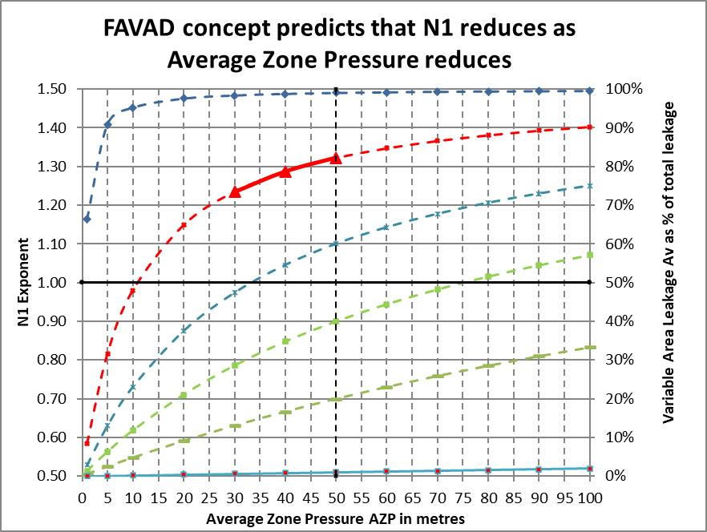
FAVAD analysis of a reliable N1 test is the key to improved system-specific DMA calculations
By quoting both the average N1 (1.29) and the corresponding average AZP (40.5 metres) together, you can derive the relationship between N1 and Average Zone Pressure AZP
You can also calculate ‘in your head’ the % of fixed or variable area leaks at current AZP, for example
  when N1 = 1.29
  % of variable area leaks = N1 – 0.50 = 0.79 =79%
  % of fixed area leaks = 1.50 –N1 = 0.21 = 21%
So as the AZP reduces and N1 reduces, the % of Variable Area Leaks also reduces
WLR&A have been able to show that these curves are the key to more reliable system-specific calculations of pressure:leak flowrate relationships
All these methods have already been field tested and used on actual DMAs in operational systems in different countries
A reliable N1 test locates a point on a curve of AZP against N1, somewhere within a family of curves
Copyright WLR&A Ltd 2023
Notes:
So when a good quality N1 test is completed for a zone or DMA, the value of N1 at a specific AZP will please that zone or DMA somewhere within a family of curves, shown in this graph. This will derive the relationship in that zone or DMA between AZP and N1.
When you know the value of N1, you can quickly calculate the % of fixed and variable area leaks, for example:
If N1=1.29, % of variable area leaks =N1-0.5 = 79%, and % of fixed area leaks = 1.5-N1 = 0.29 = 29%
So as the AZP reduces and N1 reduces, the % of Variable Area Leaks also reduces
WLR&A have been able to show that these curves are the key to more reliable system-specific calculations of pressure:leak flowrate relationships
All these methods have already been field tested and used on actual DMAs in operational systems in different countries

Slide 12
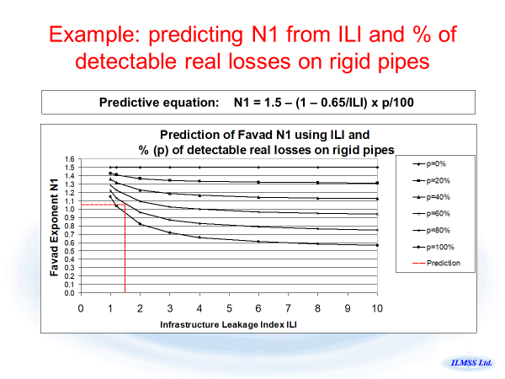
It’s time to put this N1 prediction method to bed!
This was the first simple initial N1 prediction method developed by Allan Lambert over 20 years ago
It was based on UARL parameters at an average pressure of 50 metres
  before widespread pressure management was implemented
However as it has now become superseded by a better method Allan strongly advises practitioners not to use it now or in future
  as it takes no account of the fact that N1 varies significantly with pressure
Notes:
In the past 20 years, better and more reliable techniques have evolved to predict the value of N1 – this is the method proposed by Allan Lambert more than 20 years’ ago – however, Allan no longer advised using this, as it does not take account of N1 varying with pressure and is based on UARL parameters at an AZP of 50m only.

Slide 13

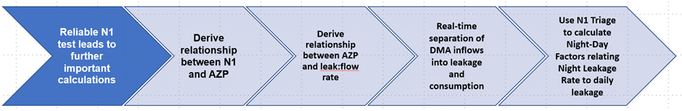
Full FAVAD analysis of N1 data - Key takeaways
Each N1 test produces an average N1 value at a specific Average Zone Pressure
Always quote N1 and AZP values together
For example N1 = 1.29 @ 40.5m AZP
At this pressure, % of Variable Area Leaks = N1 – 1.29 = 0.71 = 71%
% of Fixed Area Leaks = 1.5 – 1.29 = 0.21 = 21%
Notes:
In summary –
Any N1 value from an N1 test is not fixed, but changes as AZP decreases or increases. Rates of change in N1 are greatest at lowest pressures.
Each N1 test produces an average N1 value at a specific AZP, so always quote the N1 and AZP values together.
Use the value of N1 to calculate the % of Fixed and Variable Area leaks
Reliable N1 tests can open the door to even more important calculations, such as the relationship between AZP and Leak:Flow rate, the real-time separation of DMA inflows into leakage and consumption, and the calculation of zone-specific Night Day Factors (if used).

Slide 14

Thank you to Marco Fantozzi and the ISLE Italy team for inviting me to present at this event
  Kate Stanton-Davies
  Water Loss Research & Analysis Ltd
  katesdavies@wlranda.com
Notes:
Thank you Marco and the ISLE Italy team for inviting me to present at this event – I hope the presentation was interesting and useful to you.

