Slide 1




SCF extends the practical application of UARL and recommended use of UARL₁₉₉₉, ILI and UARL with SCF
ALLAN LAMBERT & KATE STANTON-DAVIES| RAI - amsterdam, 7 – 8 november 2023
Notes:
Good morning.
I’ll start with some background as to why I’ve continued researching over the last 23 years on how to extend the range of application of the 1999 UARL equation, and then pass over to Kate to describe three Case Study results.

Slide 2
AGENDA: UNAVOIDABLE ANNUAL REAL LOSSES
UARL₁₉₉₉ Equation for whole large systems
  Why it was needed
  UARL evolution since 1999
UARL with System Correction Factor SCF (2019)
  How is a UARL with SCF calculation different?
  Reduction in bursts by pressure management predictable since 2013
  Interpreting SCF results
  Case Studies results and feedback
  Context – Implications for Regulators and Utilities
  Guidance on use of UARL₁₉₉₉, ILI and UARL with SCF
  © Water Loss Research & Analysis 2023
Notes:
Here’s the agenda

Slide 3
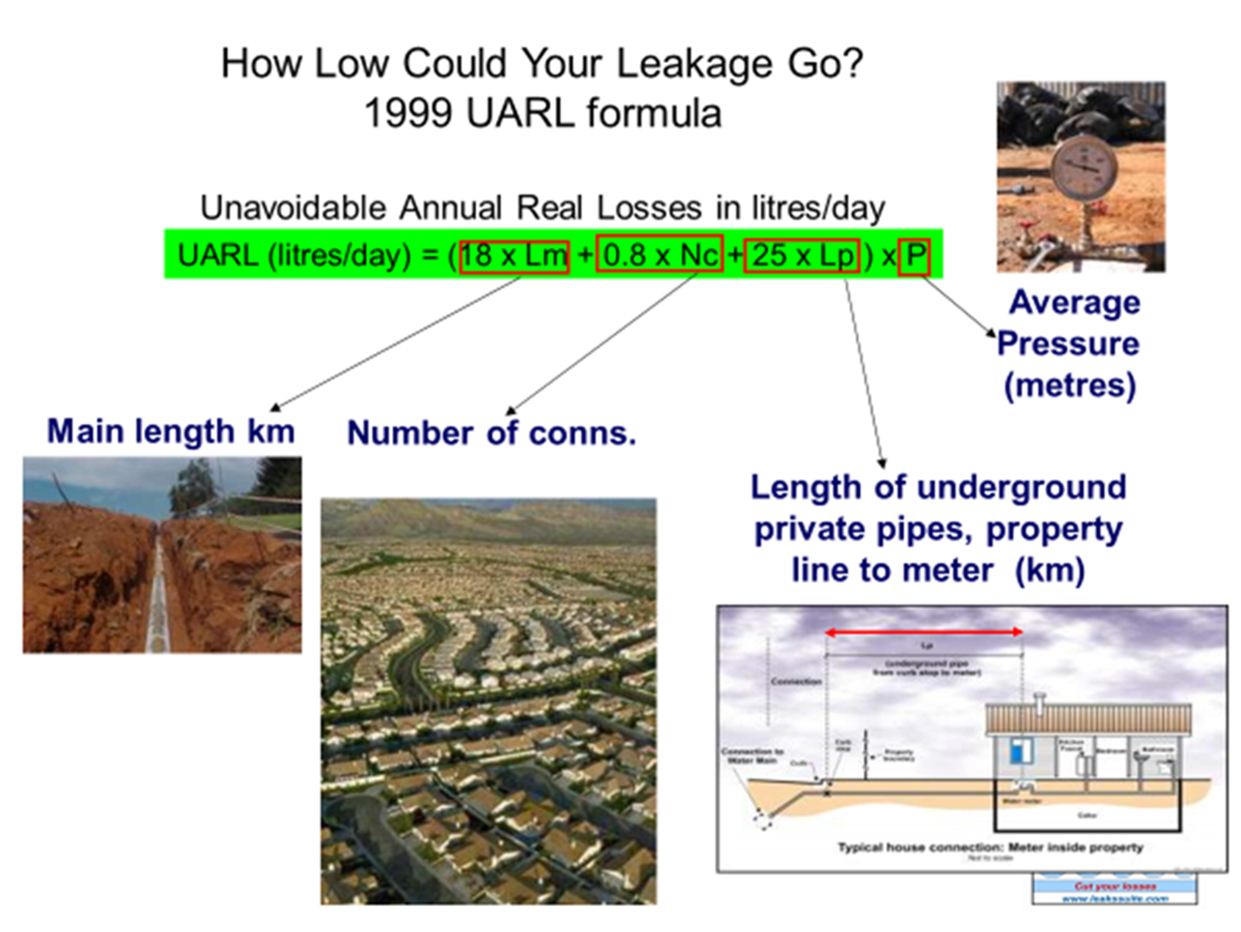
UARL₁₉₉₉ Equation for whole systems – why it was needed
1st IWA Water Loss Task Force 1995-1999
  Tasked to review KPIs for international comparisons of water losses and develop standard international water balance
Limitations of real losses KPIs in use in 1995 were identified, new approach needed
  Task force agreed parameters for an unavoidable annual real losses (UARL) component analysis equation to calculate how low REAL LOSSES could be reduced for well-managed Utilities with good infrastructure
  Current Annual Real Losses volume (CARL) then divided by UARL to get a non-dimensional Infrastructure Leakage Index (ILI) for international technical comparisons of leakage management
Assumptions and limitations of the UARL₁₉₉₉ equation
  UARL₁₉₉₉ equation designed, tested and intended to be used only for larger systems > 5000 service connections
  Leak flow rates vary with pressure to power N1, range 0.5 to 1.5; was simplified to linear, N1 = 1 for mixed pipe materials
  Pressure:burst frequency relationships not widely recognised in 1999 although some evidence existed, but not included in UARL₁₉₉₉
  © Water Loss Research & Analysis 2023
Notes:
The illustration on the left shows the UARL1999 equation developed by the first IWA Water Loss Task Force, as part of a 5 year review of KPIs for international comparisons of loss in water supply systems.
The UARL equation uses Component Analysis (Background and Bursts) concepts with 15 auditable components to assess ‘how low could you go?’ with real (physical) losses, at different system pressures.
The UARL equation was created for large whole systems with more than 5000 service connections, and was tested on 27 large systems, including several national or State capital cities, in 20 countries
Current Annual Real Losses volume is then divided by UARL volume to derive the non-dimensional Infrastructure Leakage Index (ILI) for large systems exceeding 5000 service connections.
Using assumptions available at the time, leak flow rates were assumed to vary linearly with pressure, but pressure:burst frequency relationships were not included as their existence was not widely recognised at that time.

Slide 4
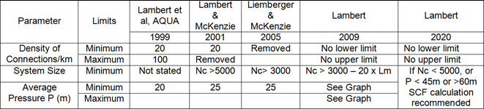
UARL evolution since 1999
The boundary conditions initially recommended for using UARL₁₉₉₉ for large whole systems are highlighted below
Current Recommendations using UARL with SCF
Source: ISO 24528 (en-standard.eu) (2021)
Practitioners liked UARL₁₉₉₉ and began using it for small systems including DMAs with less than 5000 connections
  Some calculated ILIs were less than 1.0, particularly in small systems with flexible pipe materials and lower pressures
  Some users and researchers incorrectly applied UARL to very small systems, or included above-ground service pipe lengths, or incorrectly included number of sub-meters in apartment blocks in their UARL calculation
  Attempts to review boundary conditions 2005 to 2009 did not resolve anomalies for small systems
Subsequent research by WLR&A identified three additional interacting factors which influence UARL volumes
  Fixed and variable area discharges (FAVAD) concept used for varying pressure:leak flow rate relationships:
  Pressure:burst frequency relationships
  Use Median (not Annual Average) UARL burst frequencies of Poisson distribution, appropriate for any size of system
These factors are now used to calculate individually customised System Correction Factors (SCF) to provide more reliable UARL with SCF real losses volumes for any size of system or subsystem at any average system pressure
  © Water Loss Research & Analysis 2023
Notes:
Additional boundary conditions for use of the UARL equation have evolved since 1999 as shown in the table. Practitioners liked UARL₁₉₉₉ and began using it for small systems including DMAs with less than 5000 connections
Some calculated ILIs were less than 1.0, particularly in small systems with flexible pipe materials and lower pressures
Some users and researchers incorrectly applied UARL to very small systems, or included above-ground service pipe lengths, or incorrectly included number of sub-meters in apartment blocks in their UARL calculation
Attempts to review boundary conditions 2005 to 2009 did not resolve anomalies for small systems
Subsequent research by WLR&A identified three additional interacting factors which influence UARL volumes
Fixed and variable area discharges (FAVAD) concept used for varying pressure:leak flow rate relationships:
Pressure:burst frequency relationships
Use Median (not Annual Average) UARL burst frequencies of Poisson distribution, appropriate for any size of system
These factors are now used to calculate individually customised System Correction Factors (SCF) to provide more reliable UARL with SCF real losses volumes for any size of system or subsystem at any average system pressure.

Slide 5
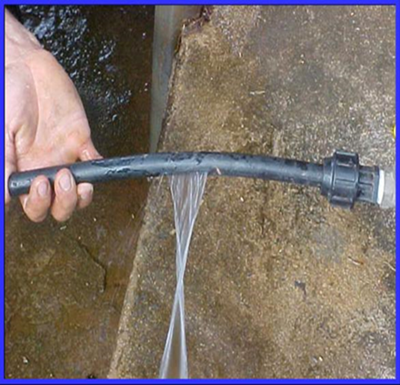
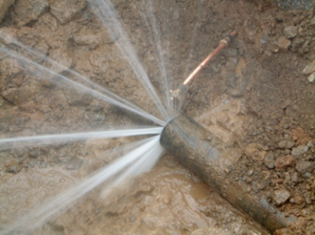
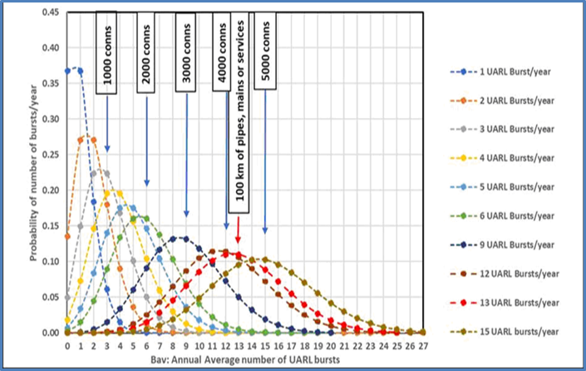
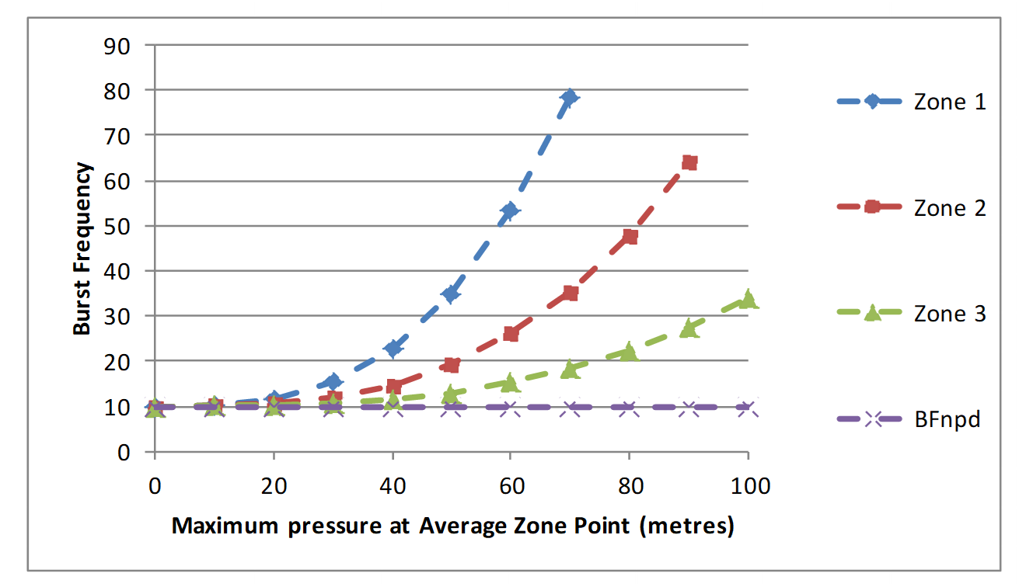
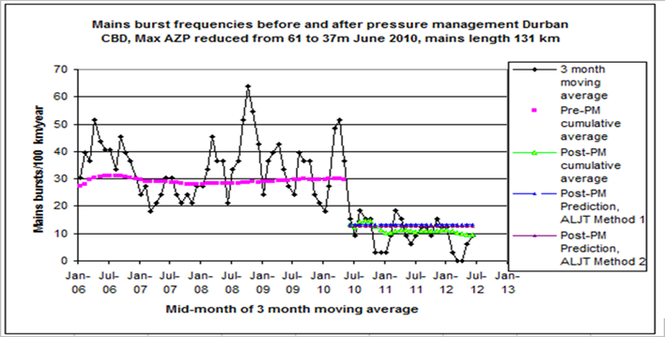
How is a UARL with SCF calculation different?
These combined influences on UARL volumes which were not included in the original 1999 UARL equation:
FAVAD
Fixed and Variable Area Discharges: type of leak and pipe materials influences pressure: leak flow rates relationships significantly
Uses power law N1=1.5 for variable area leaks (background leakage at joints and bursts on flexible pipes) and N1=0.5 for fixed area bursts on rigid pipe materials
POISSON DISTRIBUTION FOR BURSTS
The Poisson probability distribution considers bursts as isolated events; it generates median and modal values for UARL burst frequencies less than the average in small systems, but median and modal values close to the average for larger systems
For small systems, the median probability (50% chance of exceedance in any year) is more appropriate than average UARL burst frequency for isolated events
PRESSURE:BURSTS
Predicts the influence of a general relationship between pressure and burst frequency (not available prior to 2013) customised with local parameters
  © Water Loss Research & Analysis 2023
Notes:
These combined influences used in SCF calculations are briefly described below
Fixed and Variable Area Discharges: type of leak and pipe materials influences pressure: leak flow rates relationships significantly
Uses power law N1=1.5 for variable area leaks (background leakage at joints and bursts on flexible pipes, see left side photo) ) and N1=0.5 for fixed area bursts on rigid pipe materials (right side photo)
Poisson Distribution considers bursts as isolated events; it generates median and modal values for UARL burst frequencies less than the average in small systems, but median and modal values close to the average for larger systems;
For small systems, the median probability (50% chance of exceedance in any year) is more appropriate than average UARL burst frequency for isolated events
Pressure: Bursts : Predicts the influence of a general relationship between pressure and burst frequency customised with local parameters . There are many published examples since 2005 like this example from Durban

Slide 6
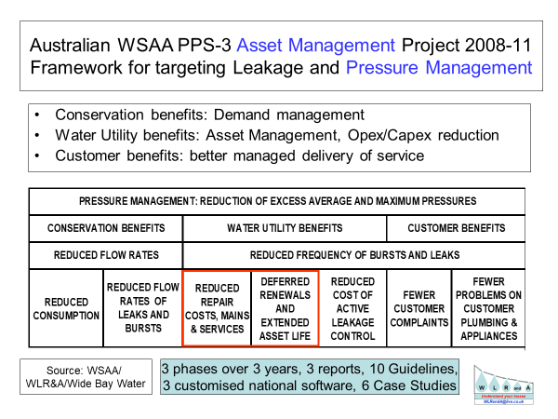
Reduction in Bursts by pressure management has been predictable following a major study in Australia
Since 2013, these predictions of reductions in burst frequency from pressure management continue to be applied successfully in several countries, notably South Africa and several UK Utilities
The economic benefit of reducing bursts for several years, coupled with deferred replacement of mains and services due to the extension of infrastructure life, is very large compared to the savings in reduced flow rates of existing leaks and bursts.
Savings in energy and carbon costs can also now be included as part of the sustainable benefits of pressure management
How can you possibly calculate meaningful technical or economic real losses targets and performance indicators without taking pressure and pressure management into account? It’s like trying to explore the universe without taking account of gravity!
If Regulators required Utilities to publish their average pressures as explanatory factors, interpretation of all real loss KPIs would be much more meaningful!
  © Water Loss Research & Analysis 2023
Notes:
This major study in Australia by WLR&A for Water Services Association of Australia lead to the prediction equations developed and currently used by WLR&A Ltd
Since 2013, these predictions of reductions in burst frequency from pressure management continue to be applied successfully in several countries, notably South Africa and several UK Utilities
The economic benefit of reducing bursts for several years, coupled with deferred replacement of mains and services due to the extension of infrastructure life, is very large compared to the savings in reduced flow rates of existing leaks and bursts.
Savings in energy and carbon costs can also now be included as part of the sustainable benefits of pressure management
How can you possibly calculate meaningful technical or economic real losses targets and performance indicators without taking pressure and pressure management into account? It’s like trying to explore the universe without taking account of gravity! If Regulators required Utilities to publish their average pressures as explanatory factors, interpretation of all real loss KPIs would be much more meaningful!

Slide 7
Interpreting SCF results
UARL with SCF = SCF x UARL_{1999 volume}
SCF is a non-dimensional number which is multiplied by the UARL₁₉₉₉ volume to give a customised UARL volume for a whole system, zone or DMA
SCF | Interpretation
0.9-1.1 | Represents +/-10% around the UARL₁₉₉₉ volume – many systems, zones and DMAs with mid-range pressures between 45-60m and/or with more than 5000 service connections could have SCFs in this range
<0.9 | Indicates that the standard UARL₁₉₉₉ equation over-estimates UARL volume – ie., lower UARL volume targets could be set. Systems, Zones and DMAs operating at <45m AZP and/or with <5000 service connections may have SCFs <0.9.
>1.1 | Indicates that the standard UARL₁₉₉₉ equation under-estimates UARL volume – ie., higher UARL volume targets should be set. Systems, Zones and DMAs operating at >60m AZP and/or with >5000 service connections may have SCFs >1.1
  © Water Loss Research & Analysis 2023
Notes:
SCFs are calculated using online software – the SCF is a non-dimensional number, which is then multiplied by the standard 1999 UARL volume, resulting in a customised UARL volume for an individual DMA, Zone or whole system.
Many Zones, DMAs or whole systems operating at 45m-60m AZP and/or with more than 5000 service connections will have an SCF between 0.9-1.1, that is around +/- 10% of the standard UARL calculation.
SCFs <0.9 typically relate to systems, zones or DMAs operating at <45m AZP and/or with < 5000 service connections – in these circumstances, the standard UARL equation tends to over-estimate UARL volume, and lower UARL volume targets could be set here.
SCFs >1.1 typically relate to systems, zones or DMAs operating at higher pressures of >60m AZP with > 5000 service connections – in these circumstances, UARL volume targets set using the 1999 equation are unlikely to be achieved, and higher volume targets may need to be set.

Slide 8
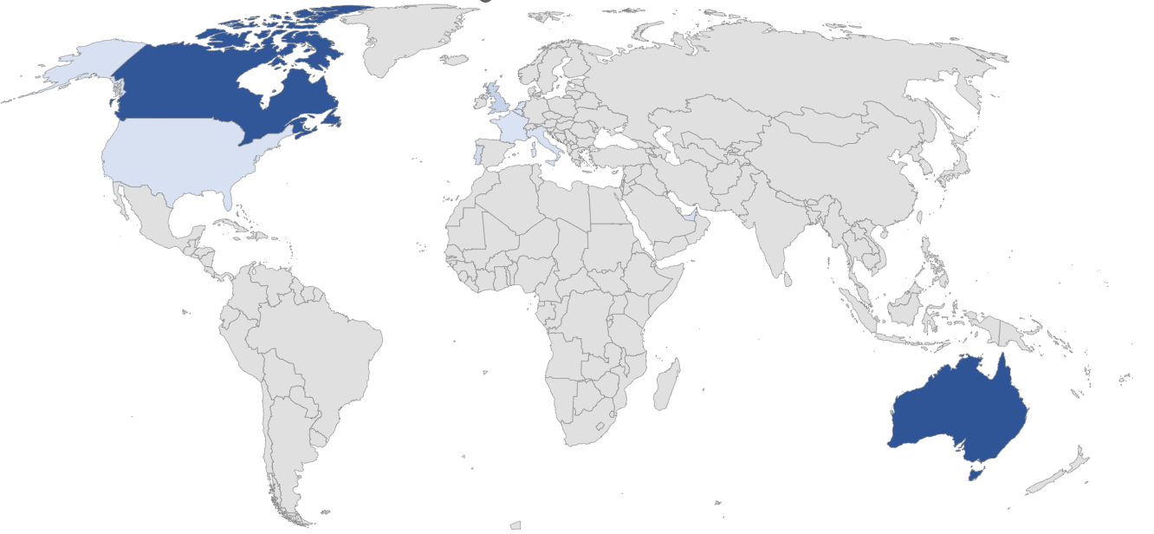
Case Study results and feedback
  © Water Loss Research & Analysis 2023
Notes:
To date more than 2,500 calculations in 12 countries have been completed. Let’s take a look at 3 case studies for Utilities large using UARL with SCF in Australia, Canada and Europe.

Slide 9
Case Study 1 – Sydney Water (Australia)
SERVICE CONNECTIONS (customer meters at property line) | 1.37 MILLION
DENSITY OF CONNECTIONS (AVERAGE) | 58.6 per km mains
MAINS LENGTH (km) | 23800
AVERAGE ZONE PRESSURE (m) | 51.9 (15-137m)
MAINS AND SERVICES PIPE MATERIALS | 82% RIGID MAINS 85% RIGID SERVICES
NUMBER OF SCF CALCULATIONS | 655
CURRENT ILI (2020) | 1.3
User Feedback
“We are using SCF calculations to plan the DMA program.
The data is useful in desktop analysis of choosing preliminary DMA candidates to enable the operators to confirm the candidates based on network configuration and local conditions.
….and adopt the system level SCF corrected UARL as future targets to plan leakage control works ie., pressure reduction, sensors, traditional Active Leak Detection or DMA sectorisation.
We are working on system level water loss. Once that is done the corrected UARLs can be set as targets and planning may be undertaken to address the gap between actual water loss and the UARL targets.”
All data reproduced with kind permission of Sydney Water, Australia
  © Water Loss Research & Analysis 2023
Notes:
The first case study is Sydney Water, with over 1.3million service connections, nearly 24000km of mains, operating at a range of AZP from 15-137m, and with mostly rigid mains and services. 655 calculations were performed across their whole water distribution network. Customer meters are located at the property line.
The SCF results are being used for two main purposes – firstly to identify suitable candidate Zones for their DMA program. SCF volumes will be adopted as volume targets, rather than the original 1999 UARL volume.

Slide 10
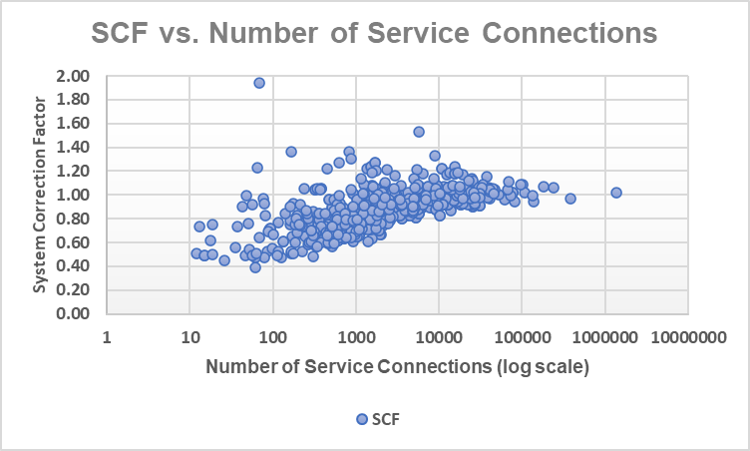
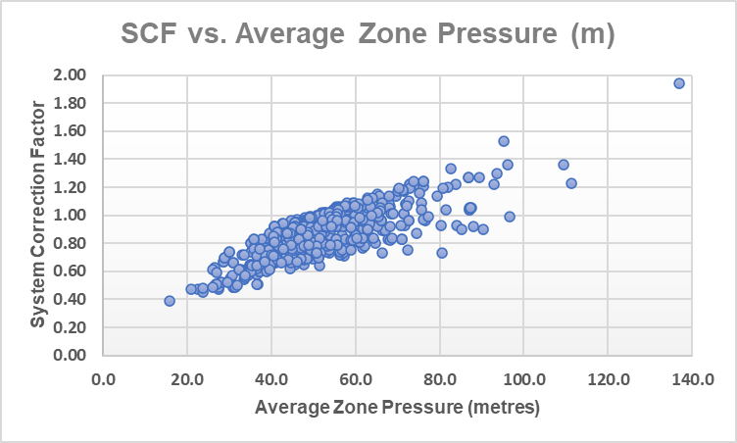
Case Study 1 – Sydney Water (Australia)
0
All data reproduced with kind permission of Sydney Water, Australia
  © Water Loss Research & Analysis 2023
Notes:
These 2 scatter graphs show the relationships between the value of the SCF on the Y axis, and Number of service connections on the first graph, and the value of the SCF vs. AZP on the second graph.
In the first graph, you can see that there is no single relationship between SCF and system size, but systems with more than 5000 service connections tend to have values between 0.9 and 1.1. as system size reduces below 5000, the spread of SCF widens.
In the second graph, the solid blue line represents the UARL1999 assumption of a linear pressure:leakage relationship. Smaller lower pressure zones have SCFs in the green dash box below 0.9 , meaning that lower UARL volume targets are possible here. Some higher-pressure zones have SCFs above 1.1 in the red dashed box, meaning that volume targets set using the standard UARL equation are unlikely to be achievable at that pressure in these parts of the network.

Slide 11
Case Study 2 - Quebec Province (Canada)
626 Individual Utilities UARL includes private underground service pipe
SERVICE CONNECTIONS | 2111989
DENSITY OF CONNECTIONS (AVERAGE) | 50.9 per km mains
MAINS LENGTH (km) | 41429
AVERAGE ZONE PRESSURE (m) | 49.7 (18-102m)
MAINS AND SERVICES PIPE MATERIALS | 95% RIGID MAINS 95% RIGID SERVICES
NUMBER OF SCF CALCULATIONS | 855
CURRENT ILI (2019) | 6.6
User Feedback
“The SCF factor helped MAMH analysts to understand why some systems were always reporting really low ILI (below 1). It helped them to validate the data sent over by the municipalities and, for calculated ILIs less than 1.0, to avoid spending extensive time finding possible raw data errors. Further enquiries into the raw Current Annual Real Losses data are triggered only if the CARL volume is less than the calculated UARL with SCF volume.
The SCF also helped to contextualize the results of larger systems with high ILI. By adding the SCF into the analysis, it was made clear that we should not directly compare the ILI of larger systems with smaller ones. Knowing the ILI with and without the SCF for all municipalities helped analysts to better tailor their advice to municipalities to improve the efficiency of their systems. There may be other uses for UARL with SCF further down the line, perhaps in the next phase of the Quebec Water Efficiency Strategy.”
All data reproduced with kind permission of MAMH and
Reseau Environnement, Quebec
Notes:
The second case study is the whole of Quebec province in Canada – data from 626 Utilities was used for 855 calculations – over 2.1 million service connections and 41000km of mains, operating at a range of AZP from 18-102m, with almost all services and mains made of rigid pipe materials.
The SCF results are being used in multiple ways by MAMH – to help analysts understand which influences cause some systems to report ILIs of <1, as well as being able to better advise municipalities on how to improve the efficiency of their systems. The SCF calculations were part of an earlier phase of the Quebec Water Efficiency Strategy.

Slide 12
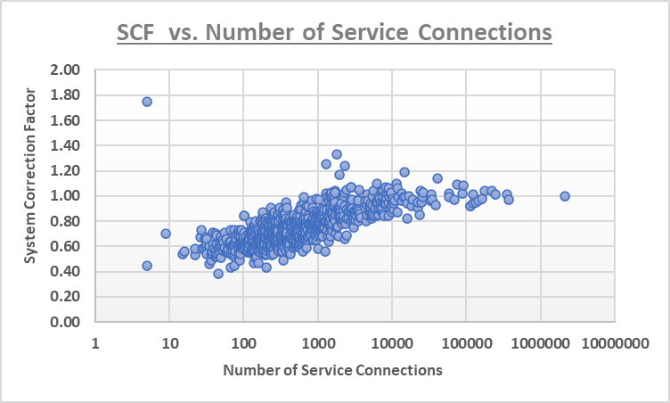
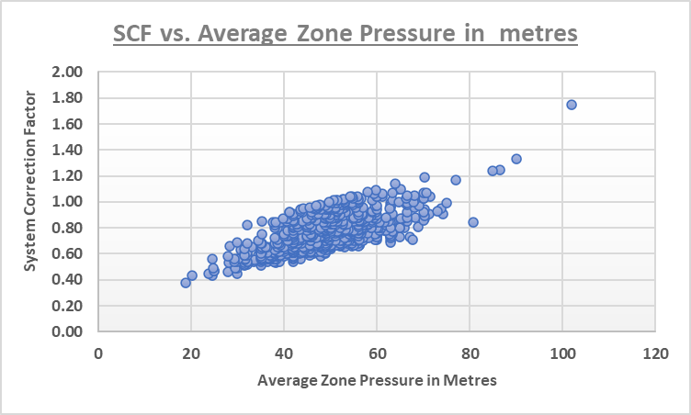
Case Study 2 - Quebec Province (Canada)
All data reproduced with kind permission of MAMH and Reseau Environnement, Quebec
Notes:
Here are the 2 scatter graphs for the Quebec data, which show the relationships between the value of the SCF on the Y axis, and Number of service connections on the first graph, and the value of the SCF vs. AZP on the second graph.
Again, the spread of data looks similar to that of Sydney Water, with a proportion of zones operating with >5000 service connections and with mid-range pressures 45-60m having SCF values between 0.9-1.1, meaning that the standard 1999 UARL equation can still be used to set meaningful volume targets in those systems and zones.
Many smaller lower pressure zones have SCFs in the green dash box below 0.9 , so lower UARL volume targets could be set here, and the larger higher-pressure zones have SCFs above 1.1 in the red dashed box, meaning that volume targets set using the standard 1999 UARL equation are unlikely to be achievable at that pressure.
And again, the clear relationship between SCF and Pressure can be seen in the second graph

Slide 13
Case Study 3 - Water Services Corporation (Malta
SERVICE CONNECTIONS (all meters at property line) | 130000
DENSITY OF CONNECTIONS (AVERAGE) | 80.7 per km of mains
MAINS LENGTH (km) | 2141
AVERAGE ZONE PRESSURE (m) | 32 (17-74m)
MAINS AND SERVICES PIPE MATERIALS | 93% RIGID MAINS 5% RIGID SERVICES
NUMBER OF SCF CALCULATIONS | 320
CURRENT ILI (2022) | 1.7
User Feedback
“UARL with SCF software allows us to further customise UARL calculations for each of 320 individual Zones and Sub-Zones, for the first time.
Integrating this methodology within the snapshot ILl concept will result in rapid identification of Zones where we may expect to set and achieve lower leakage targets and better quantification of leakage and burst reductions from further pressure management.
Fine tuning the UARL now is allowing us further scope to further reduce leakage, saving millions of euros in the process.”
“The UARL with SCF gives us a more precise and generally lower value of leakage, well increasing our scope to attain ever lower leakage levels.
This approach was implemented at a point where we thought we were already close to where we needed to arrive, so the further scope in reducing leakage was more than welcome.”
All data reproduced with kind permission of
Water Services Corporation, Malta
  © Water Loss Research & Analysis 2023
Notes:
The third case study is for the whole of Water Services Corporation in Malta – 130000 service connections over more than 2100km of mains, operating at a range of AZP from 17-74m, with mostly rigid mains and mostly flexible service connection materials.
SCF calculations are being used to fine tune and further reduce leakage targets, identify target zones for Pressure management and quantify leakage and burst reductions from pressure management activities, saving the Utility million of euros in the process.

Slide 14
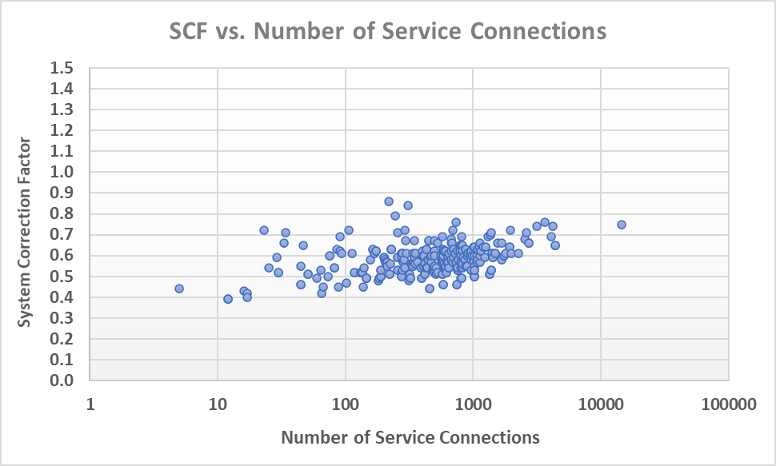
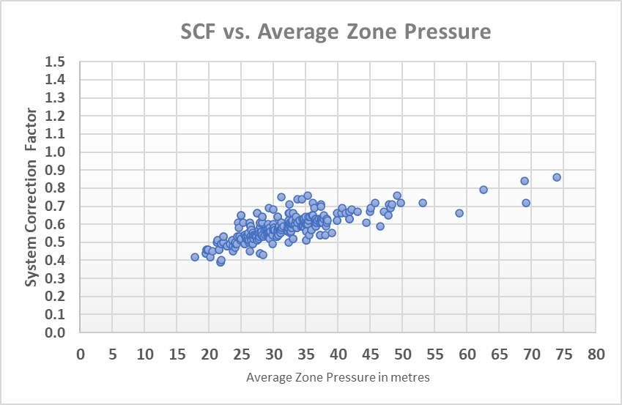
Case Study 3 - Water Services Corporation (Malta)
All data reproduced with kind permission of Water Services Corporation, Malta
  © Water Loss Research & Analysis 2023
Notes:
These 2 graphs, again showing SCF vs number of service connections and SCF vs AZP are significantly different from those for Sydney Water and Quebec – note there are no SCFs between 0.9-1.1, nor are there any SCFs above 1.1!
These results are due to several new influences now included in the SCF calculation, acting together –nearly all systems are small or very small (less than 3000 service connections). 95% of service connections (where most real losses occur) are made of flexible materials with flow rates sensitive to pressure, and there has been sustained pressure management campaigns by WSC over the last 20 years during which ILI has been reduced from 20 to 1.7.

Slide 15
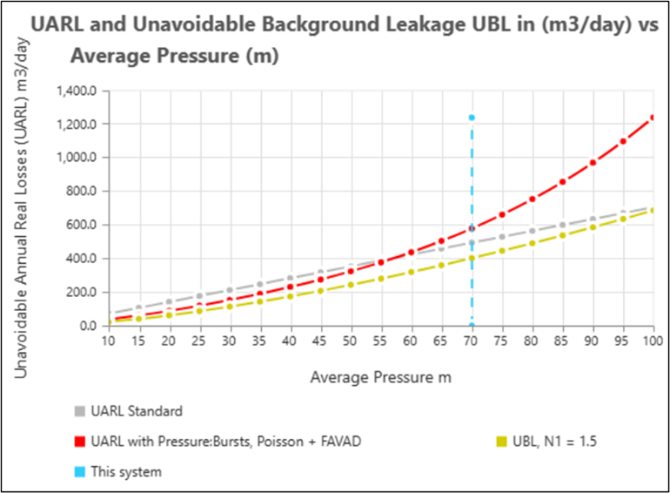
Using SCF to quantify the benefits of pressure management
For this system, UARL targets set using the 1999 UARL equation are
unlikely to be achievable at this pressure
Average Zone Pressure (m) | UARL Standard (m³/day) | UARL with Favad + Poisson + Pressure:Bursts (m³/day) | UBL Variable Area, N1 = 1.5 (m³/day)
40.0 | 282.0 | 229.8 | 173.4
45.0 | 317.3 | 274.4 | 207.0
50.0 | 352.5 | 323.1 | 242.4
55.0 | 387.8 | 376.7 | 279.7
60.0 | 423.0 | 436.8 | 318.6
65.0 | 458.3 | 503.8 | 359.3
70.0 | 493.5 | 578.2 | 401.5
75.0 | 528.8 | 660.9 | 445.3
6000 service connections, 100km mains, 70m AZP
Av. Length of service connection property line to meter = 3m
Mix of rigid and flexible mains and services pipe materials
If AZP can be reduced by 5m (from 70m to 65m),
UARL with SCF volume can be reduced by approx. 74m³/day or 27,156m³/year
  © Water Loss Research & Analysis 2023
Notes:
SCF has now been used to calculate UARL volume targets for numerous whole systems, Zones and DMAs of any size, operating at wide ranges of pressure.
The software also quantifies the benefits of reductions in Average pressure, as shown in this example. The table on the left shows UARL, SCF and Unavoidable background leakage UBL volumes at different AZPs for a large system of 6000 service connections operating at 70m AZP. The graph on the right shows these volumes plotted against AZP and clearly show (if you look at the red dotted line) how pressure increases standard UARL, UARL with SCF and UBL.
At 70m AZP, the Standard UARL₁₉₉₉ equation calculates a UARL volume of 494 m3/day. However, SCF calculates that the lowest likely UARL volume is higher at 578 m3/day, including 402 m3/day undetectable background leakage – in other words, the standard UARL volume is unlikely to be achieved at 70m AZP.
If this system could be operated at, say 65m AZP, then predicted UARL with SCF volume of 504 m3/day including 359 m3/day undetectable background leakage would represent a saving of 74 m3/day, or over 27,100m3/year, plus a reduction in burst frequency. Every metre of excess pressure that can be shaved off will bring benefits by reducing UARL, UARL with SCF and UBL volumes. Also consider the reduction in burst frequencies, repair costs and extension of infrastructure life which can be assessed from separate software.

Slide 16
Guidance on use of UARL₁₉₉₉, ILI and UARL with SCF
UARL₁₉₉₉ annual volume should always continue to be calculated as a first step, whatever the size of system or sub-system. Average pressure used in the calculation must be specified
ILI should continue to be calculated for whole systems with more than 5000 service connections, using the UARL₁₉₉₉ volume as the denominator, as an international KPI for external comparisons of technical performance of real losses management in large systems.
For smaller systems less than 5000 service connections, achievable low real losses are greatly influenced by a variety of parameters
UARL with SCF software allows UARL₁₉₉₉ to be customised and calculated in terms of unavoidable annual volume at any pressure for any size of system or sub-system, and can then be used as a basis for internal Utility calculations for:
  target setting in terms of volume/day, volume/service connection/day, or m3/km mains/day
  prioritising individual small systems or zones for quantified benefits of further active leakage control and/or pressure management
  © Water Loss Research & Analysis 2023
Notes:
So, we have seen how the UARL equation has evolved over the last 25 years, and the importance of UARL with SCF in calculating UARL volumes for systems, zones and DMAs outside of the original parameters of the 199 equation.To summarize this presentation, we advise the following guidance on when to use each of these KPIs:-
First, to always use the UARL 1999 equation as a first step in calculating UARL annual volume, whatever the size of system or sub-system.
When calculating ILI, this should always be for a whole system of more than 5000 service connections, and always using the UARL1999 volume as the denominator. The ILI with average pressure specified is recommended as an international KPI for comparing technical performance of real losses in large systems.
This presentation has shown that there are a variety of parameters that affect real losses in small systems of less than 5000 service connections;
UARL with SCF should be used as a basis for internal utility calculations to set targets in volume/day, volume/service conn/day or m3/km mains/day and for the prioritisation of systems, zones or DMAs for active leakage control and/or pressure management activities.

Slide 17
References
Low ILIs and Small Systems | LEAKSSuite Library
UARL with System correction factor – Water Loss Research & Analysis Ltd (wlranda.com)
NAWL Conference December 2019
NAWL Conference 2021
IWA Water Loss Conference 2022
IWA Caribbean Water Loss Conference 2023
The application of UARL with SCF is referenced in:-
  AWWA Free Water Audit software v.6 Free Water Audit Software | American Water Works Association (awwa.org)
  ISO standard 24528 ISO 24528 (en-standard.eu)
A longer version of this presentation, with audio and further references will be available on the Leakssuite Library website – www.leakssuitelibrary.com – by the end of November 2023.
  © Water Loss Research & Analysis 2023
Notes:
For further information on UARL with SCF, we have included some references listed here.
The application of UARL with SCF is referenced in the AWWA Free Water Audit software v.6 as well as in ISO standard 24528.
A longer version of this presentation, with audio and further references will be available on the Leakssuite Library website – www.leakssuitelibrary.com – by the end of November 2023.

Slide 18


Thank You!
Allan Lambert
allanlambert@leakssuitelibrary.com
Kate Stanton-Davies
katesdavies@wlranda.com
Director
Water Loss Research
& Analysis Ltd
www.wlranda.com

