Slide 1

Lost in translation – a Rosetta Stone approach to understanding inter-relationships between Real Losses KPIs
Kate Stanton-Davies
Director
Water Loss Research & Analysis Ltd

Slide 2


Brescia, 12-14 maggio 2026
What’s the Rosetta Stone and what does it have to do with KPIs?
It contains the same information written in three scripts:
  Hieroglyphics, Demotic and Ancient Greek
When it was discovered, no one could read Egyptian hieroglyphs.
But scholars could read Ancient Greek, so they used the Greek section to decypher the hieroglyphs.
In our world of water loss, we face a similar challenge: different real losses KPIs speak different ‘languages.’
Let’s understand how real losses KPIs relate to each other, so we can translate between them and unlock deeper insights
Notes:
The Rosetta Stone was a breakthrough in linguistic decoding.
It helped scholars translate Egyptian hieroglyphs using Ancient Greek.
In our world of water loss, we face a similar challenge: different KPIs speak different ‘languages.’
But if we understand how they relate, we can translate between them and unlock deeper insights,
particularly when we use those KPIs to make comparisons of performance between systems.

Slide 3
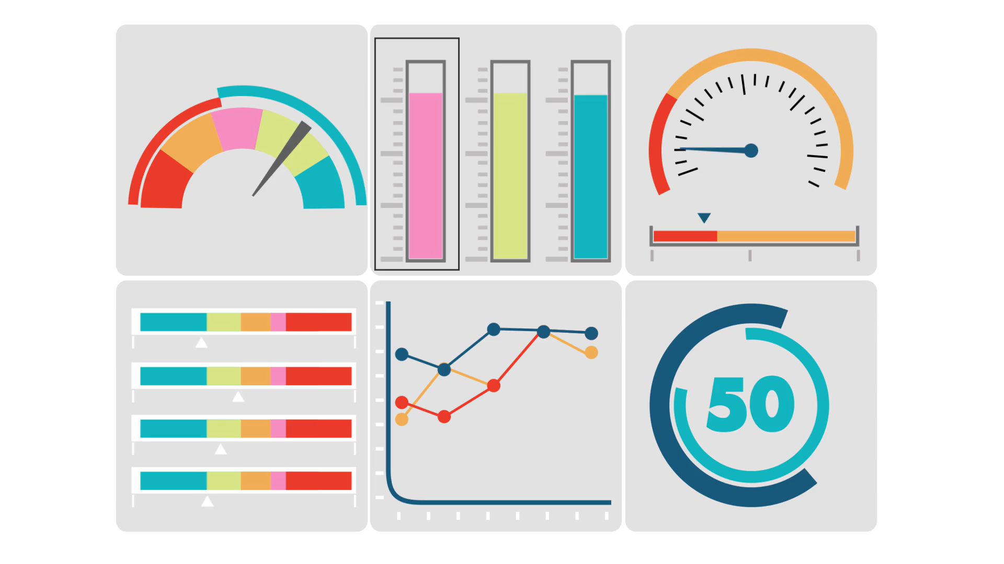
Brescia, 12-14 maggio 2026
Selecting a suitable Real (Physical) Losses KPI should be simple…
…….but there are so many to choose from!
Notes:
You’d think choosing a suitable Real Losses (physical losses) KPI would be straightforward.
But as many of you know, it’s anything but.
There are numerous options, and several options implemented in different ways can imply different conclusions.

Slide 4
Brescia, 12-14 maggio 2026
Which of these popular KPIs do you use?
Volume per year
One of these traditional or newer KPIs, multiple KPIs……or something else?
Litres/
Billed Property/day
Litres/
Physical service conn/
day
Infra-structureLeakage Index (ILI) and UARL
% of System Input Volume
m³/
Km of mains/
day
Litres/billed connection?
System Correction Factor (SCF)?
% of Water Supplied
Notes:
Here are just a few of the KPIs in circulation.
Some of you might use the traditional KPIs such as litres per physical service connection per day, others might prefer m³/km mains/day, and some still use % of system input volume. You may also be using Infrastructure Leakage Index ILI, the ratio of leakage volume per year to Unavoidable Annual Real Losses UARL.
Perhaps you are using something else – litres/billed connection, or the System Correction Factor?

Slide 5
Brescia, 12-14 maggio 2026
Utilities can use System Correction Factor (SCF) software to calculate UARL calculations for whole systems, zones or DMAs under these conditions:-
< 5000 physical service connections from mains (NOT administrative or billing connections)
<45m Average Zone Pressure
>60m Average Zone Pressure
SCF prioritises where to target Active Leakage Control and/or Pressure Reduction and set more meaningful volume targets
SCF now used for > 2500 calculations in Italy, Portugal, Malta, UK, USA, Canada, Australia
System Correction Factor
www.wlranda.com/software
Low ILIs and Small Systems | LEAKSSuite Library
https://www.wlranda.com/presentations
Notes:
The original 1999 equation for UARL remains valid for systems with more than 5000 physical service connections with average pressure between 45 and 60 metres, but since 2019 customised UARL calculations for smaller systems, zones and district metered areas can be made using UARL with SCF, specifically where there are less than 5000 service connections or the zone is operating at pressures outside the 45-60m range
SCF identifies where to target Active Leakage Control and Pressure Management within a large Utility as well as setting more meaningful Real Losses volume targets.

Slide 6
Brescia, 12-14 maggio 2026
Using the right KPI for the right purpose
OBJECTIVE | GOOD PRACTICE PERFORMANCE INDICATOR FOR LEAKAGE, FIT FOR PURPOSE
 | VOLUME PER YEAR | LITRES/ SERVICE CONNECTION | M3/KM MAINS | LITRES/ BILLED PROPERTY | % OF SYSTEM INPUT VOLUME | % OF WATER SUPPLIED | INFRASTRUCRURE LEAKAGE INDEX, WITH PRESSURE
SET TARGETS + TRACK PERFORMANCE FOR AN INDIVIDUAL SYSTEM | YES, for large systems | YES* | YES* | YES (uk) | NO | NO | Only if all justifiable pressure management completed
TECHNICAL PERFORMANCE COMPARISONS OF DIFFERENT SYSTEMS | NO | NO | NO | NO | NO | NO | YES
DRAW GENERAL CONCLUSIONS FROM SINGLE OR MULTIPLE SYSTEMS | NO | NO | NO | NO | NO | NO | YES Together with other contextual factors
* Choose litres/service connection if connections > 20/km or m3/km mains if connections < 20/km, or base choice on custom or country practice
Notes:
This very useful Table, based on a 2015 European Leakage Report, shows which KPIs are fit for which objectives.
For example, if you’re setting targets for a single system, litres per connection or m³/km mains are suitable. The general best guidance is to use volume/service connection if density of connections is > 20/km or volume/km mains if density of connections is < 20. If all justifiable pressure management has been completed, then the ILI is also suitable
But if you’re comparing technical performance across systems, or drawing general conclusions from single or multiple systems, the Infrastructure Leakage Index (ILI) is more comprehensive as it allows for the significant influences of pressure on leakage...

Slide 7
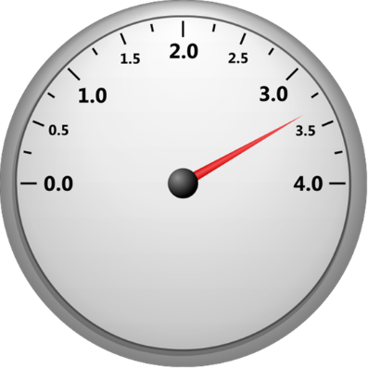




Brescia, 12-14 maggio 2026
Physical context variables influencing real losses
Average System Pressures
          Pressure influences burst frequency and leak flow rates
          But most traditional KPIs don’t require reporting of pressure data!
Service Connection density
          How can you reasonably compare KPIs for a city with a rural network?
        Customer meter location on the service connection
          Can you compare performance between utilities with meters at the property line vs. those many metres away?
          Mains and services pipe materials
          The pressure:leakflow rate relationship is significantly different for flexible and rigid pipe materials (FAVAD)
          Size of system
          Increased awareness of new leaks in small systems
Notes:
Leakage isn’t just about volume—it’s shaped by system-specific factors.
Average pressure, Service Connection density per km of mains, Customer meter location on the service connection, mains and services pipe materials, and network topology all influence performance.
So we must ask: are we comparing like with like? Think about how these context factors would affect a fair comparison between systems.

Slide 8
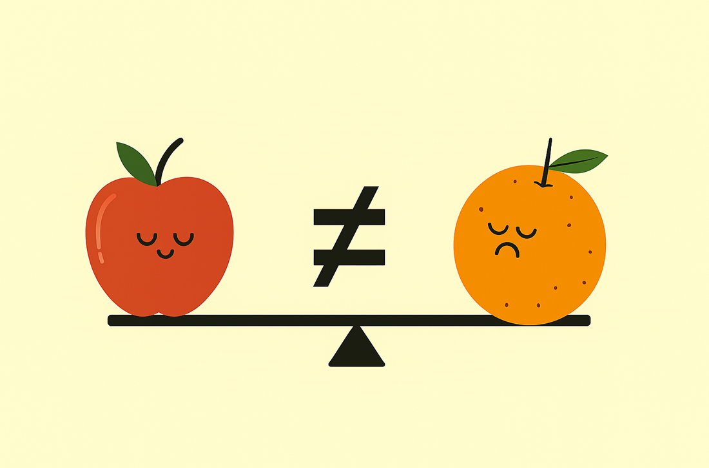
Brescia, 12-14 maggio 2026
The problem
Different Utilities, governments or regulators use different KPIs
Context variables matter – they have a large influence on annual leakage
So how can meaningful comparisons of KPIs be made between Utilities or Countries?
Notes:
Different utilities and regulators use different KPIs.
That makes benchmarking difficult. If context variables are not taken into account, comparisons can be misleading or even meaningless.

Slide 9

Brescia, 12-14 maggio 2026
The solution
  Clear definition of all inputs
    Number of Physical connections to mains, (NOT administrative or billing connections)
    Meter location (average distance in metres after edge of street)
    Average System Pressure (Measured or Assessed with uncertainty limits)
  Data quality, consistency and accuracy
Then use the “Rosetta Stone” approach to translate one KPI into all the others!
Once you can “translate” one Real Losses KPI into many others, utilities and regulators can compare real losses performance in a more meaningful way
Notes:
The answer lies in clarity and consistency.
Define your parameters, particularly the number of physical connections to the mains, rather than admin or billed connections; be aware of the meter location when making comparisons; and measure Average Pressure.
Understand your data quality.
Then you can use the Rosetta Stone approach to translate one KPI into others. That way, you can compare apples to oranges—even across different systems.

Slide 10

Brescia, 12-14 maggio 2026
Example calculations
Water Loss Research and Analysis Ltd 2025
10
What if I don’t have an accurate measurement for Average Pressure?
The effects of pressure, meter location and number of connections
Notes:
Lets look at a few examples.
First, remember that Pressure is the most fundamental influence driver of burst frequencies, and leak flow rates on water distribution infrastructure – if there is no pressure, then there are no bursts and no leakage.
Lets examine the effects of pressure, meter location and number of connections on KPIs, then deal with the scenario where average pressure is not measured but estimated.

Slide 11
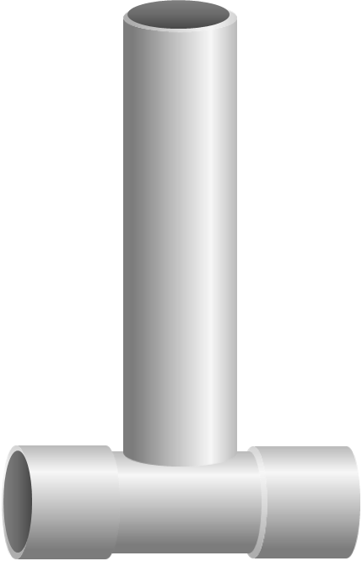
Brescia, 12-14 maggio 2026
Let’s get translating
Real Losses Litres/conn/day | 329.4
Real Losses m3/km mains/day | 12.80
CARL = 19170 m3/day
Number of service connections* = 58192
Mains Length = 1498 km
UARL in m3/day | 4678
UARL in litres/conn/day | 80.39
UARL in m3/km mains/day | 3.12
ILI | 4.1
Average length underground service conns from property line to meter = 10.6m/conn
Average Pressure = 52.6m
* Physical connections from mains to property line
Notes:
Here’s System 1 with CARL of 19,170 m³/day, 58,192 physical connections, 1,498 km of mains.
Standard KPIs from these three inputs are shown.
Let's add Average Pressure and Average length of underground service connections from the property line to the customer meter.
Now are can calculate UARL in different forms and also ILI.

Slide 12
Brescia, 12-14 maggio 2026
The influence of system pressure on KPIs
PHYSICAL CONTEXT INFORMATION | SYSTEM 1 | SYSTEM 2
Mains Length (km) | 1498 | 1498
Number of service connections (Nc) | 58192 | 58192
Current Annual Real Losses CARL in m3/day | 19170 | 19170
Average length of underground service from edge of street to meter (m/conn) | 10.6 | 10.6
Average Pressure in metres | 52.6 | 30
REAL LOSSES KPIs | SYSTEM 1 | SYSTEM 2 | Comparison
Real Losses Litres/conn/day | 329.4 | 329.4 | NO CHANGE
Real Losses m3/km mains/day | 12.80 | 12.80 | NO CHANGE
UARL in m³/day | 4678 | 3867
UARL in litres/conn/day | 80.39 | 45.85
UARL in m3/km mains/day | 3.12 | 1.78
Infrastructure Leakage Index ILI | 4.1 (Band C1) | 7.2 (Band C2)
12
Notes:
As burst frequencies and leak flow rates both increase with pressure, a fairer comparison of leakage KPIs must take account of the different average pressures in each system.
In the above comparison, System 1 and System 2 both have the same physical characteristics (mains length, number of connections, meter location on service pipe) If their system pressures are not taken into account, they appear to have equal performance (329 litres/connection/day, 12.8 m3/km/day) using traditional simple KPIs. However if we calculate the Unavoidable Annual Real Losses and ILIs which do take account of the different system pressures, we find that System 2 with ILI = 7.2 is performing significantly worse than System 1 with an ILI of 4.1.
So by including the context parameter of average Pressure, you can now make meaningful performance comparisons.

Slide 13
Brescia, 12-14 maggio 2026
The influence of meter location on KPIs
 | SYSTEM 1 | SYSTEM 2
Mains Length (km) | 1498 | 1498
Number of service connections (Nc) | 58192 | 58192
CARL in m3/day | 19170 | 19170
Average length of underground service from edge of street to meter (m/conn) | 10.6 | 0.00
Average Pressure in metres | 52.6 | 52.6
REAL LOSSES KPIS | SYSTEM 1 | SYSTEM 2 | Comparison
Real Losses Litres/conn/day | 329.4 | 329.4 | NO CHANGE
Real Losses m3/km mains/day | 12.80 | 12.80 | NO CHANGE
UARL in m³/day | 4678 | 3867
UARL in litres/conn/day | 80.39 | 66.45
UARL in m3/km mains/day | 3.12 | 2.58
ILI | 4.1 | 5.0
Notes:
Next, we adjust the meter location. If meters in System 2 are at the property line, the underground service pipe length drops to zero. All other parameters remain the same. The change in meter location reduces UARL volume and therefore increases the ILI.

Slide 14
Brescia, 12-14 maggio 2026
The influence of service connections on KPIs
 | SYSTEM 1 | SYSTEM 1 - corrected
Mains Length (km) | 1498 | 1498
Number of service connections (Nc) | 58192 | 37824
CARL in m3/day | 19170 | 19170
Average length of underground service from edge of street to meter (m/conn) | 10.6 | 10.6
Average Pressure in metres | 52.6 | 52.6
REAL LOSSES KPIS | SYSTEM 1 | SYSTEM 1 - corrected | Comparison
Real Losses Litres/conn/day | 329.4 | 506.8
Real Losses m3/km mains/day | 12.80 | 12.80 | NO CHANGE
UARL in m³/day | 4678 | 3537
UARL in litres/conn/day | 80.39 | 93.52
UARL in m3/km mains/day | 3.12 | 2.36
ILI | 4.1 | 5.4
Notes:
In this scenario, lets assume we have over-estimated the number of physical service connections in System 1 – we have used billing connections in error.
So, lets correct this by using the correct number of physical service connections and see what happens.
Logically, Real losses volume in litres/conn/day rises, Real losses volume in m3/km mains remains the same.
UARL volume/day reduces due to the smaller number of connections, but UARL in litres/conn/day rises. UARL in m3/km mains/day reduces also as expected
Because the overall UARL volume has reduced, ILI will rise.
This example shows how important it is to get good quality of input data, as it can make a real difference to the results in your KPIs.

Slide 15
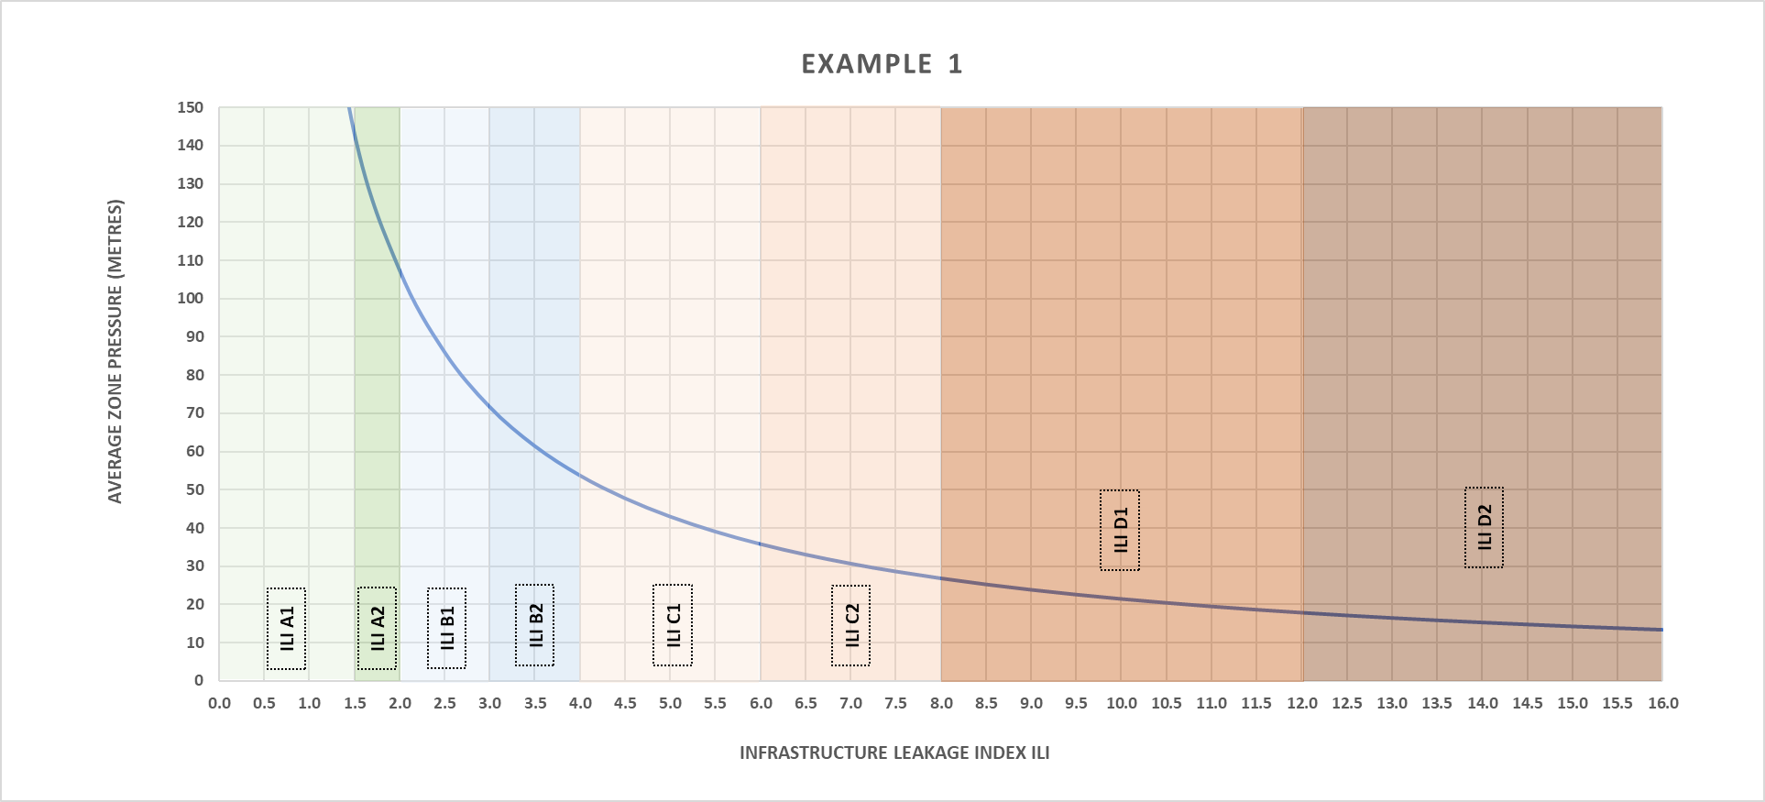
Brescia, 12-14 maggio 2026
What if I can only estimate a range of pressure?
 | SYSTEM 1
Mains Length (km) | 1498
Number of service connections (Nc) | 58192
CARL in m3/day | 19170
Average length of underground service from edge of street to meter (m/conn) | 10.6
Average Pressure in metres - estimated | 35-50m
Don’t use this graph to estimate the average pressure required to achieve a specific ILI –
It does not show the effect of reducing or increasing pressure on CARL, only on UARL
ILI estimated between
4.3-6.2
(ILI Bands C1/C2)
Notes:
If pressure data is missing, we can estimate a range. In this example, if we estimate an Average Pressure of 35-50m, then the ILI could be anywhere from 4.3-6.2., which puts that system in ILI Bands C1-C2
Don’t use this graph to estimate the average pressure required to achieve a specific ILI – it does not show the effect of reducing or increasing pressure on CARL, only on UARL

Slide 16
Summary
Think about the choice of Real Losses KPI and make sure it is fit for purpose
  Please don’t use %s of anything!
Consider all the other variables that influence Real Losses and use them to provide context to your interpretation
Deploy careful quality control of the inputs to your KPIs
  Number of Physical Service Connections from the mains
    Not administrative or billed connections
  Measure Average Zone Pressure to understand your Real Losses
    But you can still gain insights if you have an estimated range
Use the “Rosetta Stone” approach to quickly translate your chosen Real Losses KPI into multiple other KPIs
Notes:
So, in summary
Think carefully about your choice of Real Losses KPI, ensuring it is fit for purpose
Please don’t use %s of anything, as % based KPIs are misleading
Use other Real Losses variables to add context to your chosen KPI
Be careful to ensure quality control of KPI inputs, particularly using the correct number of physical service connections, not administrative or billed connections
Measuring Average Pressure is key to understanding your Real Losses, but you can still gain insights if you initially only have an estimated range
The Rosetta Stone approach can quickly translate your KPI into others, so that meaningful comparisons can be made within a single system or between multiple systems.

Slide 17

Thank You!
The software to estimate ILI will be available later this year– check www.wlranda.com for updates on release
The Leakssuite Library – www.leakssuitelibrary.com has a number of articles on KPIs
  KPIs Fit for Purpose | LEAKSSuite Library
  Global ILIs | LEAKSSuite Library
  UARL and ILI | LEAKSSuite Library
  Low ILIs and Small Systems | LEAKSSuite Library
Email me Katesdavies@wlranda.com if you have any questions!
Connect with me on LinkedIn

