Slide 1
IWA Water and Development Congress & Exhibition 2025
8-12 December 2025 | Bangkok – Thailand
LOST IN TRANSLATION
- A Rosetta Stone Approach
to understanding inter-relationships between
Real Loss KPIs
Kate Stanton-Davies
WATER LOSS RESEARCH & ANALYSIS LTD
Allan Lambert
LEAKSSUITE LIBRARY

Slide 2


What’s the Rosetta Stone and what does it have to do with KPIs?
A stone slab inscribed in 196 BCE during the reign of Ptolemy V.
It contains the same decree written in three scripts:
Hieroglyphics
Demotic
Ancient Greek
At the time of its discovery, no one could read Egyptian hieroglyphs.
Because scholars could read Ancient Greek, they used the Greek portion to decipher the hieroglyphs.
It is a symbol of linguistic decoding and cross-cultural understanding

Slide 3
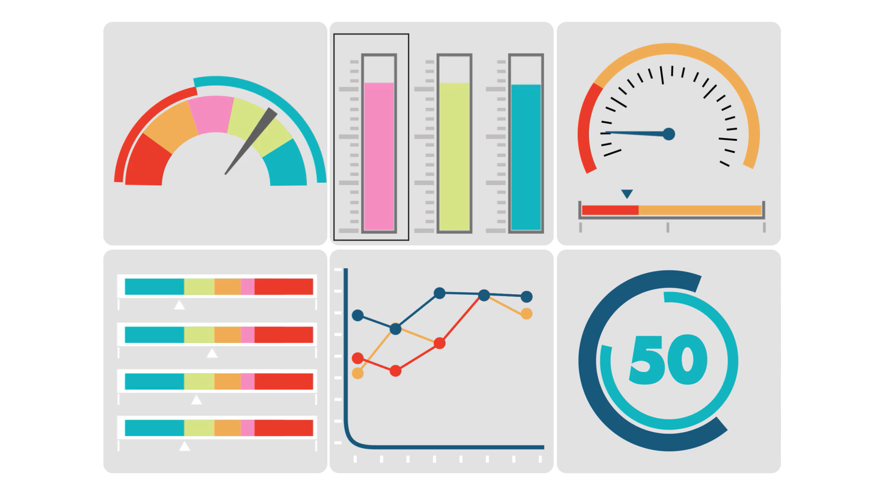
Selecting a suitable Real (Physical) Losses KPI should be simple…
…….but there are so many to choose from!

Slide 4
So which of these popular KPIs do you use?
Volume per year
One of these traditional or newer KPIs, multiple KPIs……or something else?
Litres/
Billed Property/day
Litres/
Physical service conn/
day
Infra-structureLeakage Index (ILI) and UARL
% of System Input Volume
m³/
Km of mains/
day
Litres/billed connection?
System Correction Factor (SCF)?
% of Water Supplied

Slide 5
System Correction Factor (SCF) software (2019) customises UARL calculations for whole systems, zones or DMAs which are outside the original boundaries of the IWA Water Loss Task Force 1999 UARL equation
< 5000 physical service connections from mains (NOT administrative or billing connections)
<45m Average Zone Pressure
>60m Average Zone Pressure
SCF prioritises where to target Active Leakage Control and/or Pressure Reduction and set more meaningful volume targets
SCF now used for > 2500 calculations in 12 countries
A note on System Correction Factor (SCF)
for UARL calculations
www.wlranda.com/software
Low ILIs and Small Systems | LEAKSSuite Library
https://www.wlranda.com/presentations

Slide 6
Using the right KPI for the right purpose
OBJECTIVE | GOOD PRACTICE PERFORMANCE INDICATOR FOR LEAKAGE, FIT FOR PURPOSE
 | VOLUME PER YEAR | LITRES/ SERVICE CONNECTION | M3/KM MAINS | LITRES/ BILLED PROPERTY | % OF SYSTEM INPUT VOLUME | % OF WATER SUPPLIED | INFRASTRUCRURE LEAKAGE INDEX, WITH PRESSURE
SET TARGETS + TRACK PERFORMANCE FOR AN INDIVIDUAL SYSTEM | YES, for large systems | YES* | YES* | YES (uk) | NO | NO | Only is all justifiable pressure management completed
TECHNICAL PERFORMANCE COMPARISONS OF DIFFERENT SYSTEMS | NO | NO | NO | NO | NO | NO | YES
DRAW GENERAL CONCLUSIONS FROM SINGLE OR MULTIPLE SYSTEMS | NO | NO | NO | NO | NO | NO | YES Together with other contextual factors
* Choose litres/service connection if connections > 20/km or m3/km mains if connections < 20/km, or base choice on custom or country practice

Slide 7
Physical context variables influencing real losses
Average System Pressures vary from less than 10 to over 100 metres
Pressure influences burst frequency and leak flow rates
But most traditional KPIs don’t require reporting of pressure data!
Service Connection density
Varies from less than 5 to more than 100 per km of mains. How can you reasonably compare KPIs for a city with a rural network?
Customer meter location on the service connection
Customer meters can be at the edge of the street (property line) or up to 30 metres (or more) further away on leaking private pipes, with their leakage attributed to the Utility
Mains and services pipe materials
The pressure:leakflow rate relationship is significantly different for flexible and rigid pipe materials at different pressures
Size of system: increased awareness of new leaks on small system
Network topology
Can you compare large zones with smaller sectorised networks with DMAs?

Slide 8
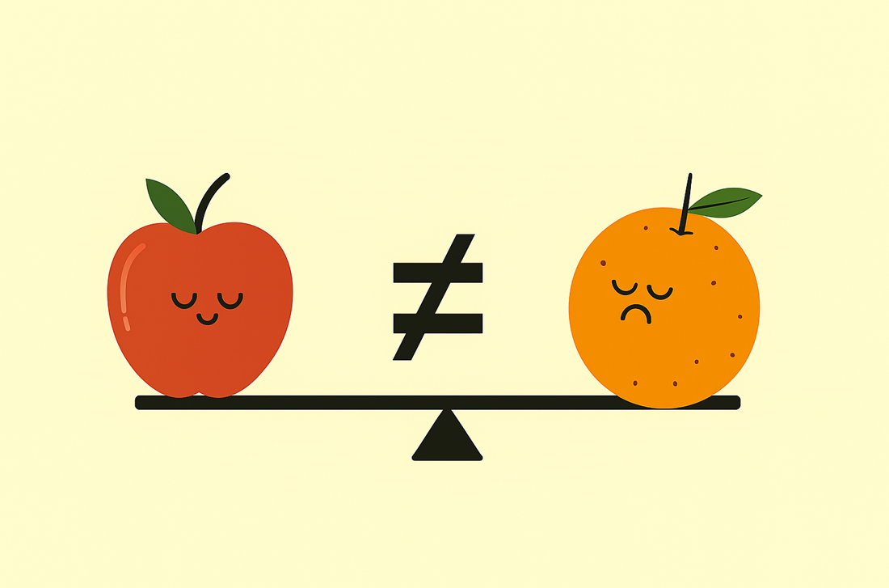
The problem
Different Utilities, governments or regulators use different KPIs
Context variables matter – they have a large influence on annual leakage
So how can meaningful comparisons of KPIs be made between Utilities or Countries?

Slide 9

The solution
Clear definition of all parameters used to calculate the KPI you have chosen
Number of Physical connections to mains, (NOT administrative or billing connections)
Meter location (average distance in metres after edge of street)
Average System Pressure (Measured or Assessed with uncertainty limits)
Data quality, consistency and accuracy
Then use the “Rosetta Stone” approach to translate one KPI into all the others!
Once you can “translate” one Real Losses KPI into many others, utilities and regulators can compare real losses performance in a more meaningful way

Slide 10

What information do I need?
Usual known parameters for Real Losses KPIs
Length of mains in km
Number of technical service connections from mains
Current Annual Real Losses in m3/day
Context-specific variables
Average length of underground service from edge of street to meter in m/conn
Average Pressure in metres

Slide 11

Example calculations
The effects of pressure, meter location and number of connections
What if I don’t have an accurate measurement for Average Pressure?

Slide 12
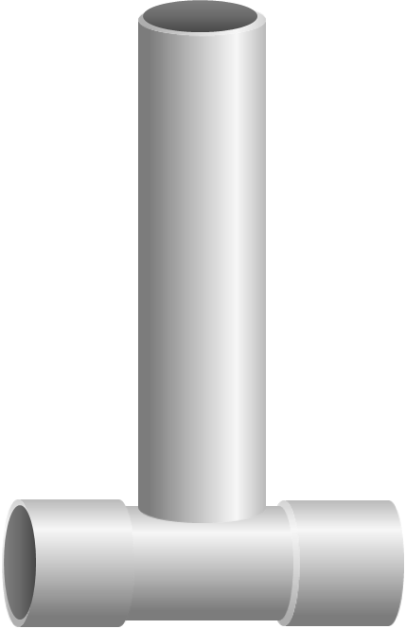
Let’s get translating
Real Losses Litres/conn/day | 329.4
Real Losses m3/km mains/day | 12.80
CARL = 19170 m3/day
Number of service connections* = 58192
Mains Length = 1498 km
Average length underground service conns from property line to meter = 10.6m/conn
UARL in m3/day | 4,678
UARL in litres/conn/day | 80.39
UARL in m3/km mains/day | 3.12
ILI | 4.1
Average Pressure = 52.6m
* Physical connections from mains to property line

Slide 13
The influence of system pressure on KPIs
PHYSICAL CONTEXT INFORMATION | SYSTEM 1 | SYSTEM 2
Mains Length (km) | 1498 | 1498
Number of service connections (Nc) | 58192 | 58192
Current Annual Real Losses CARL in m3/day | 19170 | 19170
Average length of underground service from edge of street to meter (m/conn) | 10.6 | 10.6
Average Pressure in metres | 52.6 | 30
REAL LOSSES KPIs | SYSTEM 1 | SYSTEM 2 | Comparison
Real Losses Litres/conn/day | 329.4 | 329.4 | NO CHANGE
Real Losses m3/km mains/day | 12.80 | 12.80 | NO CHANGE
UARL in m³/day | 4,678 | 3,867
UARL in litres/conn/day | 80.39 | 45.85
UARL in m3/km mains/day | 3.12 | 1.78
Infrastructure Leakage Index ILI | 4.1 (Band C1) | 7.2 (Band C2)

Slide 14
The influence of meter location on KPIs
 | SYSTEM 1 | SYSTEM 2
Mains Length (km) | 1498 | 1498
Number of service connections (Nc) | 58192 | 58192
CARL in m3/day | 19170 | 19170
Average length of underground service from edge of street to meter (m/conn) | 10.6 | 0.00
Average Pressure in metres | 52.6 | 52.6
REAL LOSSES KPIS | SYSTEM 1 | SYSTEM 2 | Comparison
Real Losses Litres/conn/day | 329.4 | 329.4 | NO CHANGE
Real Losses m3/km mains/day | 12.80 | 12.80 | NO CHANGE
UARL in m³/day | 4,678 | 3,867
UARL in litres/conn/day | 80.39 | 66.45
UARL in m3/km mains/day | 3.12 | 2.58
ILI | 4.1 | 5.0

Slide 15
The influence of service connections on KPIs
 | SYSTEM 1 | SYSTEM 1 - corrected
Mains Length (km) | 1498 | 1498
Number of service connections (Nc) | 58192 | 37824
CARL in m3/day | 19170 | 19170
Average length of underground service from edge of street to meter (m/conn) | 10.6 | 10.6
Average Pressure in metres | 52.6 | 52.6
REAL LOSSES KPIS | SYSTEM 1 | SYSTEM 1 - corrected | Comparison
Real Losses Litres/conn/day | 329.4 | 506.8
Real Losses m3/km mains/day | 12.80 | 12.80 | NO CHANGE
UARL in m³/day | 4,678 | 3,537
UARL in litres/conn/day | 80.39 | 93.52
UARL in m3/km mains/day | 3.12 | 2.36
ILI | 4.1 | 5.4

Slide 16
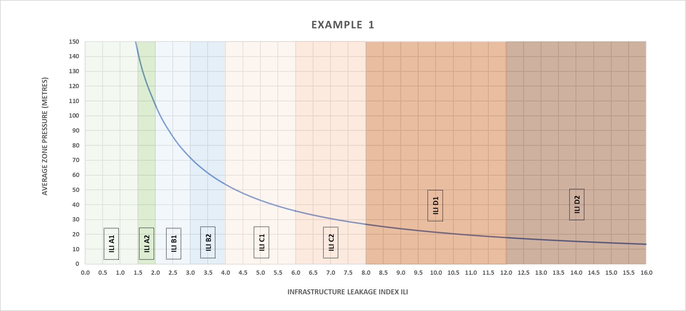
What if I can only estimate a range of pressure?
 | SYSTEM 1
Mains Length (km) | 1498
Number of service connections (Nc) | 58192
CARL in m3/day | 19170
Average length of underground service from edge of street to meter (m/conn) | 10.6
Average Pressure in metres - estimated | 35-50m
Don’t use this graph to estimate the average pressure required to achieve a specific ILI –
It does not show the effect of reducing or increasing pressure on CARL, only on UARL
ILI estimated between
4.3-6.2
(ILI Bands C1/C2)

Slide 17
Summary
Think about the choice of KPI and make sure it is fit for purpose
Please don’t use %s of anything!
Consider all the other variables that influence Real Losses and use them to provide context to your interpretation
Deploy careful quality control of the inputs to your KPIs
Number of Physical Service Connections from the mains
Not administrative or billed connections
Measure Average Zone Pressure to understand your Real Losses
But you can still gain insights if you have an estimated range
Use the “Rosetta Stone” approach to quickly translate your chosen Real Losses KPI into multiple other KPIs

Slide 18
Thank You!
The software used in this presentation will be available early in 2026 for Utilities – for updates on availability
Follow me on LinkedIn - www.linkedin.com/in/catherine-stanton-davies-0a564a39
www.wlranda.com
The Leakssuite Library – www.leakssuitelibrary.com has a number of articles on KPIs
KPIs Fit for Purpose | LEAKSSuite Library
Global ILIs | LEAKSSuite Library
UARL and ILI | LEAKSSuite Library
Low ILIs and Small Systems | LEAKSSuite Library
Contact Katesdavies@wlranda.com if you have any questions!

