Slide 1
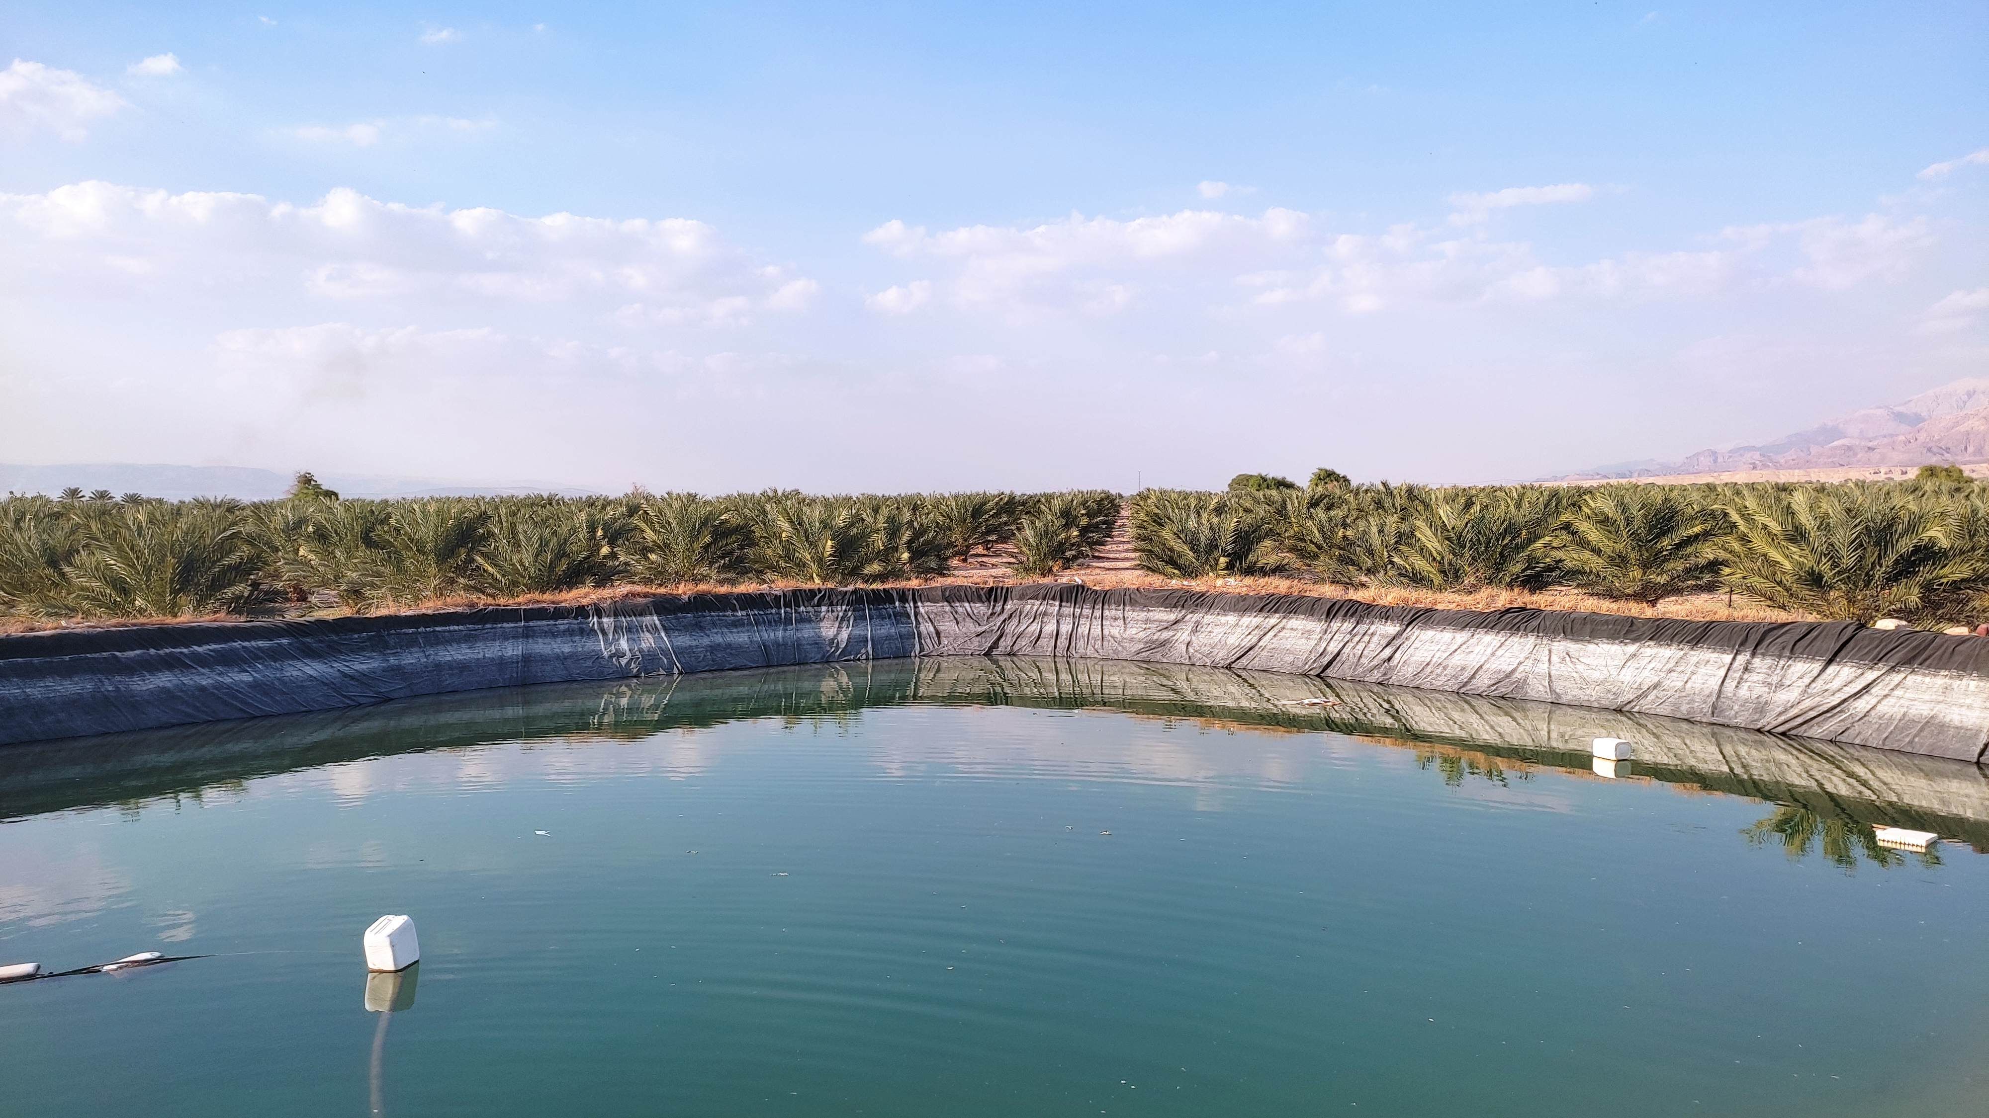

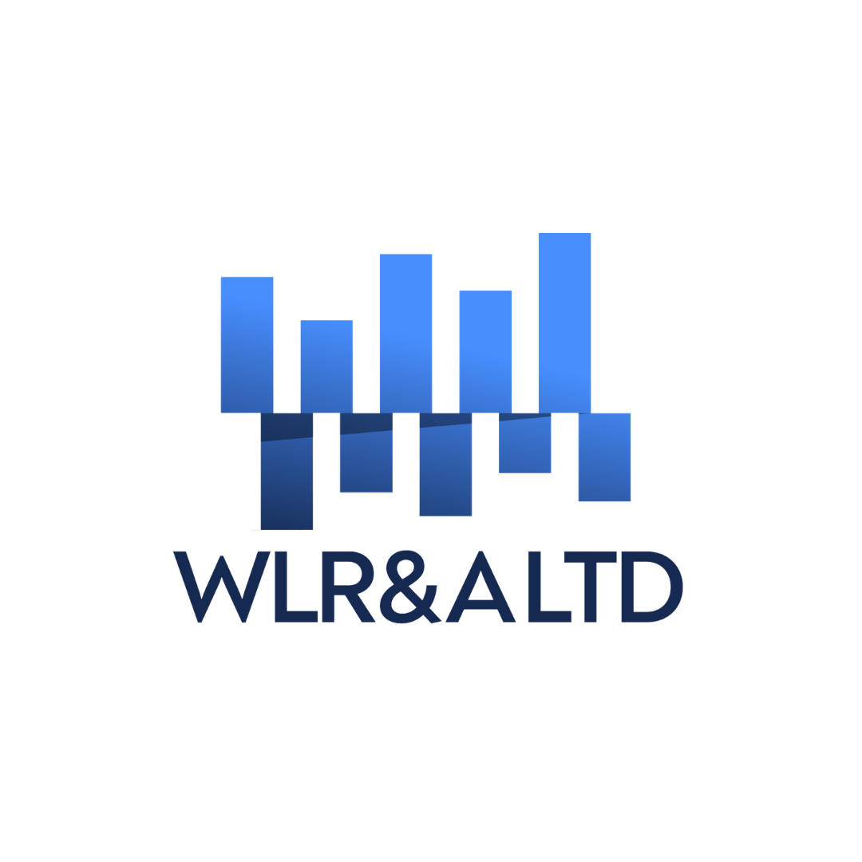
Reducing NRW with AI-Powered Technologies

Slide 2
House Keeping Rules
Mute Your Mic – Please keep your microphone muted unless speaking to minimize background noise.
Q&A Session – There will be a dedicated Q&A session at the end of the webinar. Feel free to submit questions via the Q&A feature.
Stay Engaged – Polls, reactions, and the chat are great ways to participate.
Recording & Replay – This webinar is being recorded. Recording & slides will be shared afterward.
Tech Support – If you experience any issues, message our tech support team in the chat.

Slide 3
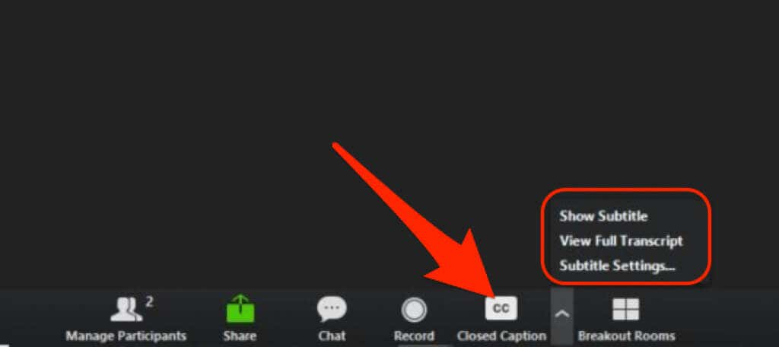
Enable translated captions

Slide 4

Kate Stanton-Davies
Co-founder and Director of
Water Loss Research & Analysis
8 years of experience in NRW reduction software and training
Katesdavies@wlranda.com
www.wlranda.com

Slide 5

Baker Bozeyeh
Co-founder and CEO of Flowless
Business development & expansion leader
www.flowless.co

Slide 6

Agenda
Introduction
Understanding NRW Fundamentals
Building an NRW Strategy for 2025
Leveraging Technology for NRW Reduction
Case Studies
Q&A Session
Closing & Call-to-Action

Slide 7
Introduction
Importance of NRW Reduction
  Significant loss for water utilities in operational costs and environmental sustainability
  Critical for meeting community needs and preserving resources
Impact of NRW Reduction
  Affects utility performance, customer satisfaction, and community trust
  Enhances service delivery and operational efficiency
Webinar Goals
  Understand core components of NRW and real losses developments over the last 30 years
  Explore strategies to reduce NRW using AI-powered technologies
  Implement sustainable and actionable strategies with Flowless' solutions

Slide 8
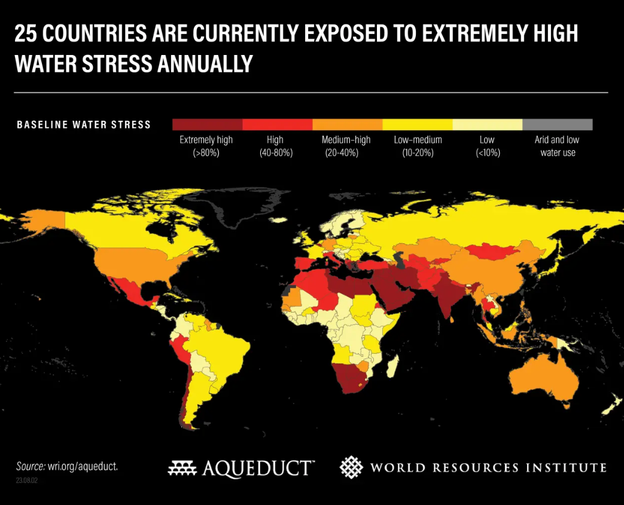
The challenges of global water stress
Growing populations
Climate change
Increasing demand - agriculture, industry, manufacturing, energy production, datacenters, AI
Ageing infrastructure
Lack of capital investment

Slide 9

Linking NRW reduction to lower carbon emissions
  Energy is used to extract, treat, pump and distribute each unit of water.
  Every unit of water lost to leakage results in carbon emissions that would otherwise be avoided if such leakage were reduced.
  Must be balanced against carbon expended in activities to reduce NRW
  IWA Leakage Emissions Initiative, including carbon water balances - Home | LEI Group

Slide 10

Time to get back to the basics
Let's review some fundamentals before we look at setting strategy and exploring solutions
Focus on Real Losses

Slide 11

Poll 1
Notes:
First, a quick poll to understand how much you already know about NRW – please answer the poll question coming up on screen now.

Slide 12
Understanding NRW Fundamentals
“You can’t connect the dots looking forward; you can only connect them looking backwards.” – Steve Jobs
“Study the past if you would define the future.” – Confucius

Slide 13
NRW Milestones from the last 30 years
1999
IWA Water Balance,
IWA recommended (KPIs) for NRW and Real Losses
Unavoidable Annual Real Losses UARL, and Infrastructure Leakage Index ILI
1994
Component Analysis of Real Losses (BABE)
Fixed and Variable Area Discharges (FAVAD)
2012
Pressure:bursts relationship
2017
Variable N1 Concept
2020
1997
2000-2001
Economic Intervention Policy for Active Leakage Control based on rate of Rise of Unreported Leakage
Use of Confidence Limits in Water Balance and Night Flow calculations
2015
EU Reference Document
Good Practices on Leakage Management
UARL with SCF
Night Flow Component Analysis
Average Zone Point and Night Day Factors

Slide 14
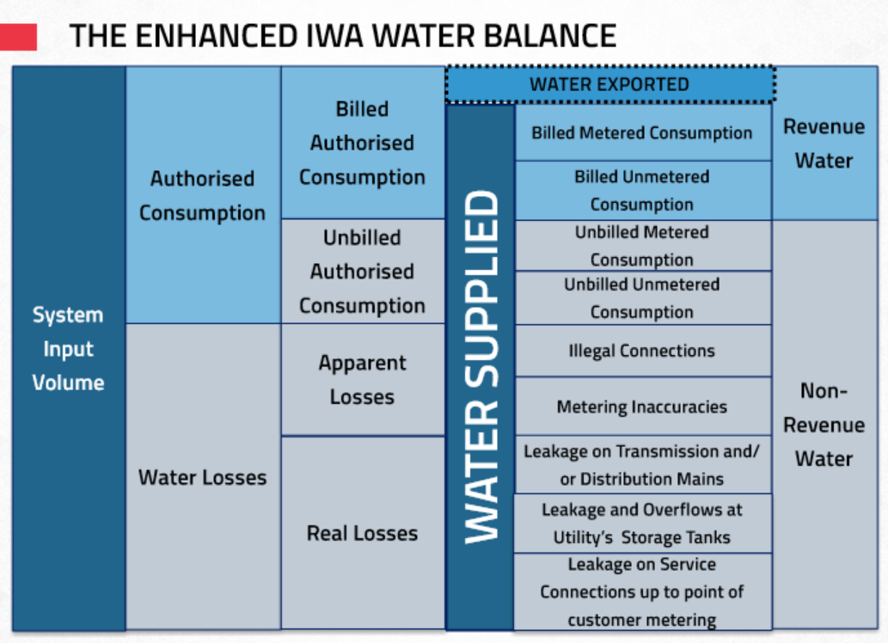
Let's start with a Water Balance
Non-Revenue Water
Unbilled Authorised Consumption
Apparent (commercial)Losses*
Real (physical) Losses
Reducing each component requires a different approach and set of targeted interventions
*AL-Guidance-Note-Final-15th-Sep-2016-00000002.pdf
Apparent Water Losses – MCAST

Slide 15
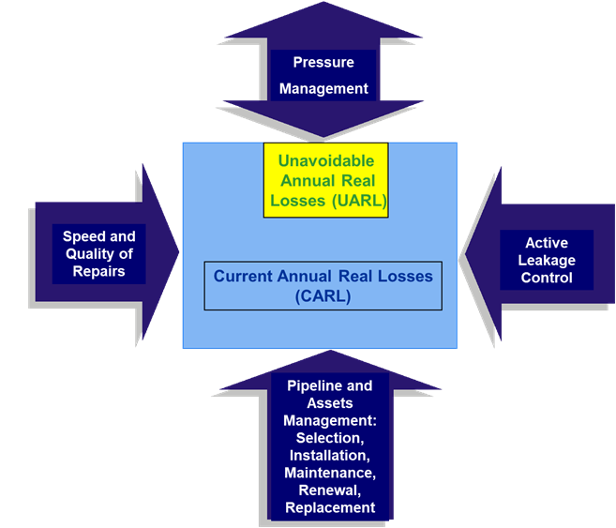
The 4 Basic Methods of Managing Real Losses

Slide 16
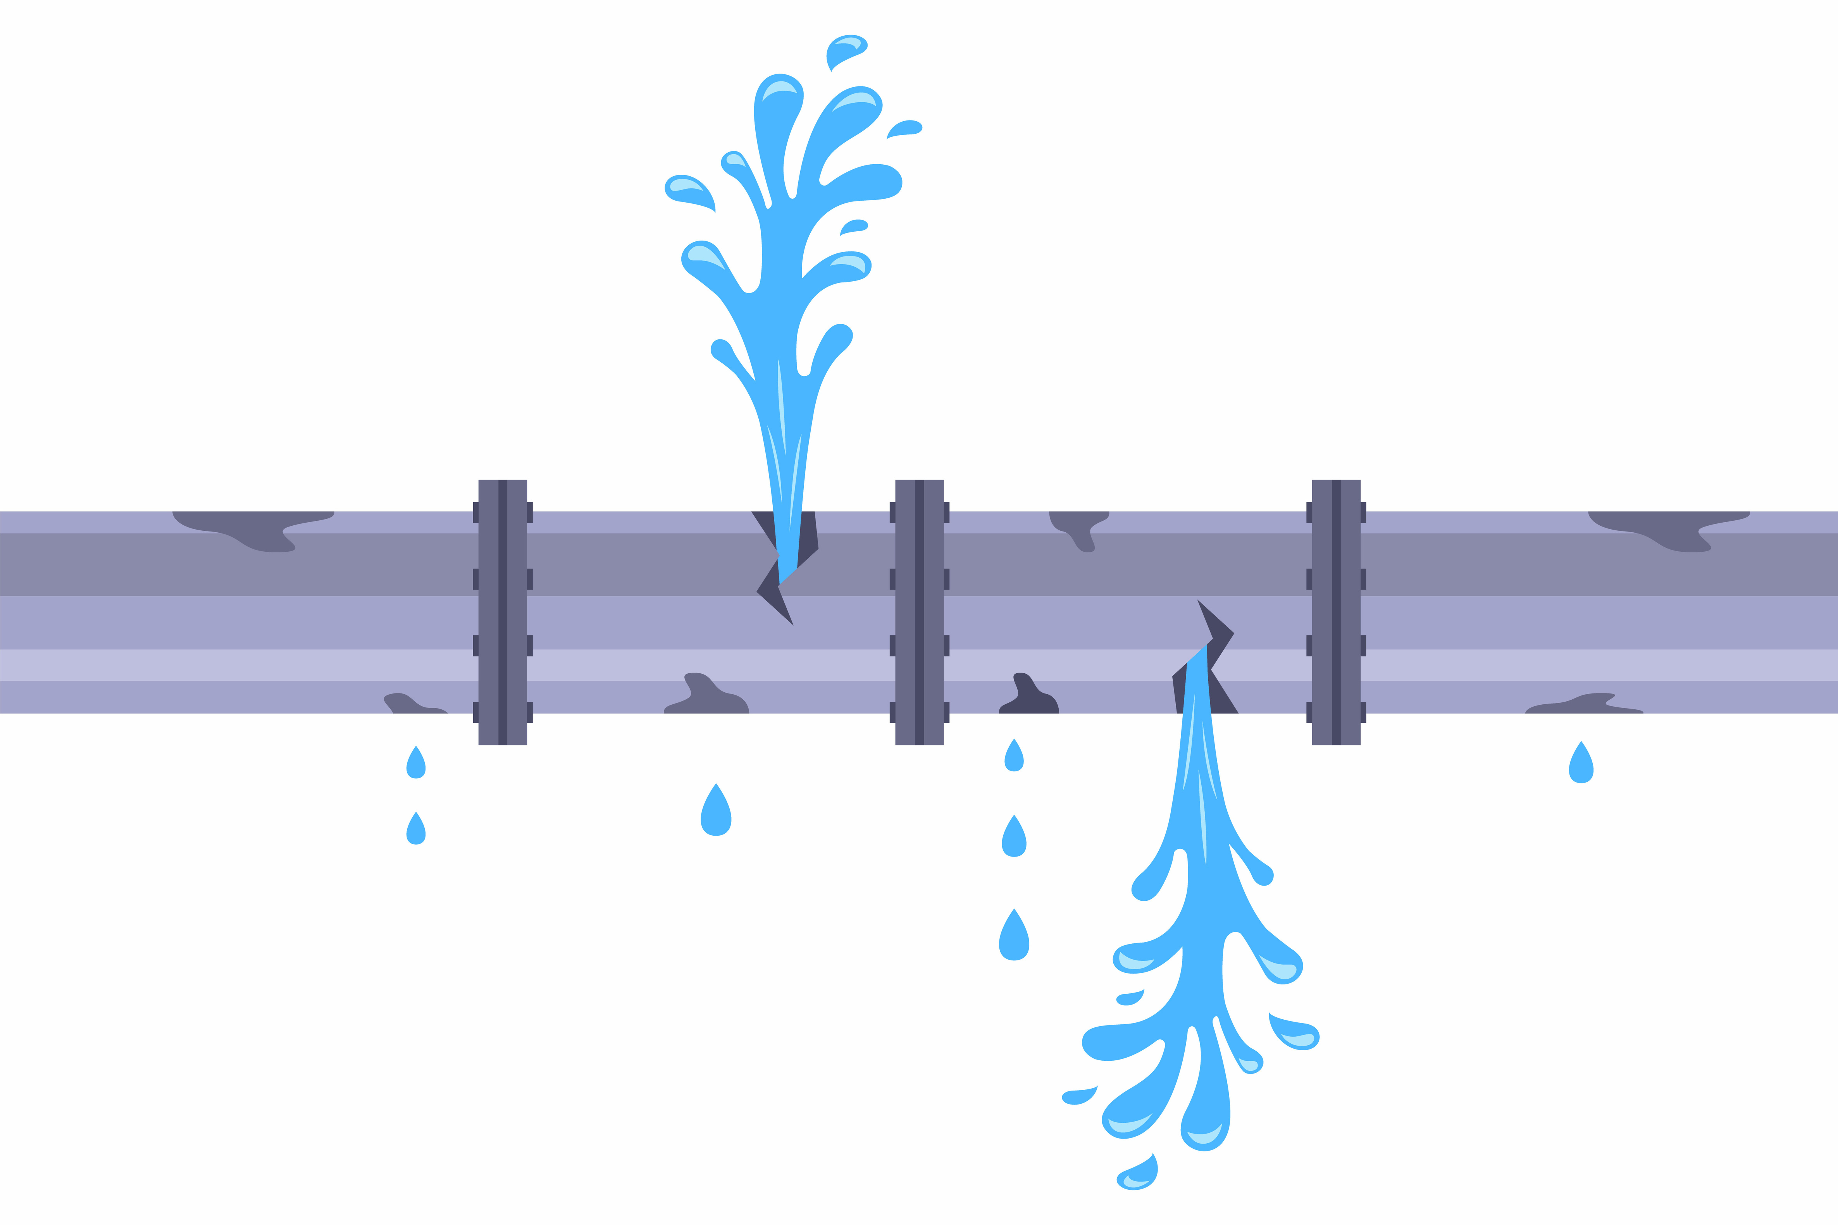
Benefits of managing excess pressure
Managing transients
Reduction of Leak Flow Rates
Reduction of Burst Frequencies
Extension of infrastructure life
Reduction in consumption

Slide 17
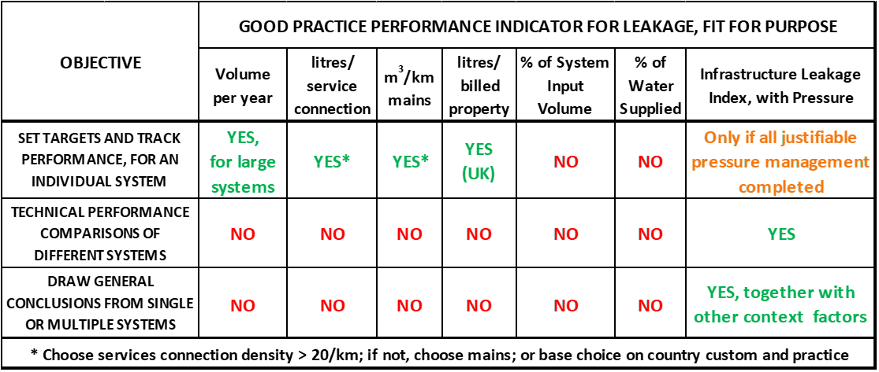
Real Losses KPIs
Choose service connection if density >20/km; if not, choose mains, or base choice on country custom and practice
Based on EU Reference Document

Slide 18
What is a System Correction Factor?
UARL₁₉₉₉ equation calculates lowest estimate of Annual Real Losses for a well-maintained whole system:-
  More than 5000 service connections
  Average Pressure range 45-60m
  Outside these boundary conditions, it tends to over-estimate volumes for small lower pressure systems and under-estimate for larger higher-pressure systems
A System Correction Factor overcomes these boundary conditions and can be used:-
  For whole system, zone or DMA
  For any number of service connections
  At wide range of Average Pressures
UARL with SCF = SCF x UARL₁₉₉₉ volume
​
Provides Utility with priority insights for leakage reduction and pressure management opportunities​, identifying maximum recoverable leakage for each DMA or Zone

Slide 19
Why an SCF calculation is different
FAVAD (Fixed and Variable Area Discharges)
  Relationship between how the leak flow area in different pipe materials responds to changes in pressure
  N1 Power Law simplifies this pressure:leak flow rate relationship
  Original UARL equation uses N1=1 for simplicity (10% reduction in pressure results in 10% reduction in leak flow rate)
  SCF calculations use N1=0.5 for rigid pipes and N1=1.5 for flexible pipes and Unavoidable Background Leakage
Poisson effect
  Small, low pressure systems will have less than the average numbers of UARL bursts per year
  Median burst frequencies modelled in SCF calculations
Pressure:bursts
  Original UARL equation used burst frequencies at 50m pressure
  SCF models pressure:bursts relationship across a wide range of operating pressures

Slide 20
Scenarios for using SCF – Small DMA, Low Pressure
New Target
EXAMPLE
Number of service connections=3000
Average length of private service pipe = 3m/conn (from curb stop to meter)
Mains Length = 50 km
Average Zone Pressure = 35m
60% rigid mains
40% rigid services (mains to curb stop)
30% rigid services (curb stop to meter)
SCF result | UARL₁₉₉₉ volume in m3/day | UARL with SCF volume in m3/day
0.74 | 123.4 | 91.0
Current Target

Slide 21
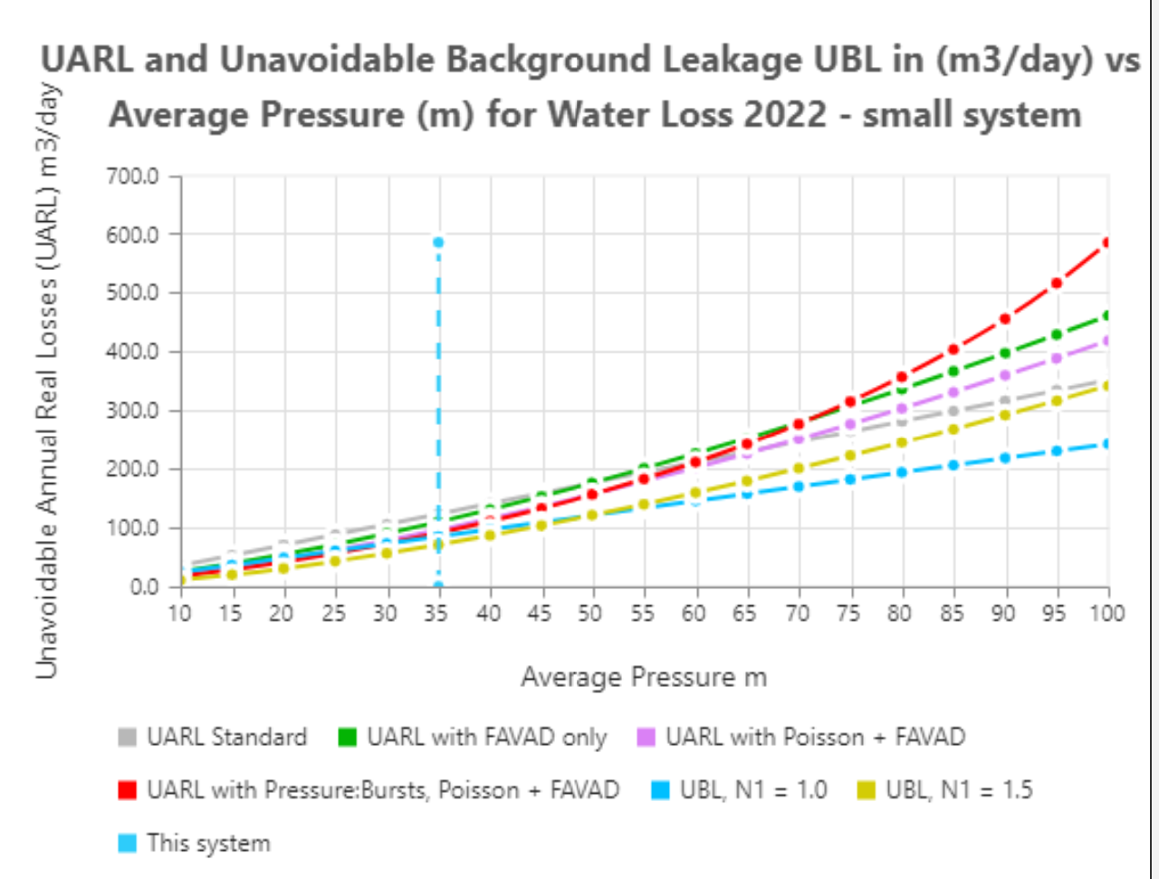
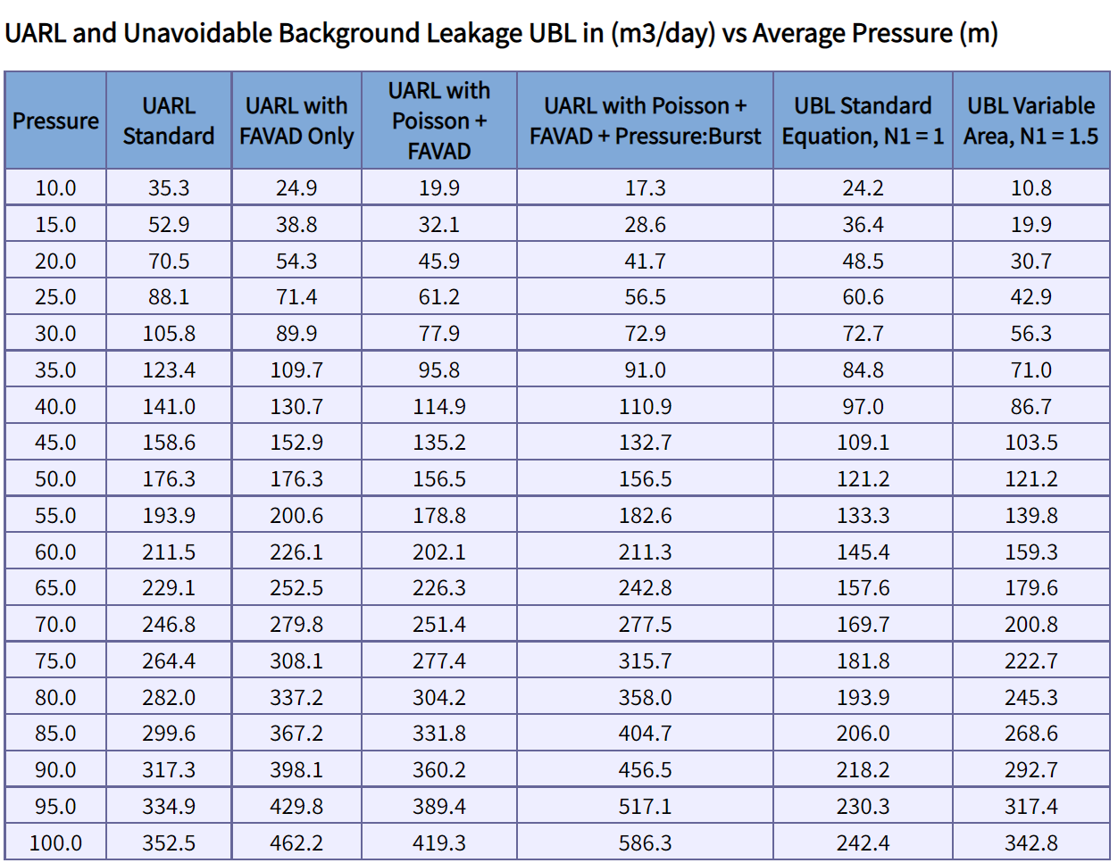
Scenarios for using SCF – Small DMA, Low Pressure
In this example, if AZP can be reduced by 1 m (from 35m to 34m)
UARL volume can be reduced by 3.6m³/day or 1314m³/year

Slide 22
Scenarios for using SCF – Large DMA, High Pressure
New Target
EXAMPLE
Number of service connections=6000
Average length of private service pipe = 3m/conn (from curb stop to meter)
Mains Length = 100 km
Average Zone Pressure = 70m
60% rigid mains
40% rigid services (mains to curb stop)
30% rigid services (curb stop to meter)
SCF result | UARL₁₉₉₉ volume in m3/day | UARL with SCF volume in m3/day
1.17 | 493.5 | 578.2
Current Target

Slide 23
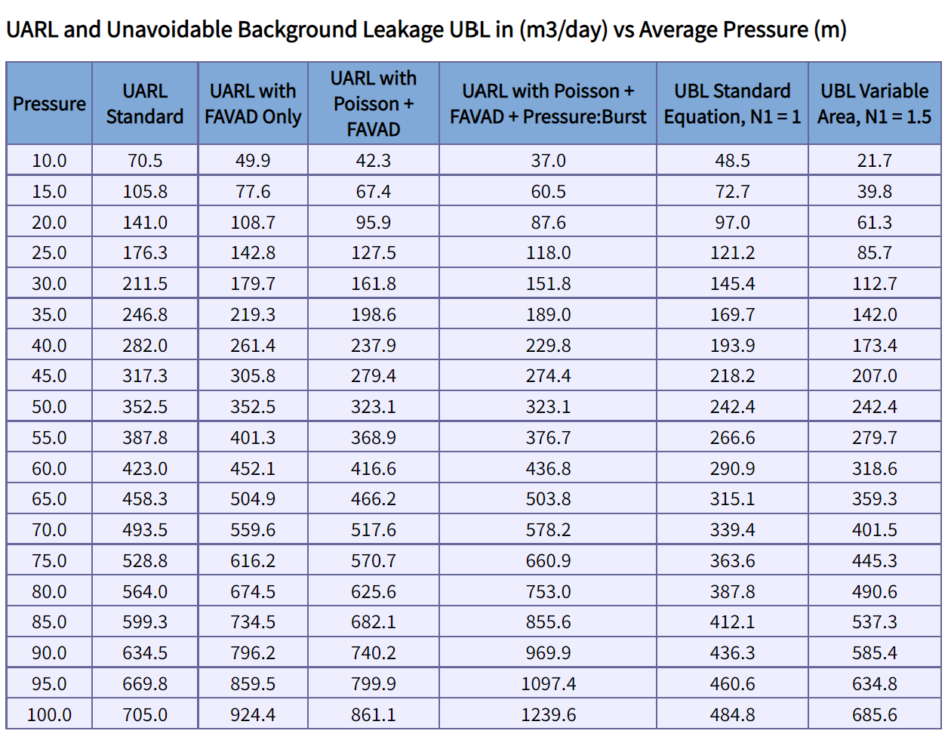
Scenarios for using SCF – Large DMA, High Pressure
If AZP can be reduced by 1 m (from 70m to 69m),
UARL volume can be reduced by approx. 15m³/day or 5475m³/year

Slide 24
Why should Utilities use SCF?
Use the original 1999 UARL equation to calculate a whole system UARL​
  Consider SCF calculations for Boundary Cases​ (<5000 conns, outside 45-60m Average Pressure range)
Use SCF to map all zones and systems within a Utility for a complete top down/bottom up view of your system ​
  Where can UARL volume targets be reduced? ​
  Where UARL volume targets may not be achievable?​
  Target zones or systems where further pressure management may be possible to reduce bursts, leak flow rates and UARL volumes, with reductions quantified​
Notes:
Read the slide

Slide 25
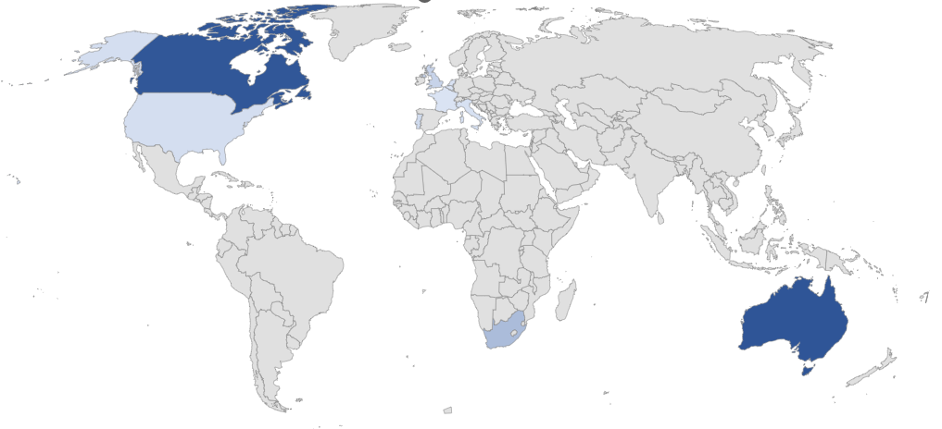
More than 3000 SCF calculations in 13 countries
“With over 55,000 water systems in North America, and over 90% of those designated as ‘small systems’ and many others with abnormally high pressures …These systems can now use the FWAS Version 6 to establish a baseline standing, then engage the UARL with SCF web application to refine their understanding for predictive leakage modeling and quantify the scale of improvement opportunity that exists specifically for their system”
Will Jernigan, USA
“UARL with SCF software allows us to further customise UARL calculations for each of 320 individual Zones and Sub-Zones, for the first time. Integrating this methodology within the snapshot ILl concept will result in rapid identification of Zones where we may expect to set and achieve lower leakage targets and better quantification of leakage and burst reductions from further pressure management. Fine tuning the UARL now is allowing us further scope to further reduce leakage, saving millions of euros in the process.”
Water Services Corporation, Malta
"adopt the system level SCF corrected UARL as future targets to plan leakage control works i.e. pressure reduction, sensors, traditional Active Leak Detection or DMA sectorisation."
Sydney Water, Australia
Water Services Corporation,Malta

Slide 26

Where will the journey take us now?
Stand on the strong foundations built by the pioneers of water loss reduction over the last 30 years
Wherever you are on you NRW reduction journey, there are proven conceptual data-driven and AI solutions to help you move forward
Whatever solution you use, make sure you understand the fundamentals first!

Slide 27
Building A Comprehensive NRW Strategy
Start small, gain traction, and scale-it up!

Slide 28
Poll 2

Slide 29

High Cost Inefficiency
Surface-level problems
Disrupted water service delivery
Falling behind regulatory targets
budget limitations
emerging water leaks
Root causes
manual data handling
low data accuracy
aging infrastructure
limited team capacity

Slide 30
Tackling The Root Causes
Efficient operations & supply continuity
Aging infrastructure
Budget constraints
Poor insights
Limited capacity

Slide 31
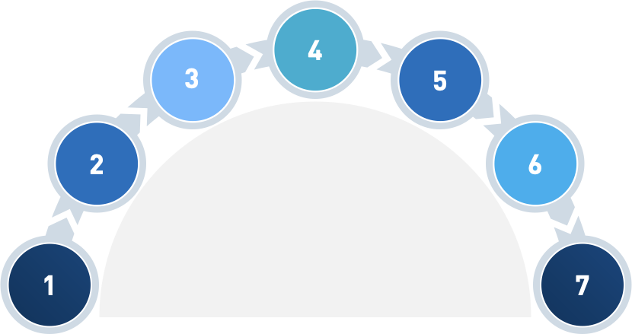
Losses Lifecycle Management
Locate
(Where is it?)
Quantify
(How big is it?)
Prioritize (tackling the low hanging fruit)
Is it a leak? Or is it something else?
Take action
(How to deal with it)
The
Comprehensive Approach
Awareness
Evaluate & Iterate

Slide 32
Leveraging Technology
For effective NRW Management

Slide 33
Technology is not a magical wand!
Said by a wise NRW guru!

Slide 34
Paradigm Shift
Data-driven approach
Insight-driven approach

Slide 35
Poll 3

Slide 36
It’s NOT Only About Data Collection!
Data Collection
Intervention Planning
Tracking & Evaluation
Step
01
Step
02
Step
03
Step
04
Step
05
Data Analysis
Implementation

Slide 37
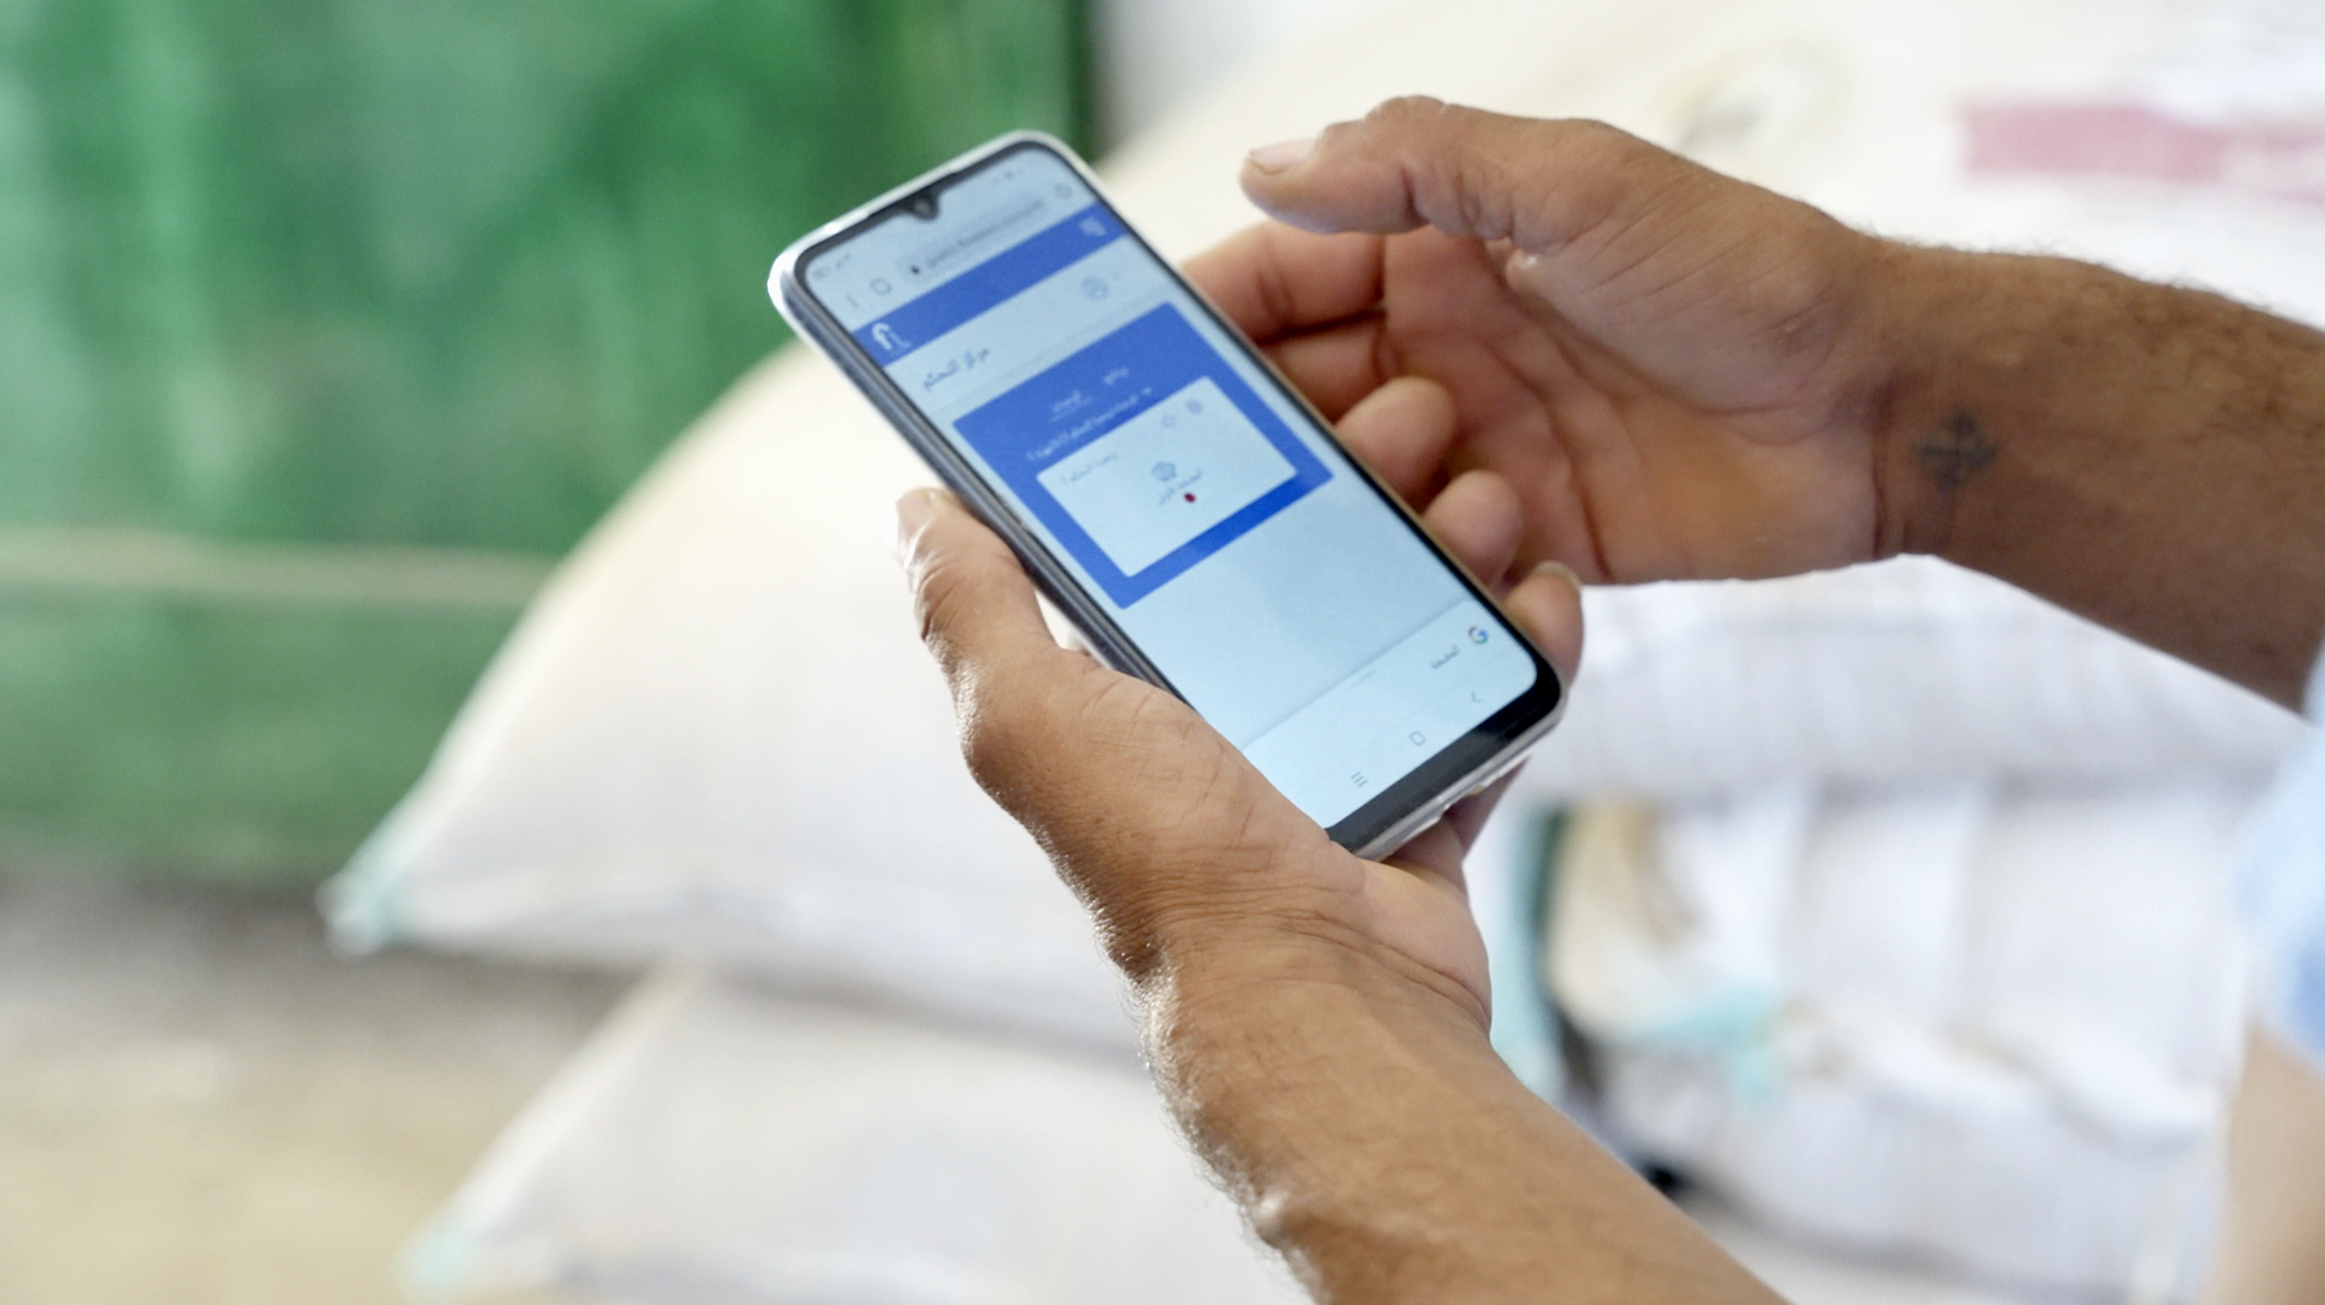
Smooth Tech Adoption Journey

Slide 38
Step 1: Understand The Needs
Accurate Data Collection
At the right frequency for accurate & timely insights

Slide 39
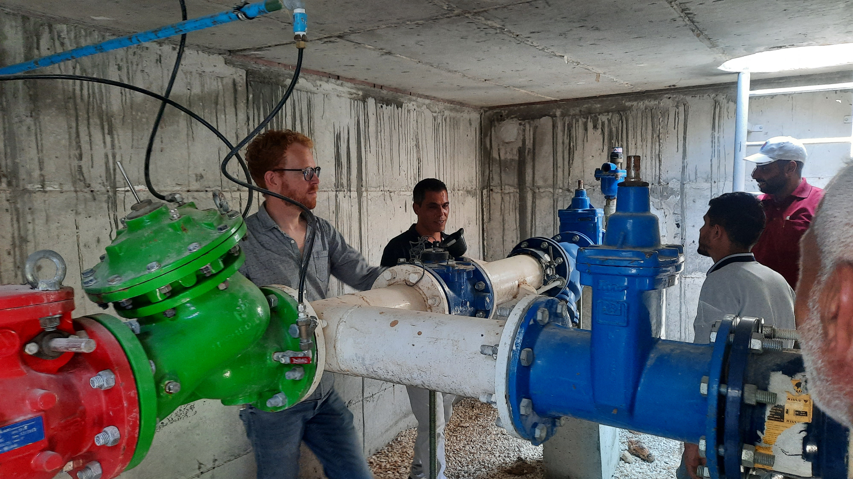
Intervention Planning
go to the field, understand the context

Slide 40
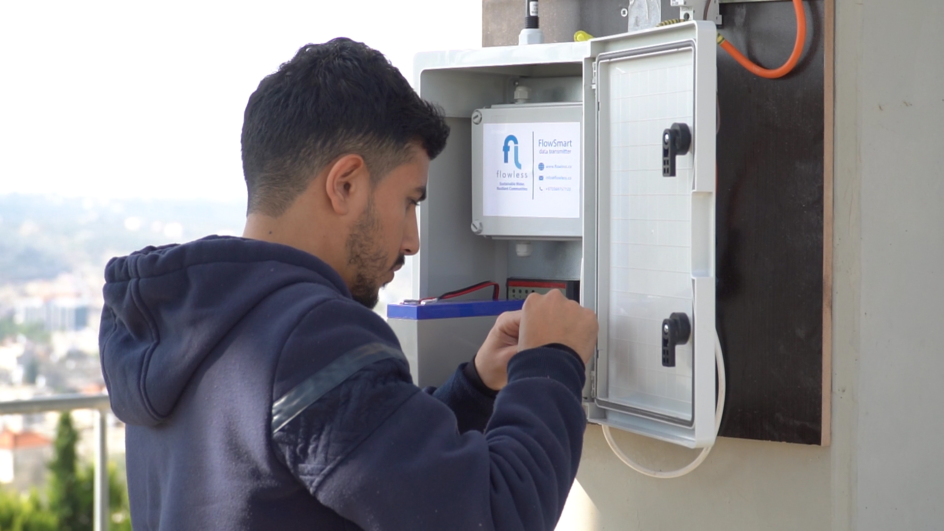
Collect & Field Data
Ideally in real-time

Slide 41
Step 2: Set your targets
Define priorities
based on measurable & attainable targets
Accurate Data Collection
At the right frequency for accurate & timely insights

Slide 42
Step 3: Watch & Analyze
Define priorities
based on measurable & attainable targets
Keep an eye on the analytics
to spot unusual events & predict issues before they emerge
Accurate Data Collection
At the right frequency for accurate & timely insights

Slide 43
Step 4: Tackle The Low-Hanging Fruit
Utilize The Insights
to allocate resources to the exact source of problem
Define priorities
based on measurable & attainable targets
Keep an eye on the analytics
to spot unusual events & predict issues before they emerge
Accurate Data Collection
At the right frequency for accurate & timely insights

Slide 44
Step 5: Evaluate & Improve
Continuous optimization and improvement
Utilize The Insights
to allocate resources to the exact source of problem
Define priorities
based on measurable & attainable targets
Keep an eye on the analytics
to spot unusual events & predict issues before they emerge
Accurate Data Collection
At the right frequency for accurate & timely insights

Slide 45
WaterCloud & SCF

Slide 46
Live Demo!

Slide 47
Case Studies
Palestine, Malaysia, Brazil, Malta, Quebec, Australia
Notes:
This slide presents case studies showcasing how Flowless' integration of SCF has significantly reduced NRW, especially in areas where traditional methods were less effective.
Original Content:
Case Studies Demonstrating Impact
Through case studies, we’ll showcase how Flowless’ integration of SCF has led to substantial reductions in NRW, particularly in areas where traditional methods struggled to make an impact.

Slide 48
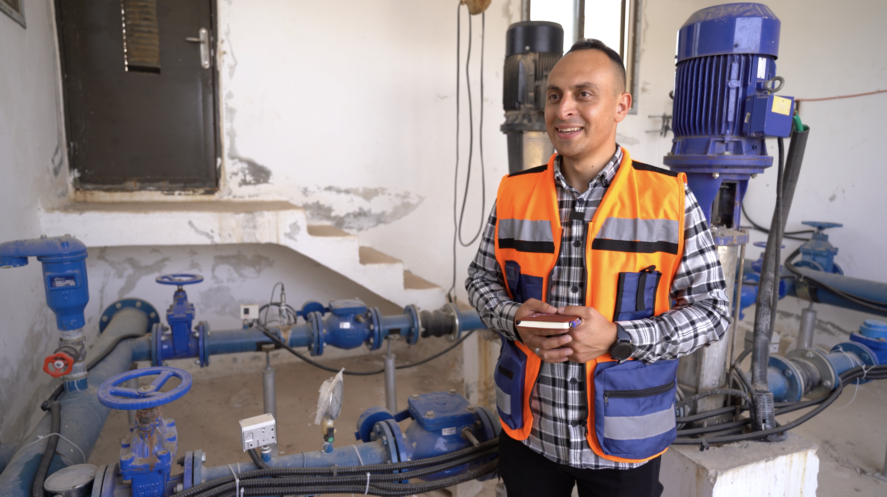
Case Study:
Saving 10,000 m3/month
Salfeet Municipality, Palestine

Slide 49
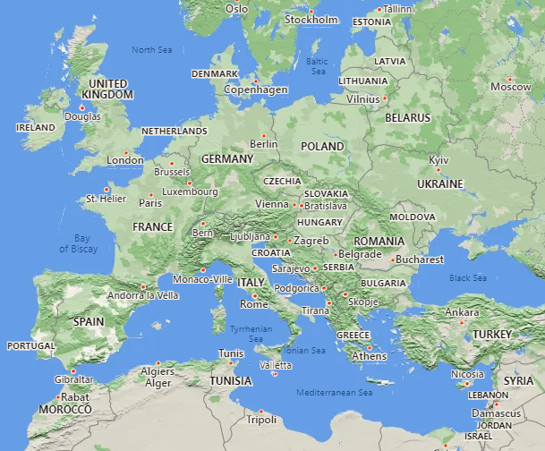

Case Study 1 - Water Services Corporation (Malta, Europe)
All properties supplied through roof storage tanks
57% of Malta’s potable water produced by 3 reverse osmosis plants; the remainder is pumped from underground aquifers.
130,000 service connections
1330 miles (2,141 km) mains
Average Pressure 45.5 psi (32m ,3.2 bar)
Customer meters are located at the curb stop
93% rigid mains, 5% rigid services (mains to curb stop)
320 UARL with SCF calculations to map all zones and DMAs across 4 regions
Latest ILI 1.8, reduced from ILI of approx. 20 in 2000
All data reproduced with kind permission of
Water Services Corporation, Malta

Slide 50
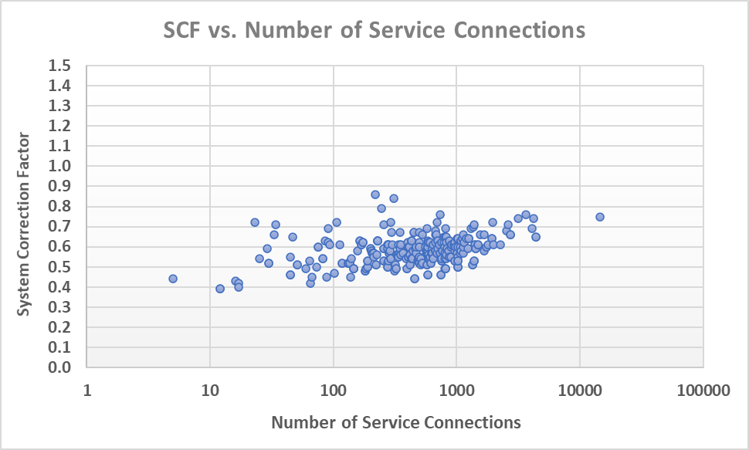
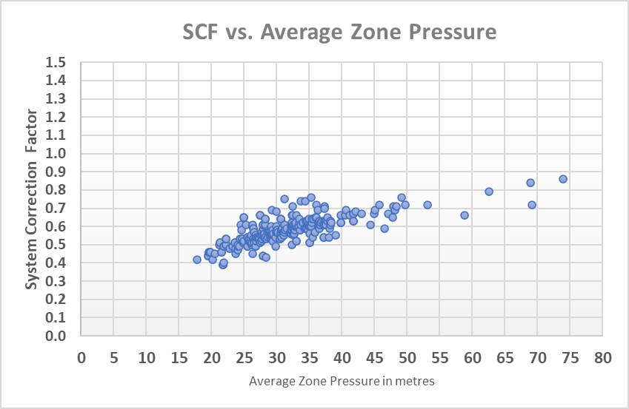
Case Study 1 - Water Services Corporation (Malta, Europe)
Case Study characteristics
Zone/System size | 5 – 14,000 service connections
Small Systems | >99% zones have <5,000 service connections
Managed AZP ranges | 24-105 psi (17-74 m)
All data reproduced with kind permission of Water Services Corporation, Malta

Slide 51
Case Study 1 - Water Services Corporation (Malta, Europe)
SCFs at current operating pressures range from
0.39 – 0.86
Standard UARL equation over-predicts UARL volumes in some zones by 61%-14%
A continuous program of Pressure Management over > 20 years
Why are these SCFs all < 0.9 ?
A large percentage (>99%) of small systems with less than 5,000 service connections
Mostly flexible materials on service connections
How are WSC using SCF calculation results?
SCF calculation results are being used in conjunction with Snapshot ILI
to rapidly identify zones where lower leakage targets could be set ,
and to better quantify leakage and burst reductions
from further pressure management
All data reproduced with kind permission of Water Services Corporation, Malta

Slide 52
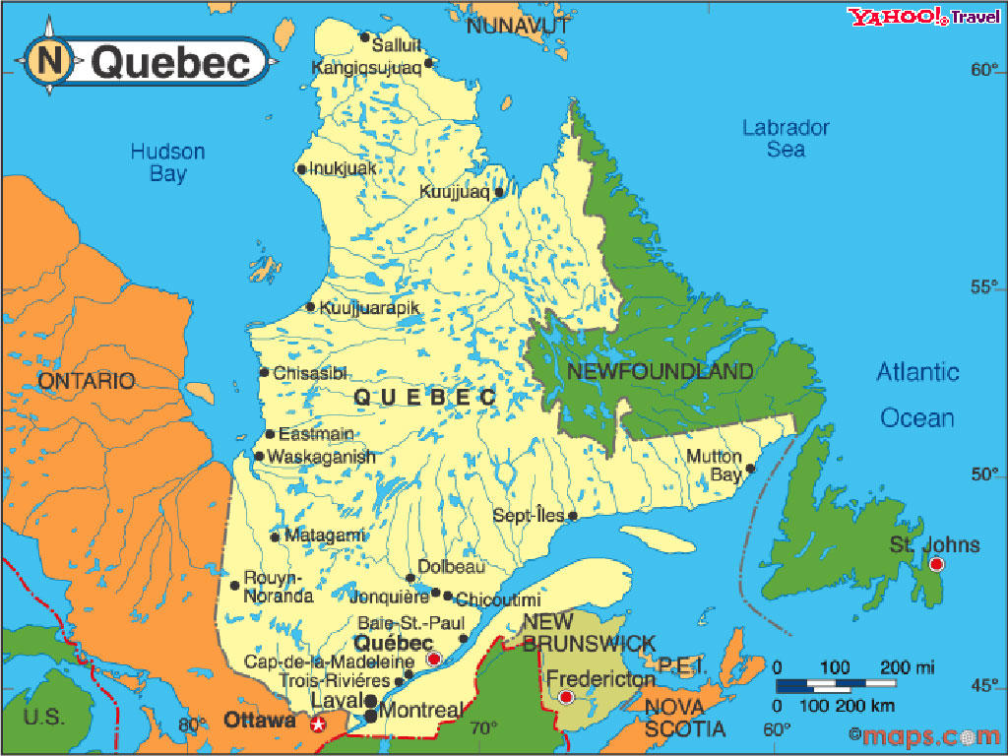


Case Study 2 - Quebec Province (Canada)
626 Individual water utilities
2,111,989 service connections
26,000 miles (41,429 km) mains
Average Pressure 70.7 psi (49.7 m)
Overall, 67% rigid mains, 95% rigid services (mains to curb stop), 95% rigid services (curb stop to meter)
855 UARL with SCF calculations to map DMAs and zones across 17 regions
Latest overall ILI 6.6 in 2019
65% of networks (in number, not length) achieved a low or moderate ILI of <4 in 2019
All data reproduced with kind permission of MAMH and
Reseau Environnement, Quebec

Slide 53
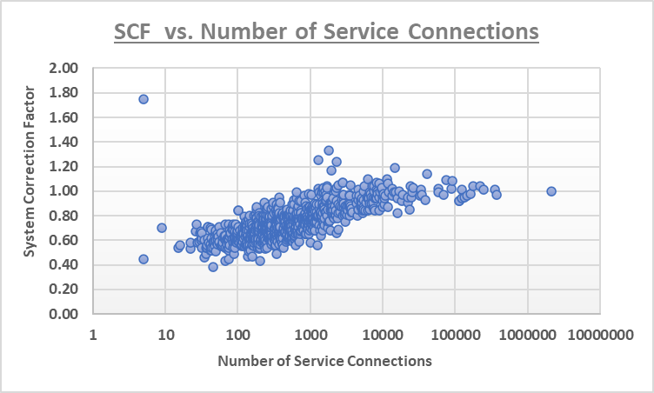
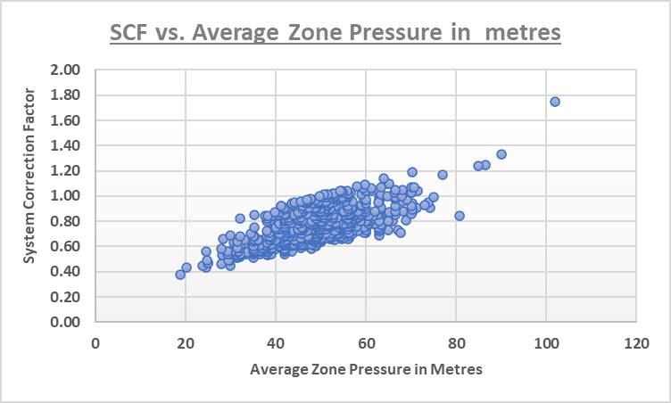
Case Study 2 - Quebec Province (Canada)
Case Study characteristics
Zone/System size | 5 – 377,362 service connections
Small Systems | >88% zones have <5,000 service connections
Managed AZP ranges | 25-145 psi (18-102 m)
All data reproduced with kind permission of MAMH and Reseau Environnement, Quebec

Slide 54
Case Study 2 - Quebec Province (Canada)
For some zones or regions, standard UARL equation
over-predicts UARL volumes by up to 62%
SCFs at current operating pressures range from
0.38 – 1.75
For some zones or regions, standard UARL equation
under-predicts UARL volumes by up to 75%
A large percentage (>88%) of small systems with less than 5,000 service connections
Why are these SCFs so varied ?
A wide variety of system/zone size
A wide range of operating pressures
Mostly rigid service connections
How are SCF calculation results being used?
SCF calculation results are being used so that
Quebec Efficiency Strategy has a better understanding of their systems and the way to reach their water loss objectives.
All data reproduced with kind permission of MAMH and Reseau Environnement, Quebec

Slide 55
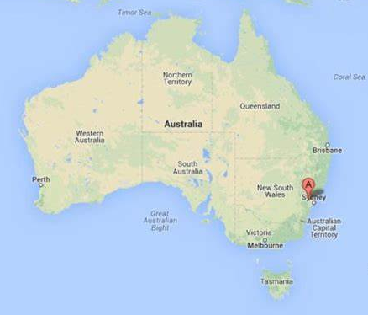

Case Study 3 – Sydney Water (Australia)
Sydney Water supply over 1.5 billion litres of drinking water to over 5.3 million people every day. Water is supplied from 11 major dams through 13 water delivery systems with:
1.37 Million service connections
12900 miles (20,800 km) mains
Average Pressure 75 psi (52.8m)
82% rigid mains, 85% rigid services (mains to curb stop)
248 reservoirs, 152 pumping stations
9 water filtration plants, Sydney Desalination Plant
655 UARL with SCF calculations to map all pressure zones, supply zones, and distribution systems across 13 water delivery systems
2020 ILI = 1.3
All data reproduced with kind permission of
Sydney Water, Australia

Slide 56
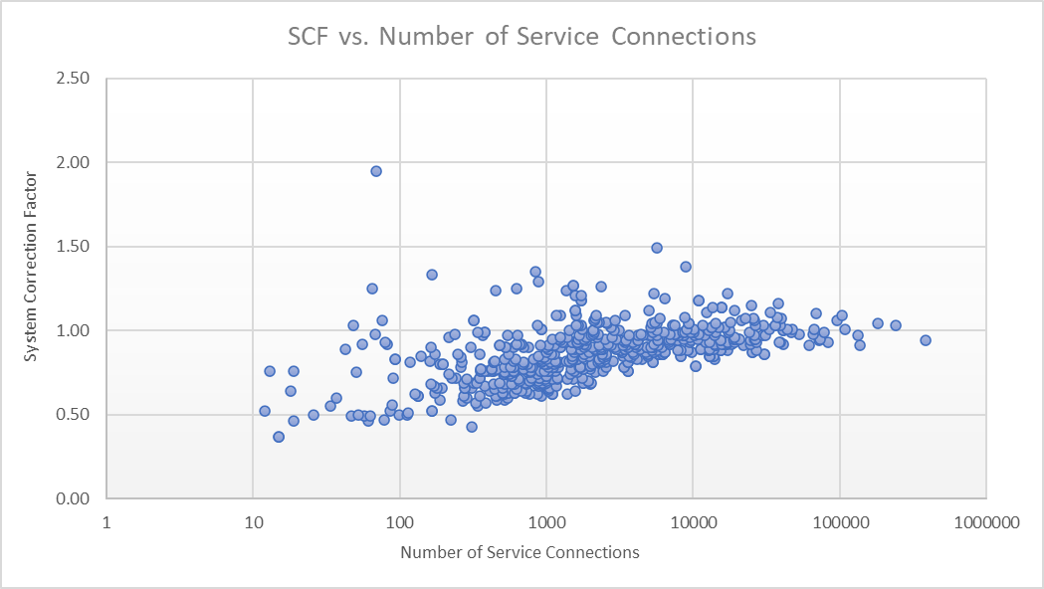
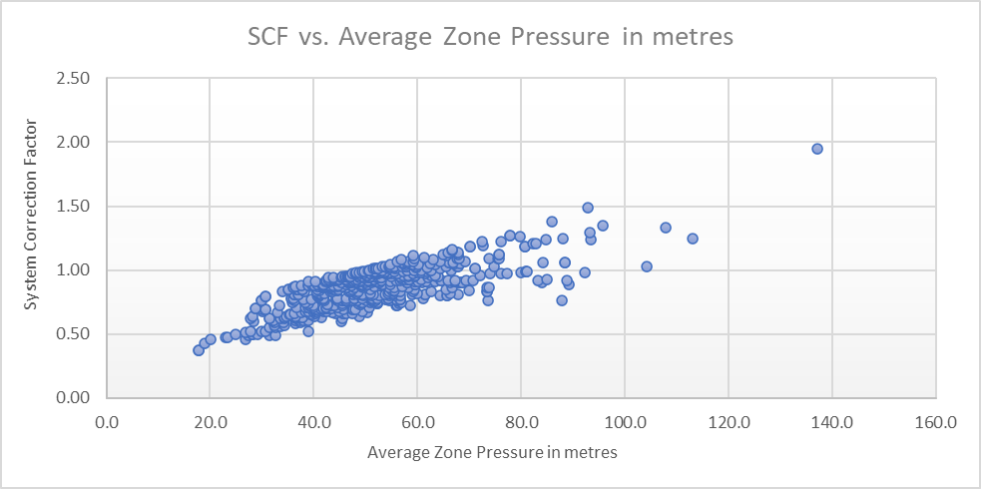
Case Study 3 – Sydney Water (Australia)
Case Study characteristics
Zone/System size | 12 – 384,864 service connections
Small Systems | >68% zones have <5,000 service connections
Managed AZP ranges | 21-195 psi (15-137 m)
0
All data reproduced with kind permission of Sydney Water, Australia

Slide 57
Case Study 3 – Sydney Water (Australia)
For some zones, standard UARL equation
over-predicts UARL volumes by up to 63%
SCFs at current operating pressures range from
0.37 – 1.95
For some zones, standard UARL equation
under-predicts UARL volumes by up to 95%
A wide range of operating pressures
Why are these SCFs so varied ?
A wide variety of system/zone size
Mostly rigid mains and service connections
How are Sydney Water using SCF calculation results?
Contributes to a complete assessment of all their pressure zones, supply zones, distribution zones and delivery systems -
this will be used for better targeting of further active leakage control
and pressure management activities
All data reproduced with kind permission of Sydney Water, Australia

Slide 58
Want to achieve similar impact in your water network?
Here are the steps to get you started:

Slide 59
Leverage smart tech in your network
Understand the context
Define your targets
Deploy the technology
Utilize the insights, implement the interventions
Improve and iterate!

Slide 60
References
The carbon footprint of desalination: An input-output analysis of seawater reverse osmosis desalination in Australia for 2005–2015, https://doi.org/10.1016/j.desal.2018.12.008
Delaware River Basin Commission Water Audit report - https://www.nj.gov/drbc/library/documents/wateraudits/Assessment_WaterAuditProgram2012-2021_dec2023.pdf
IWA Leakage Emissions Initiative - https://www.leigroup.org/
IWA Water Balance - IWA Water Balance | LEAKSSuite Library
Uncertainty in Water Balances - Random Uncertainty in Water Balance | LEAKSSuite Library
Apparent Losses Guidelines - AL-Guidance-Note-Final-15th-Sep-2016-00000002.pdf
UARL and ILI - UARL and ILI | LEAKSSuite Library
System Correction Factor software – https://www.wlranda.com/software
NRW Reduction training – https://www.wlranda.com/training

Slide 61
References
A practical approach to increase efficiency & improve feasibility: https://www.flowless.co/knowledge-base/white-paper-reducing-water-losses-a-practical-approach
More than 10 million liters of monthly water savings: https://www.flowless.co/case-studies/water-losses-reduction-in-salfeet
Flowless Octopo: https://www.flowless.co/technology/octopo
Flowless WaterCloud: https://www.flowless.co/technology/watercloud-technology

Slide 62
Q&A Session
Any questions for Allan, Baker and Kate?
Notes:
We will open the floor for questions to address NRW challenges and discuss Flowless' solutions. Additionally, we will conduct a poll to assess the current NRW status and identify the technologies or approaches being used.
Original Content:
Open the floor for questions from attendees, addressing their specific concerns about NRW challenges and how Flowless' technology can provide solutions.
Conduct a poll on the current NRW status across utilities and what technologies or approaches they’re currently using.

Slide 63

Thank You!
Let us know what you would like to see in future webinars
Follow the link below, or scan the QR code to complete the short survey
https://s.zoom.us/m/bPlTRphyO
or click on the link in the follow-up email which will also include links to the recording

