Slide 1
The power of n1
Kate Stanton-Davies
Water Loss Research & Analysis Ltd
Mark Shepherd
GWF
IWA Water Loss 2024 – 17th April 2024
Notes:
Good morning - I’m delighted to start this morning’s session with a presentation on the Power of N1
Using a fixed N1 as part of your leakage calculations may be something that you do regularly, but a deeper understanding of how N1 varies with pressure is a powerful tool that can unlock a whole range of further useful and important relationships
Let’s take a look at the agenda

Slide 2
Agenda
What is the N1 Power Law and what does it mean?
What is FAVAD?
Comparison of Fixed and Variable Area Leaks
Calculating Fixed and Variable Area Leakage from an N1 value
Implications of using a fixed N1 value
N1 is not fixed over a range of pressures
Exploring the N1 vs AZP relationship
Why it matters
The power of Variable N1 and System Correction Factors together
The Power of N1
Notes:
I’ll begin with a quick introduction to what the N1 Power Law is
What is, then we will look at key components of FAVAD theory and where N1 fits into this theory.
I will show you a quick way to calculate fixed and variable area leakage once you know your N1 value from an N1 test.
If we assume, for simplicity, that N1 is a fixed value, then what are the implications of this decision?
It has been known for some time that N1 is not fixed, so let's explore why the relationship between N1 and AZP matters, particularly at lower pressures.
Finally, I would like to show you how GWF are using variable N1 and System Correction Factor calculations together to help their customers.

Slide 3
What is N1 and what does it mean?
Power Laws
Leakage Modelling
N1 is used to model the impact of pressure management on leak flow rates
L₁=L₀(P₁/P₀)^{N1}
N1 = Pressure:leak flow rate relationship
N2 = Pressure:bursts relationship
N3 = Pressure:consumption relationship
The FAVAD (Fixed and Variable Area Discharges) concept explains results from validated N1 pressure:leak flow rate tests across the world
It allows for linear variations in the area of some types of leaks as a result of changes in pressure JOHN-MAY 1994 article
Notes:
N1 is a power law which is used in a simplified way to show the effect of changes in pressure on leak flow rates on rigid and flexible pipes. Other power laws explain the Pressure:Bursts relationship – N2 – and the Pressure:consumption relationship – N3.
You can use a value of N1 to model the change in leak flow rates when pressure is changed, using the equation shown here where L1 is the new leak flow rate, L0 is the original leak flow rate, P1 is the new Pressure and P0 the original pressure. Values of N1, determined by N1 pressure tests, range from 0.5 – 1.5, and will differ amongst pressure zones or DMAs depending on the characteristics of the zone or DMA. N1 tests must follow a strict standard operating protocol, otherwise the results may be misleading.
The FAVAD concept, proposed by John May in 1994 allows for variations in the area of leaks resulting from changes in pressure, and we use the FAVAD concept to explain the differences between Fixed Area and Variable Area leakage paths.

Slide 4
Context - the Leak flow rate relationship journey
Notes:
Research into the leak flow rate relationship has been going on for many years, and I have included some of these developments in these slides for your reference, so that you can see where key moments on this journey have occurred.
In particular John May’s FAVAD theory from 1994 and the N1 Power Law from 1996 are particularly relevant in terms of this presentation

Slide 5
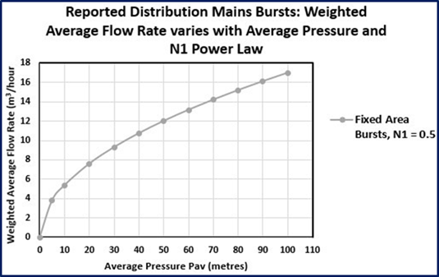
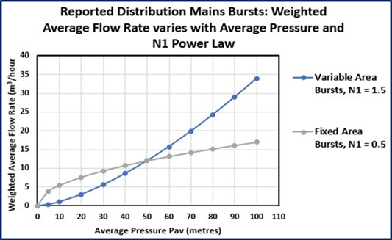
Comparison of Fixed and Variable Area Leaks
Fixed Area Leaks
Variable Area Leaks
Occur in rigid pipes
N1=0.5, least sensitive to changes in pressure
Occur in flexible pipes and Unavoidable Background Leakage (UBL)
N1=1.5, most sensitive to changes in pressure
Notes:
Fixed Area Leaks, occurring in rigid pipes, have an N1=0.5, meaning that the leak flow rate is not very sensitive or responsive to changes in pressure.
A 10% decrease in pressure results in a 5% decrease in leak flow rate.
We can see this from the graph on the left side of this slide which plots AZP in metres on the X axis against Flow Rate in m3/hr on the Y axis, and here is an example of a fixed area leak in the video.
Variable Area Leaks, occurring in flexible pipes, and background leakage have an N1=1.5, meaning that the leak flow rate is much more sensitive or responsive to changes in pressure.
A 10% decrease in pressure results in a 15% decrease in leak flow rate.
We can see this from the graph on the right side of this slide which plots AZP on the X axis against Flow Rate in m3/hr on the Y axis, and here is an example of a variable area leaks in the video.

Slide 6
Valid ranges of N1 values
Notes:
When a carefully controlled N1 test is performed, a value of n1 somewhere between 0.5-1.5 will be calculated.
If value of less than 0.5 or greater than 1.5 are calculated, then this is usually due to issues during the N1 test, such as inflow and pressure not being stable before the pressure is dropped, consumption still taking place during the test, zone breach or assessed night use parameters being too high.
So a carefully controlled test with strict quality control is key to getting a good result.

Slide 7
What value of N1 do you use?
Between 0.5-0.9?
Between 0.9-1.1?
Between 1.1-1.5?
Do you use the same N1 value for every zone or DMA?
Notes:
So what values of N1 do you use?
Who uses N1s between 0.5-0.9?
0.9-1.1?
1.1-1.5?
And do you use the same N1 value for every zone or DMA?

Slide 8
Calculating % Fixed and Variable Area Leakage from an N1 value
With any value of N1, you can quickly calculate the % of fixed or variable area leaks
% of Variable Area Leaks = N1–0.50 = 0.79 =79%
% of Fixed Area Leaks = 1.50–N1 = 0.21 = 21%
% of Variable Area Leaks = N1-0.50 = 0.3 = 30%
% of Fixed Area Leaks = 1.5-N1 = 0.7 = 70%
If N1 = 1.29, what would you estimate the % of Fixed and Variable Area Leaks to be?
If N1 = 0.8, what would you estimate the % of Fixed and Variable Area Leaks to be?
Notes:
With any value of N1, you can quickly calculate the % of fixed or variable area leaks
If N1 = 1.29
% of Variable Area Leaks = N1 – 0.50 = 0.79 =79%
% of Fixed Area Leaks = 1.50 – N1 = 0.21 = 21%
If N1 = 0.8
% of Variable Area Leaks = N1-0.50 = 0.3 = 30%
% of Fixed Area Leaks = 1.5-N1 = 0.7 = 70%

Slide 9
Implications of using a Fixed N1
Fixed values of N1 are often used for simplicity in leakage calculations, but consider what this implies –
That the % of Fixed and Variable Area leaks does not change
when pressure is reduced or increased!
Does that make sense to you for small changes in pressure?
Does that make sense to you for large changes in pressure?
And what about NDFs for large changes in pressure
Notes:
Practitioners often use a fixed value of N1 for simplicity in their leakage calculations.
However, now that you know how to take an N1 value and quickly estimate the % of fixed and variable area leaks, that may also make you consider the implications of doing so.
If you always use the same N1 value, and are undertaking pressure management activities, then the implication of always using a fixed N1 implies that regardless of whether pressure changes, the % of Fixed and Variable Area Leaks remains the same!
My question to you is Does that make logical sense?
Maybe it does for small changes in pressure, but what about larger drops in pressure? And if you use Hour Day/Night Day factors, these will also be affected by larger changes in pressure.

Slide 10
But N1 is not fixed
A 2017 paper by van Zyl, Lambert and Collins explored the N1:AZP relationship –
as pressure reduces towards zero, N1 reduces towards 0.5 and when pressure increases, N1 increases towards 1.5
In Zones or DMAs operating at very low or higher than average AZP, it is very important to understand the N1:AZP relationship
to more accurately model the impact of pressure management on leak flow rates.
Notes:
It has been understood for some time that N1 values can vary as pressure changes.
A 2017 paper thoroughly explored this relationship, showing that as pressure drops towards zero, values of N1 reduce towards 0.5, and as pressure increases, N1 values increase towards 1.5
Therefore, at low or high pressures, it is important to understand the N1:AZP relationship so that you can more accurately model the impact of pressure management activities.

Slide 11
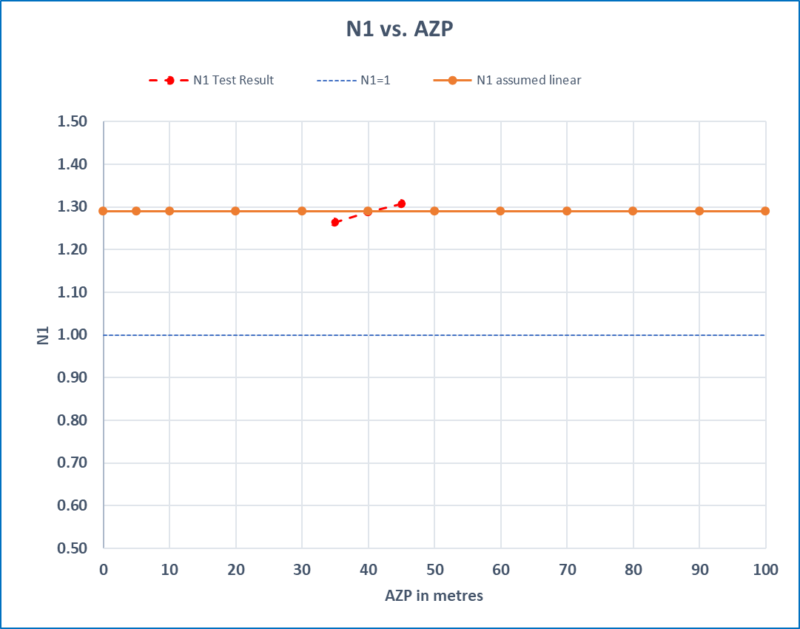
Exploring the N1:AZP relationship
Using a fixed value of N1 from a carefully controlled N1 test, for example 1.29
If N1 is assumed to be fixed, this is represented by the horizontal orange line
This assumption implies that the % of fixed and variable area leakage does not change as AZP increases or decreases!
Using a fixed N1 could result in expected results from pressure management not being met
Notes:
Let's explore this relationship a little further –
In this example, we have a Zone or DMA where a carefully controlled N1 test has resulted in an N1 value of 1.29 at an average of 40m AZP. This is represented by the red dotted line.
If we assume N1 to be fixed, then we assume that the value of 1.29 for N1 will not change, regardless of whether AZP is increased or decreased. We also assume that the % of Fixed and Variable Area leakage does not change regardless of whether pressure is increased or decreased.
Using a fixed N1 could result in expected results from pressure management not being met

Slide 12
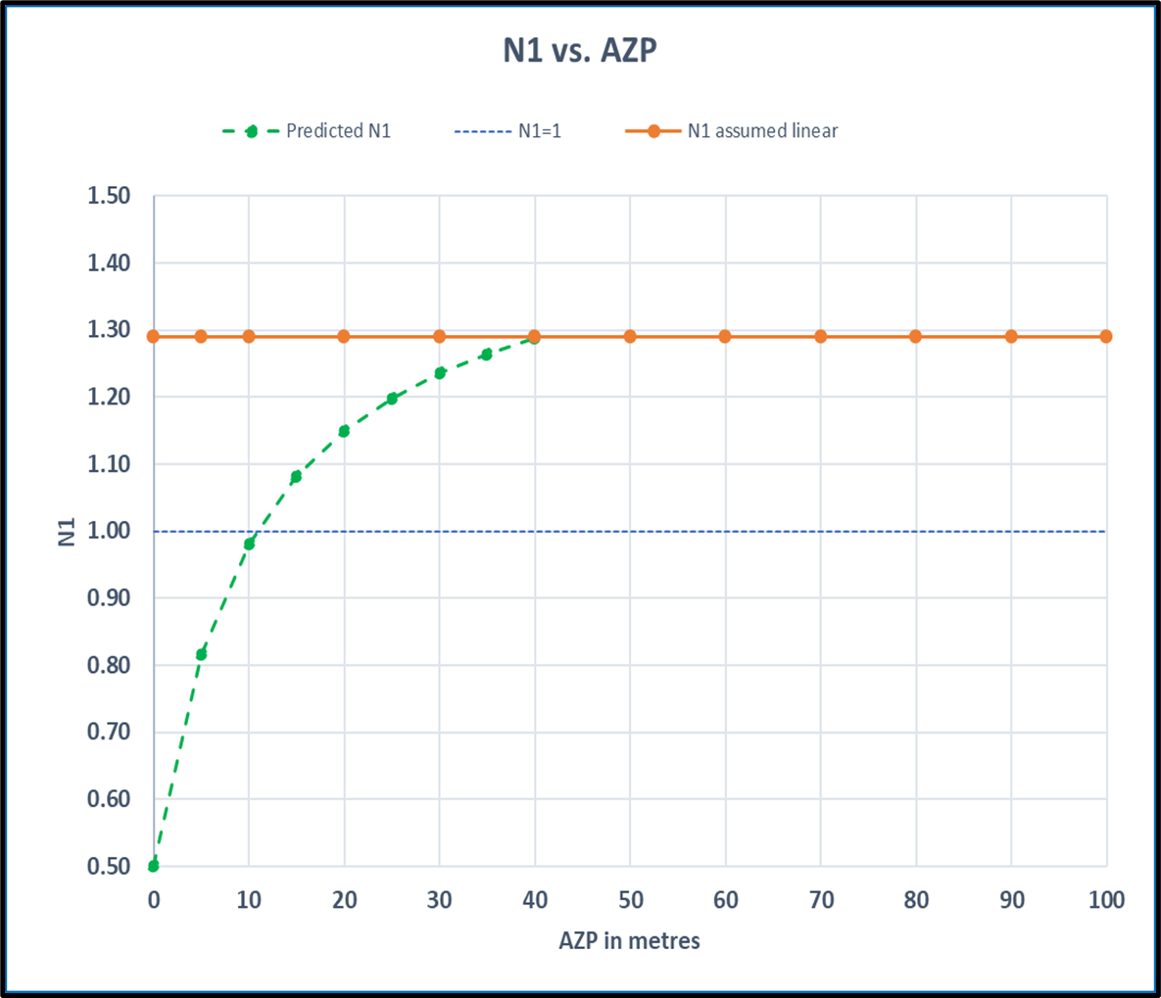
Exploring the N1:AZP relationship
Using FAVAD, we can predict that N1 reduces as AZP falls below 40m – shown as the green dotted line
Rates of change in N1 are greatest at lower pressures
In this example if you continue to use a fixed N1=1.29, then as AZP drops below 40m and the N1 value also reduces, your predictions of leakage flow rate reductions will be over-estimated
Notes:
However, using FAVAD concepts, we can predict what will happen to N1 as AZP is reduced below 40m, and this is represented in the graph by the green dotted line.
We can predict that as pressure drops, N1 drops, and this reduction in N1 is particularly strong as pressure reduces below 20m. As N1 reduces below 1.29, the percentage of Variable Area Leaks reduces and the percentage of Fixed Area Leaks increases – at an N1 of 1.29, VAL = 79% and FAL=21%, but at an AZP of 20m, N1 is approximately 1.16, with VAL of 66% and FAL of 34%
So by continuing to use a fixed N1 of 1.29 in this zone, as pressure is reduced, your predictions of leaks flow rate reductions will be over-estimated
Burst reductions are a separate calculation using the N2 power law

Slide 13
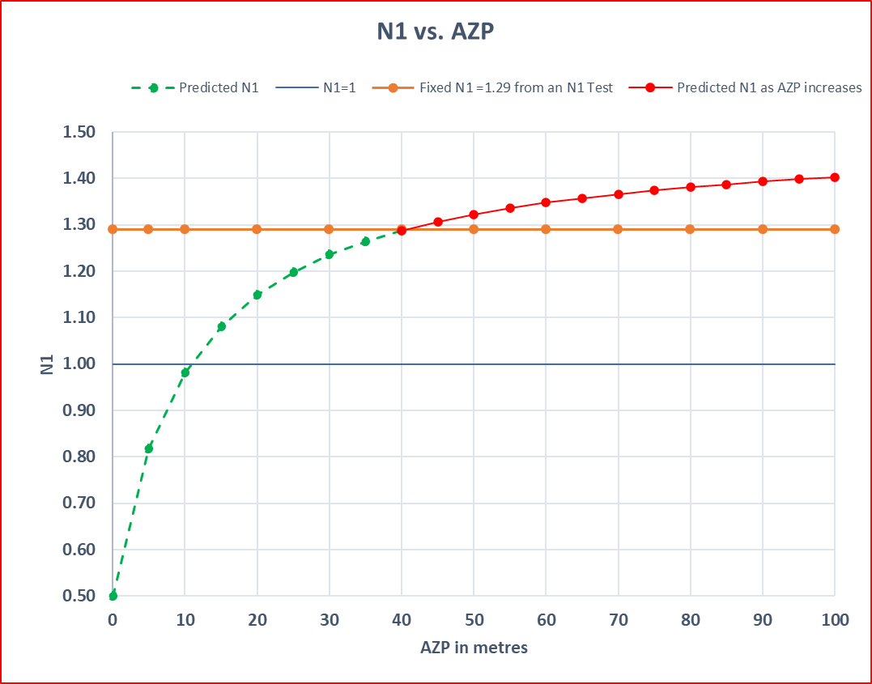
Exploring the N1:AZP relationship
Using FAVAD, we can predict that N1 increases as AZP rises above 40m
In this example, if a fixed N1 of 1.29 is used, as AZP rises above 40m, predictions of leakage flow rate increases will be underestimated.
Increasing pressure may also create additional bursts
Notes:
Using FAVAD, we can predict that N1 increases as AZP rises above 40m
In this example, if a fixed N1 of 1.29 is used, as AZP rises above 40m, predictions of leak flow rates will be underestimated.

Slide 14
FAVAD analysis of a reliable N1 test is the key to improved system-specific DMA calculations

Slide 15
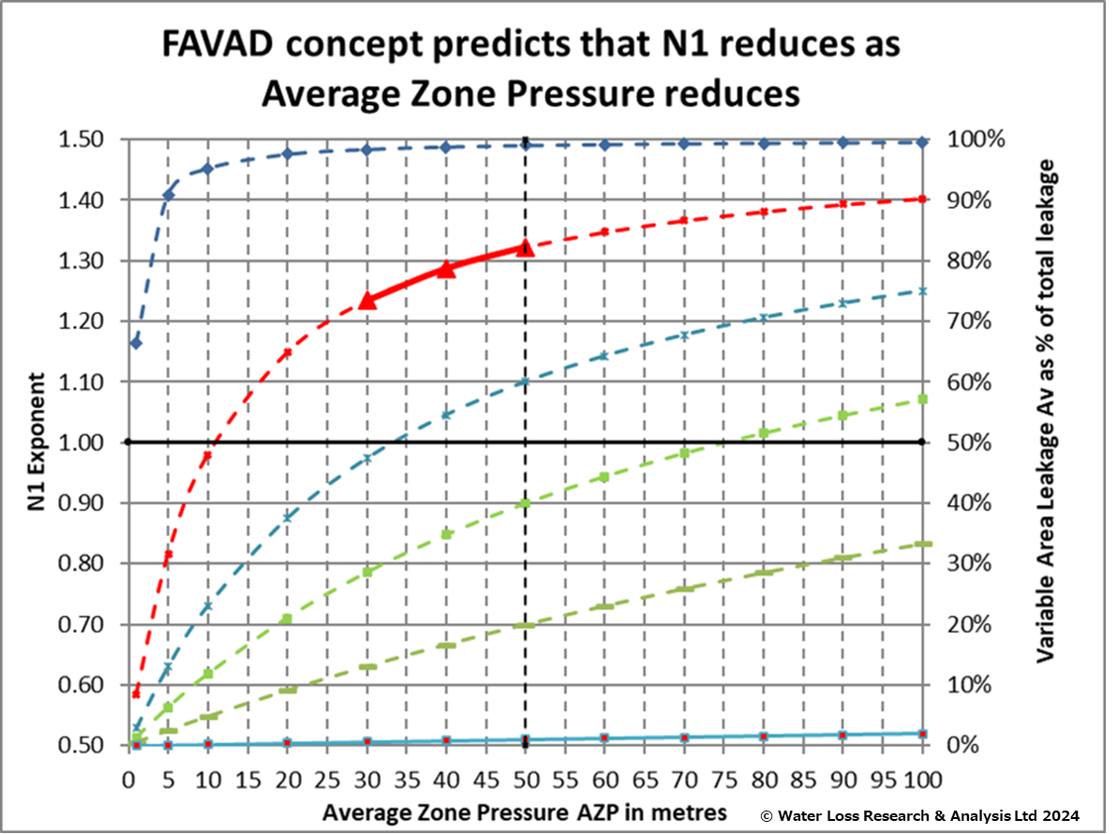
N1:AZP relationships
A reliable N1 test locates a point on a curve of AZP against N1, somewhere within a family of curves
YOU MUST QUOTE the average N1 (1.29) AND the corresponding average AZP (40m) together to derive the N1:AZP relationship
As AZP reduces and N1 reduces, the % of Variable Area Leaks also reduces
WLR&A have been using these curves as the key to more reliable system-specific calculations of pressure:leak flowrate relationships - all these methods have already been extensively field tested on DMAs in operational systems in different countries
Notes:
So when a good quality N1 test is completed for a zone or DMA, the value of N1 at a specific AZP will place that zone or DMA somewhere within a family of curves, shown in this graph. This graph shows a selection of all the possible N1:AZP curves – this graph is also shown in the recently released IWA DMA guidance notes.
This will derive the relationship in that zone or DMA between AZP and N1.
As the AZP reduces and N1 reduces, the % of Variable Area Leaks also reduces
WLR&A have been able to show that these curves are the key to more reliable system-specific calculations of pressure:leak flowrate relationships
All these methods have already been extensively field tested and used on actual DMAs in operational systems in different countries

Slide 16
Why it matters
Improved calculations
Unlock further relationships
Depending on the change in pressure, the calculation of L₁ using a variable N1 could be significantly different – lower or sometimes higher – than using an assumed fixed N1
Not only N1:AZP
AZP and Leak Flow rate
Improved inflow separation into leakage and consumption in real time
Zone-specific Night-Day Factors/Hour-Day Factors
Notes:
Experience in many countries tends to show that N1s have been over-estimated for many years, unless they are performing strictly controlled N1 tests
Reliable N1 tests unlock not only the N1:AZP relationship, but also further important calculations:
AZP AND LEAK FLOW RATE
Improved INFLOW SEPARATION INTO LEAKAGE AND CONSUMPTION
CALCULATION OF ZONE-SPECIFIC NIGHT DAY FACTORS (IF USED)
Lower operating pressures and higher N1s in the Bahamas than in UK result in NDFs as high as 90 hours/day - 3 times as large as in the 30 hrs/day shown in the UK 2017 study

Slide 17
N1+System Correction Factors together
The System Correction Factor (SCF) customises UARL volumes for systems, zones or DMAs under the following conditions:-
Any number of connections
No practical restrictions on AZP (5m-150m)
Uses N1=0.5 for Fixed Area Leaks and N1=1.5 for Variable Area Leaks and UBL
Helps to set more accurate UARL targets at the whole system, Zone or DMA level
Quantifies the effects of reductions in AZP on UARL volumes
Identifies Zones and DMAs for Active Leakage Control and Pressure Management Activities
Customers to date in USA, Canada, Malta, Portugal, Italy, Netherlands, Belgium, Australia and UK
Calculating Variable N1 at AZP values from a well-conducted N1 tests provides Utilities with more accurate leakage volume calculations when undertaking pressure management

Slide 18
N1, AZP and SCF together – GWF Balance
Notes:
GWF Balance utilises results from N1 tests and SCF calculations to really help Utilities understand their leakage at a zone or DMA level

Slide 19
Summary
Any N1 value from an N1 test is not fixed
N1 reduces as AZP reduces
Rates of change in N1 are greatest at lower pressures
An N1 test produces an average N1 value at a specific AZP
Always quote the N1 and AZP values together
Calculate % of Fixed and Variable Area Leaks from any N1 value
Reliable N1 tests unlock further important calculations
N1:AZP, AZP:Leak flow rate, improved inflow separation, zone specific Hour-Day Factors
Variable N1 and UARL with SCF together
Predict – minimum achievable leakage volume and maximum recoverable leakage
Prioritise – identify DMAs with highest recoverable leakage according to pressure management or ALC
Implement – targeted intervention for each DMA

Slide 20
THANK YOU
Kate Stanton-Davies
Katesdavies@wlranda.com
www.wlranda.com
Mark Shepherd
Mark.shepherd@gwf.ch
www.gwf.ch

