Slide 1
SCF extends the practical application of UARL and recommended use of UARL₁₉₉₉, ILI and UARL with SCF
ALLAN LAMBERT & KATE STANTON-DAVIES| RAI - amsterdam, 7 – 8 november 2023
Notes:
Good morning - It’s a pleasure for Kate and I to be with you this morning to outline the concepts we’ve used to extend and customise the 1999 Unavoidable Annual Real Losses equation to any size of system or subsystem, using the System Correction Factor Concept approach.

Slide 2
AGENDA: UNAVOIDABLE ANNUAL REAL LOSSES
UARL₁₉₉₉ Equation for whole large systems
Why it was needed
UARL evolution since 1999
UARL with System Correction Factor SCF (2019)
How is a UARL with SCF calculation different?
Reduction in bursts by pressure management predictable since 2013
Interpreting SCF results
Case Studies results and feedback
Guidance on use of UARL₁₉₉₉, ILI and UARL with SCF
© Water Loss Research & Analysis 2023
Notes:
: Here’s the Agenda. I’ll quickly run through several slides up to why UARL with SCF needed to be developed. Kate will then explain what an SCF is, show several Case Study results with user feedback, and summarise our recommended ‘good practice’ use of the UARL₁₉₉₉ equation, Infrastructure Leakage Index ILI and UARL with SCF.

Slide 3
UARL₁₉₉₉ Equation for whole systems – why it was needed
1st IWA Water Loss Task Force 1995-1999
Tasked to review KPIs for international comparisons of water losses and develop standard international water balance
Limitations of real losses KPIs in use in 1995 were identified, new approach needed
Task force agreed parameters for an unavoidable annual real losses (UARL) component analysis equation to calculate how low REAL LOSSES could be reduced for well-managed Utilities with good infrastructure
Current Annual Real Losses volume (CARL) then divided by UARL to get a non-dimensional Infrastructure Leakage Index (ILI) for international technical comparisons of leakage management
Assumptions and limitations of the UARL₁₉₉₉ equation
UARL₁₉₉₉ equation designed, tested and intended to be used only for larger systems > 5000 service connections
Leak flow rates vary with pressure to power N1, range 0.5 to 1.5; was simplified to linear, N1 = 1 for mixed pipe materials
Pressure:burst frequency relationships not widely recognised in 1999 although some evidence existed, but not included in UARL₁₉₉₉
© Water Loss Research & Analysis 2023
Notes:
The illustration on the left show the UARL1999 equation developed by the first IWA Task Force 1995-99, based on component analysis with auditable assumptions, to assess ‘how low could you go’ with real (physical) losses as part of a review of KPIs for international comparisons of losses in water supply systems. The Current Annual Real Losses volume is then divided by UARL1999 to derive the Infrastructure Leakage Index (ILI) for large systems
The UARL1999 equation was subject to assumptions, limitations and simplifications based on accepted good practice at the time. A linear relationship between pressure and average leak flow rates was assumed for large systems with mixed pipe materials; however as pressure:burst frequency relationships were then not widely acknowledged, they could not be included. The equation was designed and tested for 27 large whole systems, 25 of which had more than 5000 service connections from xx countries.

Slide 4
UARL evolution since 1999
The boundary conditions initially recommended for using UARL₁₉₉₉ for large whole systems are highlighted below
Current Recommendations using UARL with SCF
Source: ISO 24528 (en-standard.eu) (2021)
Practitioners liked UARL₁₉₉₉ and began using it for small systems including DMAs with less than 5000 connections
Some calculated ILIs were less than 1.0, particularly in small systems with flexible pipe materials and lower pressures
Attempts to review boundary conditions 2005 to 2009 did not resolve anomalies for small systems
Subsequent research by WLR&A identified three additional interacting factors which influence UARL volumes
Fixed and variable area discharges (FAVAD) concept used for varying pressure:leak flow rate relationships:
Pressure:burst frequency relationships
Use Median (not Annual Average) UARL burst frequencies of Poisson distribution, appropriate for any size of system
These factors are now used to calculate individually customised System Correction Factors (SCF) to provide more reliable UARL with SCF real losses volumes for any size of system or subsystem at any average system pressure
© Water Loss Research & Analysis 2023
Notes:
This slide, from a recent ISO standard, summarises how the boundary conditions for application of UARL1999 have gradually evolved over the last twenty years. Practitioners began to find ILIs less than 1 in well managed small systems with low pressures but attempts to change boundary conditions did not solve this problem. 17 years research gradually identified three additional interacting influential factors needed to extend UARL calculations to a much wider range of system and sub-system sizes and pressures. These are FAVAD (known and well proven since 1995); pressure:bursts relationships (solved by 2013), and using the Poisson Probability distribution (2017) to consider median annual numbers of bursts as isolated events within a continuum of time

Slide 5
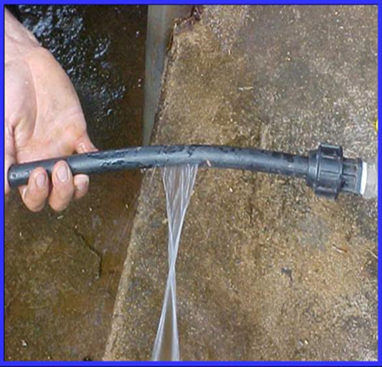
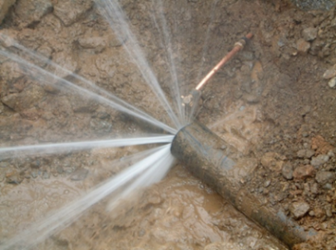
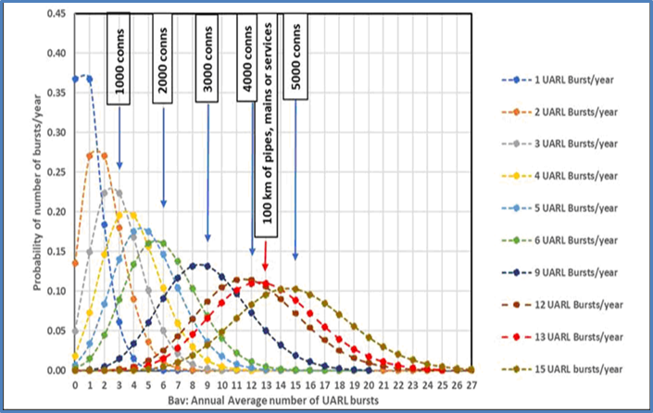
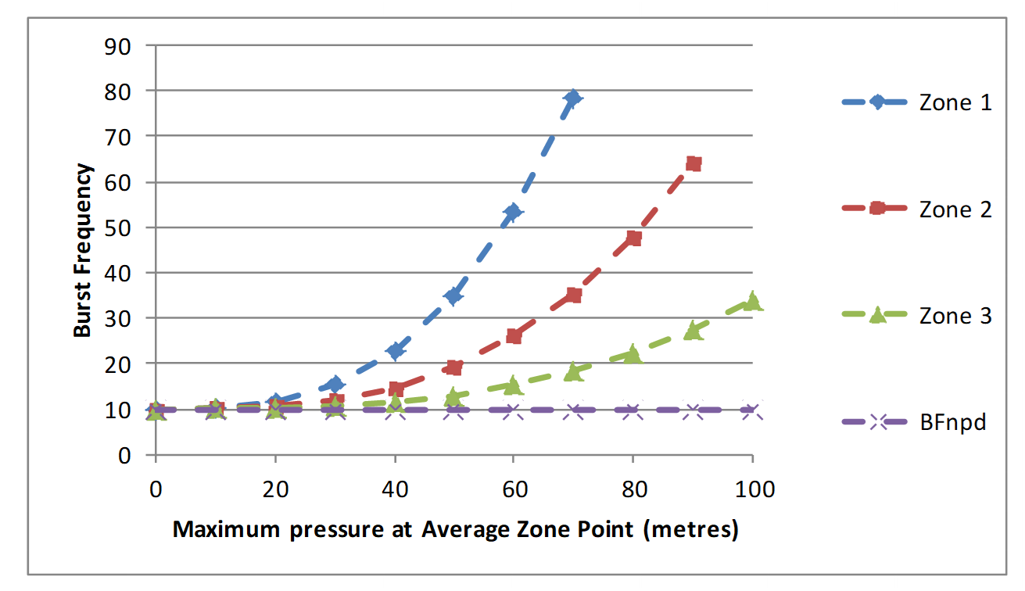
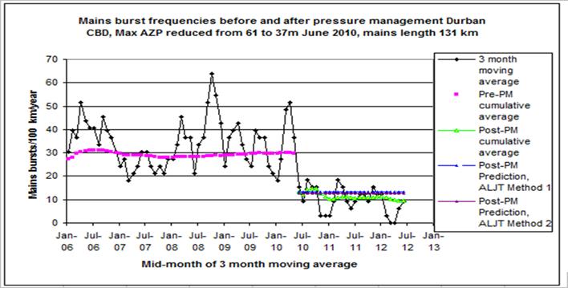
How is a UARL with SCF calculation different?
The combined influences on UARL volumes which were not included in the original 1999 UARL equation:
FAVAD
Fixed and Variable Area Discharges: type of leak and pipe materials influence on pressure: leak flow rates relationships significantly
Uses power law N1=1.5 for variable area leaks (Unavoidable Background Leakage and bursts onn flexible pipes) and N1=0.5 for fixed area bursts on rigid pipe materials)
POISSON DISTRIBUTION FOR BURSTS
The Poisson probability distribution considers bursts as isolated events; it generates median values for UARL burst frequencies less than the average in small systems, but median values close to the average for larger systems
For small systems, the median probability (50% chance of exceedance in any year) is more appropriate than average UARL burst frequency for isolated events
PRESSURE:BURSTS
Predicts the influence of a general relationship between pressure and burst frequency (not available prior to 2013) customised with local parameters
© Water Loss Research & Analysis 2023
Notes:
FAVAD (Fixed and Variable Area Discharges) recognises that type of leak and pipe materials influence the N1 power law; variable area leaks are three times more sensitive to pressure changes than fixed area leaks. A basic classification of % rigid and % flexible pipe materials is used for this purpose.
For small systems, the Poisson distribution generates lower median values for UARL burst frequencies in small systems, but the median (50% probability) approximates to the average burst frequency as system size exceeds 5000 service connections.
Although many people now accept that pressure influences burst frequency. Others however remain sceptical or may not have seen the evidence. Here is one of many case studies for them; the authors stand by this prediction method as sufficiently reliable for inclusion in SCF calculations

Slide 6
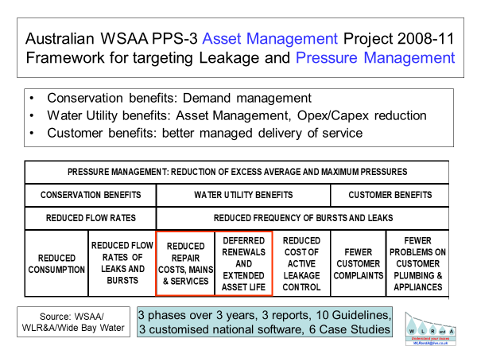
Reduction in Bursts by pressure management has been predictable following a major study in Australia
Since 2013, these predictions of reductions in burst frequency from pressure management continue to be applied successfully in several countries, notably South Africa and several UK Utilities
The economic benefit of reducing bursts for several years, coupled with deferred replacement of mains and services due to the extension of infrastructure life, is very large compared to the savings in reduced flow rates of existing leaks and bursts.
Savings in energy and carbon costs can also now be included as part of the sustainable benefits of pressure management
How can you possibly calculate meaningful technical or economic real losses targets and performance indicators without taking pressure and pressure management into account? It’s like trying to explore the universe without taking account of gravity! Regulators should require Utilities to publish their average pressures as explanatory factors to assist in interpretation of their real loss KPIs.
© Water Loss Research & Analysis 2023
Notes:
This pressure:bursts relationship was identified from ‘before’ and ‘after’ studies on large pressure management zones during a major Australian 3 year Asset Management Project 2008-11 ‘ Framework for Targeting Leakage and Pressure Management’, near the end of the 11-year Millennium Drought.
Since 2013, the prediction of reductions in burst frequency by pressure management continues to be applied successfully in several countries, notably Australia, South Africa and some UK Utilities.
The economic benefit of reducing bursts for several years, coupled with deferred replacement of mains and services due to the extension of infrastructure life, is very large compared to the savings in reduced flow rates of existing leaks and bursts
Savings in energy costs can also now be included as a benefit of pressure management. Based on 40 years' experience in leakage management, the senior author of this presentation still cannot understand why so few regulators require Utilities to report and publish their average pressures to assist in interpretation of their Water Loss KPIs.

Slide 7
Interpreting SCF results
UARL with SCF = SCF x UARL_{1999 volume}
SCF is a non-dimensional number which is multiplied by the UARL₁₉₉₉ volume to give a customised UARL volume for a whole system, zone or DMA
SCF | Interpretation
0.9-1.1 | Represents +/-10% around the UARL₁₉₉₉ volume – many systems, zones and DMAs with mid-range pressures between 45-60m and with more than 5000 service connections could have SCFs in this range
<0.9 | Indicates that the standard UARL₁₉₉₉ equation over-estimates UARL volume – i.e.., lower UARL volume targets could be set. Systems, Zones and DMAs operating at <45m AZP and with <5000 service connections may have SCFs <0.9.
>1.1 | Indicates that the standard UARL₁₉₉₉ equation under-estimates UARL volume – i.e.., higher UARL volume targets should be set. Systems, Zones and DMAs operating at >60m AZP and with >5000 service connections may have SCFs >1.1
© Water Loss Research & Analysis 2023
Notes:
SCFs are calculated using online software – the SCF is a non-dimensional number, which is then multiplied by the standard 1999 UARL volume, resulting in a customised UARL volume for an individual DMA, Zone or whole system.
Many Zones, DMAs or whole systems operating at 45m-60m AZP with more than 5000 service connections will have an SCF between 0.9-1.1, that is around +/- 10% of the standard UARL calculation.
SCFs <0.9 typically relate to systems, zones or DMAs operating at <45m AZP with < 5000 service connections – in these circumstances, the standard UARL equation tends to over-estimate UARL volume, and lower UARL volume targets could be set here.
SCFs >1.1 typically relate to systems, zones or DMAs operating at higher pressures of >60m AZP with > 5000 service connections – in these circumstances, UARL volume targets set using the 1999 equation are unlikely to be achieved, and higher volume targets may need to be set.
80 secs

Slide 8
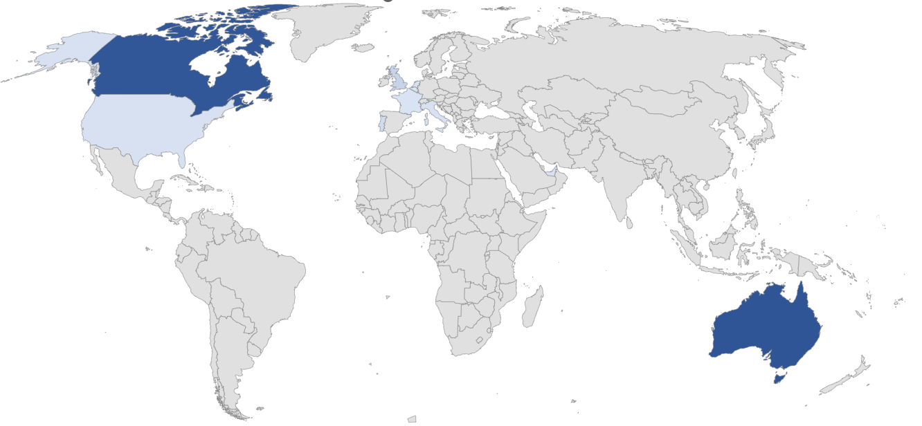
Case Study results and feedback
© Water Loss Research & Analysis 2023
Notes:
Let’s take a look at 3 case studies for Utilities using SCF – to date more than 2,500 calculations in 12 countries have been completed.
This section looks at data from 3 large scale calculation sets in Australia, Canada and Europe.
20 secs

Slide 9
Case Study 1 – Sydney Water (Australia)
SERVICE CONNECTIONS (all meters at property line) | 1.37 MILLION
DENSITY OF CONNECTIONS (AVERAGE) | 58.6
MAINS LENGTH (km) | 23800
AVERAGE ZONE PRESSURE (m) | 51.9 (15-137m)
MAINS AND SERVICES PIPE MATERIALS | 82% RIGID MAINS 85% RIGID SERVICES
NUMBER OF SCF CALCULATIONS | 655
CURRENT ILI (2020) | 1.3
“We are using SCF calculations to plan the DMA program.
The data is useful in desktop analysis of choosing preliminary DMA candidates to enable the operators confirm the candidates based on network configuration and local conditions.
….adopt the system level SCF corrected UARL as future targets to plan leakage control works ie., pressure reduction, sensors, traditional ALD or DMA sectorisation.
We are working on system level water loss. Once that is done the corrected UARLs can be set as targets and planning may be undertaken to address the gap between actual water loss and the UARL targets.”
All data reproduced with kind permission of Sydney Water, Australia
© Water Loss Research & Analysis 2023
Notes:
The first case study is Sydney Water, with over 1.3million service connections, nearly 24000km of mains, operating at a range of AZP from 15-137m, and with mostly rigid mains and services. 655 calculations were performed across their whole water distribution network.
Here are some comments from Sydney Water - The SCF results are being used for two main purposes - To identify suitable candidate Zones for their DMA program. SCF volumes will be adopted as volume targets, rather than the original 1999 UARL volume.
40 secs

Slide 10
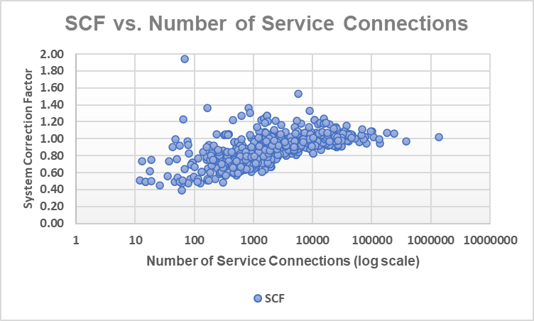
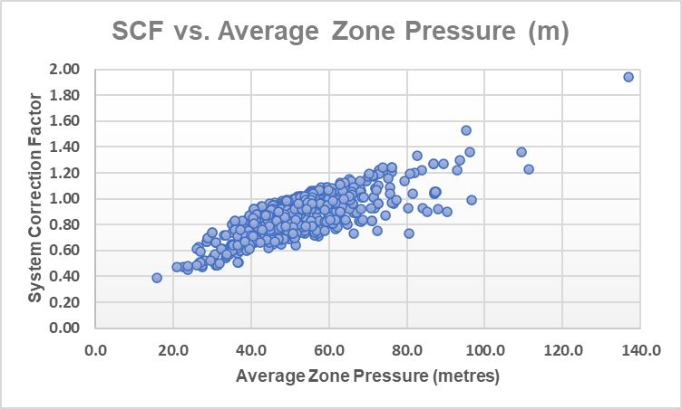
Case Study 1 – Sydney Water (Australia)
0
All data reproduced with kind permission of Sydney Water, Australia
© Water Loss Research & Analysis 2023
Notes:
These 2 scatter graphs show the relationships between the value of the SCF on the Y axis, and Number of service connections on the first graph, and the value of the SCF vs. AZP on the second graph.
In both graphs, you can see that the zones operating with >5000 service connections and with mid-range pressures 45-60m tend to have SCF values between 0.9-1.1, meaning that the standard UARL equation can still be used here as a means to set meaningful volume targets.
Smaller lower pressure zones have SCFs in the green dash box below 0.9 , meaning that lower UARL volume targets are possible here, and the larger higher-pressure zones have SCFs above 1.1 in the red dashed box, meaning that volume targets set using the standard UARL equation are unlikely to be achievable at that pressure in these parts of the network.
The clear relationship between SCF and Pressure can be seen in the second graph

Slide 11
Case Study 2 - Quebec Province (Canada)
626 Individual Utilities
SERVICE CONNECTIONS | 2111989
DENSITY OF CONNECTIONS (AVERAGE) | 50.9
MAINS LENGTH (km) | 41429
AVERAGE ZONE PRESSURE (m) | 49.7 (18-102m)
MAINS AND SERVICES PIPE MATERIALS | 95% RIGID MAINS 95% RIGID SERVICES
NUMBER OF SCF CALCULATIONS | 855
CURRENT ILI (2019) | 6.6
“The SCF factor helped MAMH analysts to understand why some systems were always reporting really low ILI (below 1). It helped them to validate the data sent over by the municipalities and, for calculated ILIs less than 1.0, to avoid spending extensive time finding possible raw data errors. Further enquiries into the raw Current Annual Real Losses data are triggered only if the CARL volume is less than the calculated UARL with SCF volume.
The SCF also helped to contextualize the results of larger systems with high ILI. By adding the SCF into the analysis, it was made clear that we should not directly compare the ILI of larger systems with smaller ones. Knowing the ILI with and without the SCF for all municipalities helped analysts to better tailor their advice to municipalities to improve the efficiency of their systems. There may be other uses for UARL with SCF further down the line, perhaps in the next phase of the Quebec Water Efficiency Strategy.”
All data reproduced with kind permission of MAMH and
Reseau Environnement, Quebec
Notes:
The second case study is the whole of Quebec province in Canada – data from 626 Utilities was used for 855 calculations – over 2.1 million service connections over 41000km of mains, operating at a range of AZP from 18-102m, with almost all services and mains made of rigid pipe materials.
The SCF results are being used in multiple ways by MAMH – to help analysts understand which influences cause some systems to report ILIs of <1, as well as being able to better advise municipalities on how to improve the efficiency of their systems. The SCF calculations were part of an earlier phase of the Quebec Water Efficiency Strategy.

Slide 12
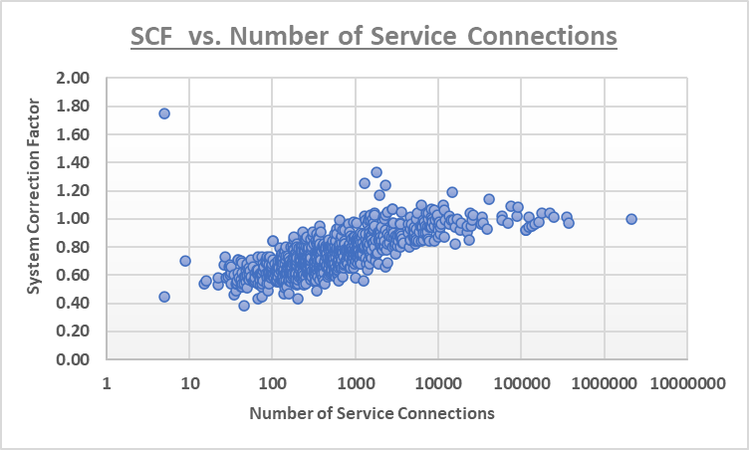
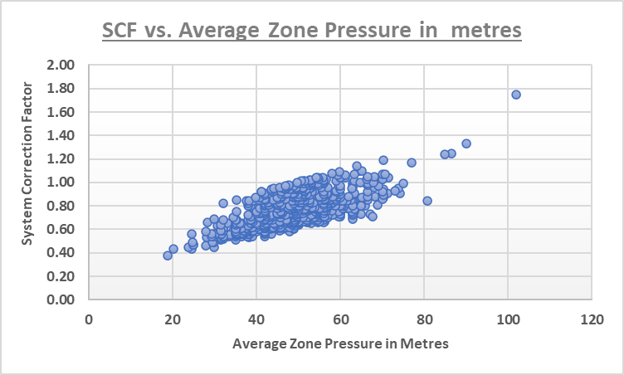
Case Study 2 - Quebec Province (Canada)
All data reproduced with kind permission of MAMH and Reseau Environnement, Quebec
Notes:
Here are the 2 scatter graphs for the Quebec data, which show the relationships between the value of the SCF on the Y axis, and Number of service connections on the first graph, and the value of the SCF vs. AZP on the second graph.
Again, the spread of data looks similar to that of Sydney Water, with a proportion of zones operating with >5000 service connections and with mid-range pressures 45-60m having SCF values between 0.9-1.1, meaning that the standard 1999 UARL equation can still be used to set meaningful volume targets in those systems and zones.
Many smaller lower pressure zones have SCFs in the green dash box below 0.9 , so lower UARL volume targets could be set here, and the larger higher-pressure zones have SCFs above 1.1 in the red dashed box, meaning that volume targets set using the standard 1999 UARL equation are unlikely to be achievable at that pressure.
And again, the clear relationship between SCF and Pressure can be seen in the second graph

Slide 13
Case Study 3 - Water Services Corporation (Malta
SERVICE CONNECTIONS (all meters at property line) | 130000
DENSITY OF CONNECTIONS (AVERAGE) | 80.7
MAINS LENGTH (km) | 2141
AVERAGE ZONE PRESSURE (m) | 32 (17-74m)
MAINS AND SERVICES PIPE MATERIALS | 93% RIGID MAINS 5% RIGID SERVICES
NUMBER OF SCF CALCULATIONS | 320
CURRENT ILI (2022) | 1.7
“UARL with SCF software allows us to further customise UARL calculations for each of 320 individual Zones and Sub-Zones, for the first time.
Integrating this methodology within the snapshot ILl concept will result in rapid identification of Zones where we may expect to set and achieve lower leakage targets and better quantification of leakage and burst reductions from further pressure management.
Fine tuning the UARL now is allowing us further scope to further reduce leakage, saving millions of euros in the process.”
“The UARL with SCF gives us a more precise and generally lower value of leakage, well increasing our scope to attain ever lower leakage levels.
This approach was implemented at a point where we thought we were already close to where we needed to arrive, so the further scope in reducing leakage was more than welcome.”
All data reproduced with kind permission of
Water Services Corporation, Malta
© Water Loss Research & Analysis 2023
Notes:
The third case study is for the whole of Water Services Corporation in Malta – 130000 service connections over more than 2100km of mains, operating at a range of AZP from 17-74m, with mostly rigid mains and mostly flexible service connection materials. 320 calculations were performed.
SCF calculations are being used to fine tune and further reduce leakage targets, identify target zones for Pressure management and quantify leakage and burst reductions from pressure management activities, saving the Utility million of euros in the process.

Slide 14
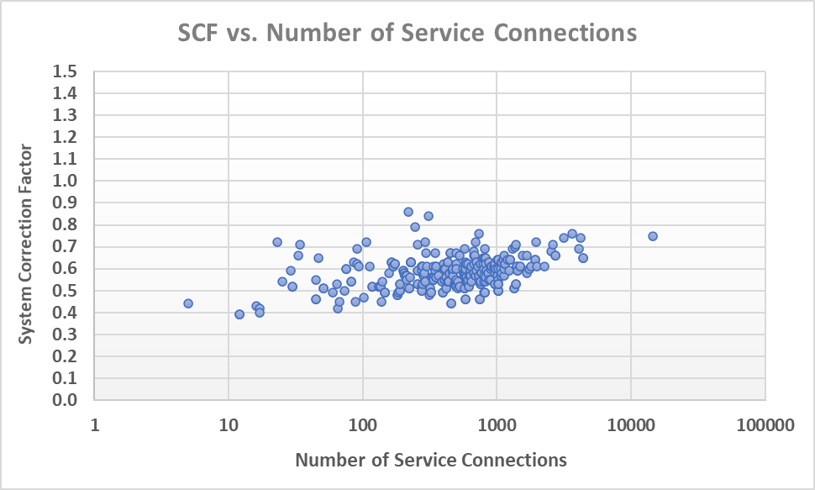
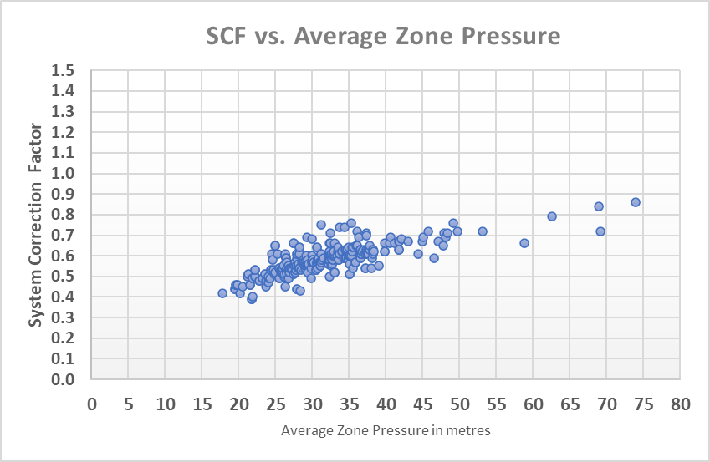
Case Study 3 - Water Services Corporation (Malta)
All data reproduced with kind permission of Water Services Corporation, Malta
© Water Loss Research & Analysis 2023
Notes:
These 2 graphs, again showing SCF vs number of service connections and SCF vs AZP are a little different from those for Sydney Water and Quebec – note there are no SCFs between 0.9-1.1, nor are there any SCFs above 1.1!
These results are due to a number of influences on UARL volume – first of all, nearly all systems are small or very small (less than 3000 service connections), 95% of service connections are made of flexible materials, and there has been sustained pressure management campaign by WSC over the last 20 years.

Slide 15
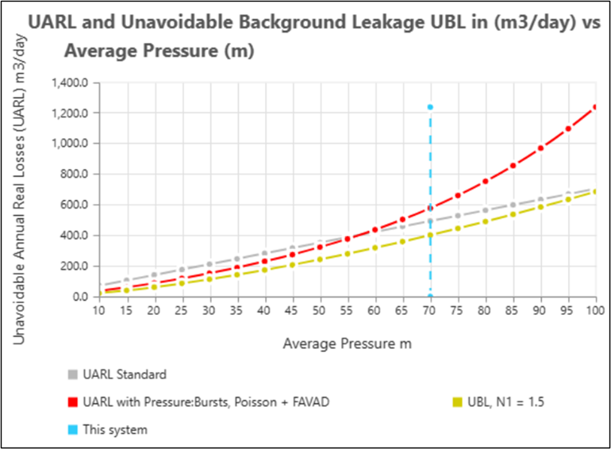
Using SCF to quantify the benefits of pressure management
For this system, UARL targets set using the 1999 UARL equation are
unlikely to be achievable at this pressure
Average Zone Pressure (m) | UARL Standard (m³/day) | UARL with Poisson + FAVAD + Pressure:Bursts (m³/day) | UBL Variable Area, N1 = 1.5 (m³/day)
40.0 | 282.0 | 229.8 | 173.4
45.0 | 317.3 | 274.4 | 207.0
50.0 | 352.5 | 323.1 | 242.4
55.0 | 387.8 | 376.7 | 279.7
60.0 | 423.0 | 436.8 | 318.6
65.0 | 458.3 | 503.8 | 359.3
70.0 | 493.5 | 578.2 | 401.5
75.0 | 528.8 | 660.9 | 445.3
6000 service connections, 100km mains, 70m AZP
Av. Length of service connection property line to meter = 3m
Mix of rigid and flexible mains and services pipe materials
If AZP can be reduced by 1 m (from 70m to 69m),
UARL volume can be reduced by approx. 14.8m³/day or 5402m³/year
© Water Loss Research & Analysis 2023
Notes:
SCF can and has been used to calculate UARL volume targets for whole systems, Zones and DMAs of any size, operating at wide ranges of pressure.
The software can be used to quantify the benefits of reductions in AZP, as shown in this example. The table on the left shows UARL, SCF and UBL volumes at different AZPs for a large system of 6000 service connections operating at 70m AZP. The graph on the right shows these volumes plotted against AZP and clearly show (if you look at the red dotted line) how pressure increases standard UARL, UARL with SCF and UBL.
At 70m AZP, the standard UARL equation calculates a UARL volume of 493.5m3/day. However, SCF calculates that the lowest likely UARL volume is 578.2m3/day – in other words, the standard UARL volume is unlikely to be achieved at 70m AZP.
If this system could operate at 65m AZP, then SCF predicts a UARL volume of 503.8m3/day – such a reduction may not be possible, but the benefits from a 1m reduction can be calculated from this table – it would reduce UARL volume by 14.8m3/day or 5402m3/year.
So every metre of pressure that can be shaved off will bring benefits to reducing UARL, UARL with SCF and UBL volumes.

Slide 16
Guidance on use of UARL₁₉₉₉, ILI and UARL with SCF
UARL₁₉₉₉ annual volume should always continue to be calculated as a first step, whatever the size of system or sub-system
ILI should continue to be calculated for whole systems with more than 5000 service connections, using the UARL₁₉₉₉ volume as the denominator, as an international KPI for external comparisons of technical performance of real losses management in large systems, with average pressure specified.
For smaller systems less than 5000 service connections, achievable low real losses are greatly influenced by a variety of parameters
UARL with SCF software allows UARL₁₉₉₉ to be customised and calculated in terms of unavoidable annual volume at any pressure for any size of system or sub-system, and can then be used as a basis for internal Utility calculations for:
target setting in terms of volume/day, volume/service connection/day, or m3/km mains/day
prioritising individual small systems or zones for quantified benefits of further active leakage control and/or pressure management
© Water Loss Research & Analysis 2023
Notes:
So, we have seen how the UARL equation has evolved over the last 25 years, and the importance of UARL with SCF in calculating UARL volumes for systems, zones and DMAs outside of the original parameters of the 1999 equation.
To summarize this presentation, we advise the following guidance on when to use each of these KPIs:-
First, to always use the UARL 1999 equation as a first step in calculating UARL annual volume, whatever the size of system or sub-system.
When calculating ILI, this should always be for a whole system of more than 5000 service connections, and always using the UARL1999 volume as the denominator. The ILI with average pressure specified is recommended as an international KPI for comparing technical performance of real losses in large systems.
This presentation has shown that there are a variety of parameters that affect real losses in small systems of less than 5000 service connections.
UARL with SCF should be used as a basis for internal utility calculations to set targets in volume/day, volume/service conn/day or m3/km mains/day and for the prioritisation of systems, zones or DMAs for active leakage control and/or pressure management activities.

Slide 17
References
Low ILIs and Small Systems | LEAKSSuite Library
UARL with System correction factor – Water Loss Research & Analysis Ltd (wlranda.com)
NAWL Conference December 2019
NAWL Conference 2021
IWA Water Loss Conference 2022
IWA Caribbean Water Loss Conference 2023
The application of UARL with SCF is referenced in:-
AWWA Free Water Audit software v.6 Free Water Audit Software | American Water Works Association (awwa.org)
ISO standard 24528 ISO 24528 (en-standard.eu)
© Water Loss Research & Analysis 2023
Notes:
For further information on UARL with SCF, we have included some references listed here.
The application of UARL with SCF is referenced in the AWWA Free Water Audit software v.6 as well as in ISO standard 24528.

Slide 18
Thank You!
Allan Lambert
allanlambert@leakssuitelibrary.com
Kate Stanton-Davies
katesdavies@wlranda.com
Director
Water Loss Research
& Analysis Ltd
www.leakssuitelibrary.com
www.wlranda.com

