Slide 1
The Power of N1
Kate Stanton-Davies
Water Loss Research & Analysis Ltd
katesdavies@wlranda.com
ALTA SCUOLA DI Formazione sulla Gestione dei Sistemi Idrici
Best Practice Internazionali - Monitoraggio Tecnologie - Casi di studio
VII Edizione - Ravenna, 17-18-19 Maggio 2023

Slide 2
Introduction
For simplicity, the N1 value for a zone / DMA is normally assumed to be a fixed value –
However, N1 can vary significantly with pressure
This is particularly important in systems operating at either low or high average pressures –
For accurate modelling of the impact of pressure management on leakage levels
This presentation will –
Review the concepts of Fixed and Variable Area Discharges (FAVAD)
Outline the progress in linking N1 with FAVAD
Identify the range of valid values for N1
Show the potential problems if a fixed N1 value is used
Show how to calculate Fixed Area and Variable Area leaks from an N1 value
Identify further calculations possible with a reliable N1 value

Slide 3
FAVAD* concept provides a deeper understanding of Pressure: Leak Flow Rate Relationships
The FAVAD concept has been used to explain diverse results from pressure:leak flow rate field tests in many countries
It allows for variations in the area of leaks as a result of changes in pressure
Velocity of leakage paths V = Cd x (2gP)^{0.5}
Cd is a discharge coefficient, typically 0.6
g is acceleration due to gravity (9.81 m/s²)
If Area of leakage paths = A, then leak flow rate L = V x A = Cd x A x (2gP)^{0.5}
Effective area (Cd x A) of some types of leakage paths are fixed; effective areas of other types of leakage paths vary linearly with pressure
*FAVAD = Fixed and Variable Area Discharge Paths (John May, 1994)

Slide 4
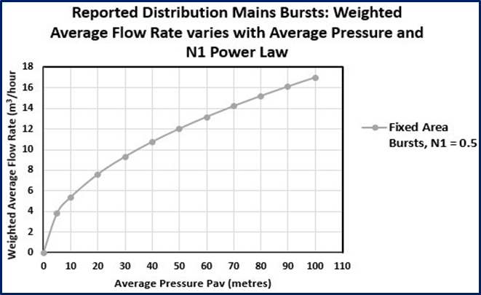
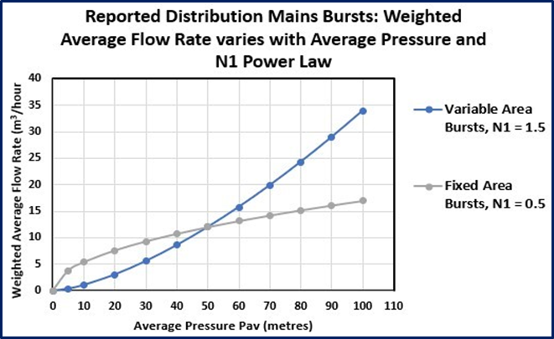
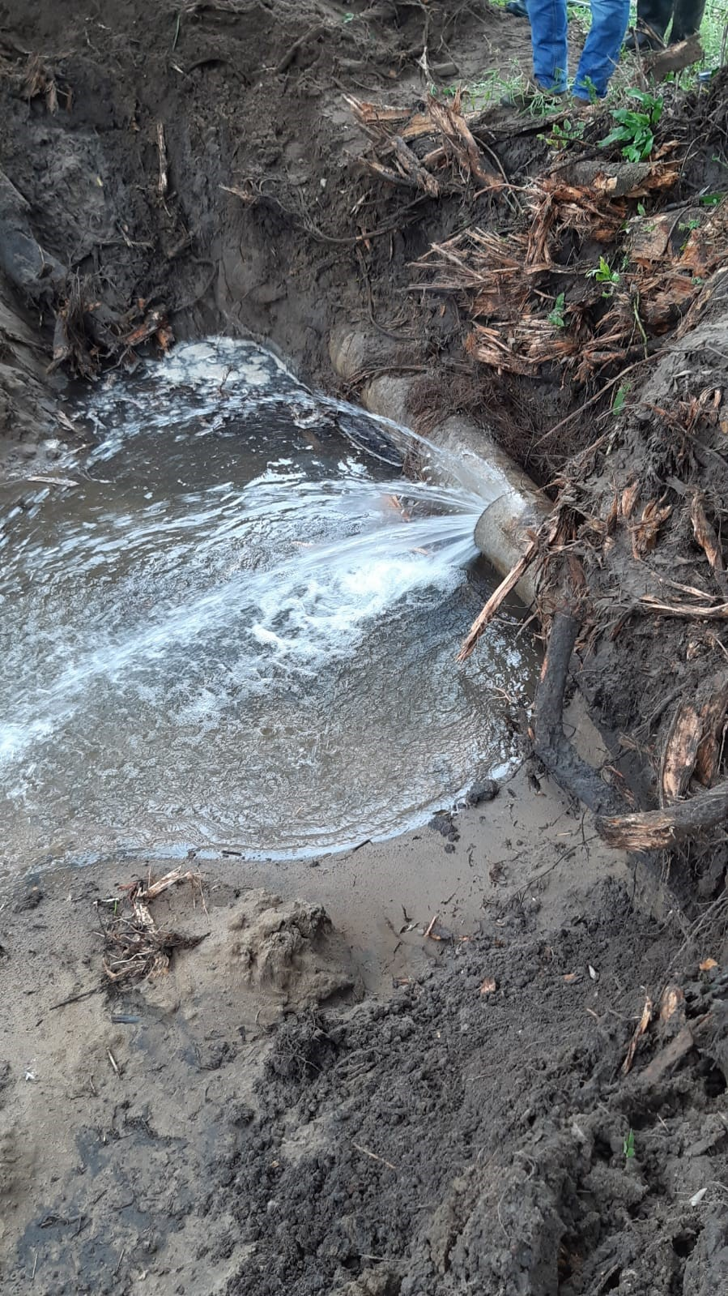
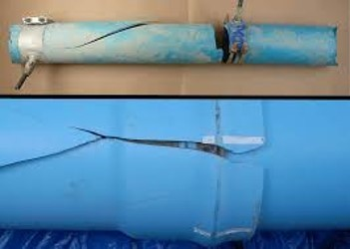
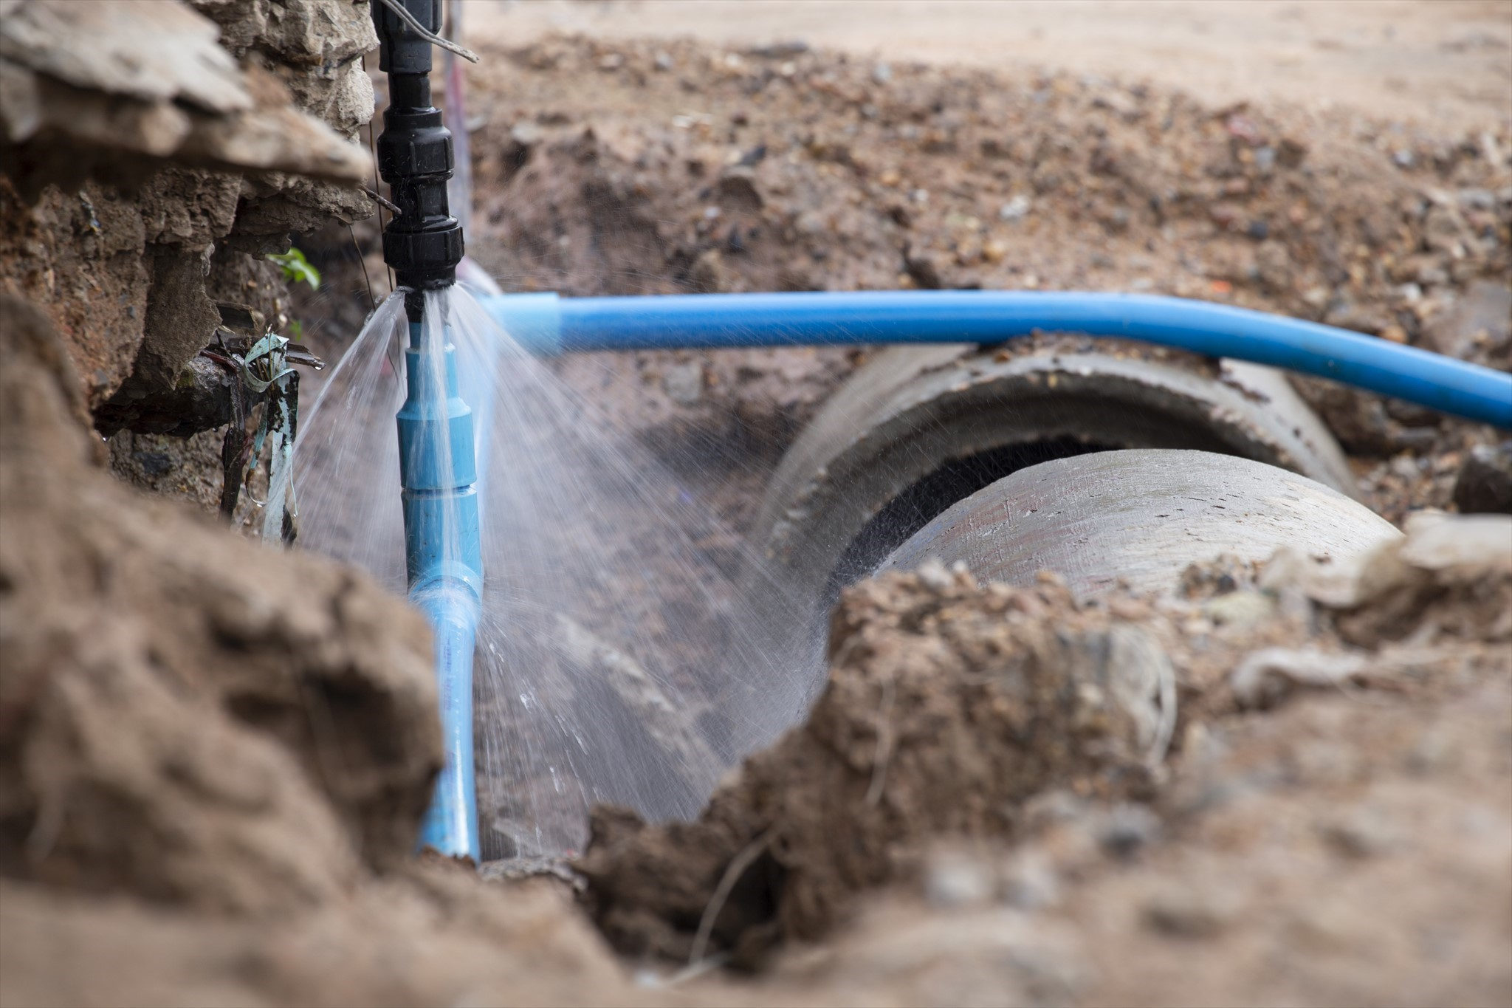
Comparison of Fixed and Variable Area Leaks
Fixed Area Leaks (rigid pipes)
Variable Area Leaks (flexible pipes and UBL)
N1 for fixed area leakage paths is 0.5 (least sensitive to changes in pressure)
N1 for variable area leakage paths is 1.5 (much more sensitive to changes in pressure)

Slide 5
Progress in understanding, from N1 to FAVAD
Simple Power Law approach (1995 onwards)
Assume that leak flow rate (volume/hour) varies with average zone pressure AZP to the power N1
L = k x AZP^{N1}
The user assumes a fixed value for N1 between 0.5 to 1.5, preferably based on N1 tests
However, the parameter ‘k’ is not fixed but also varies with pressure. If changes in pressure are small ‘k’ can to be assumed to be approximately constant

Slide 6
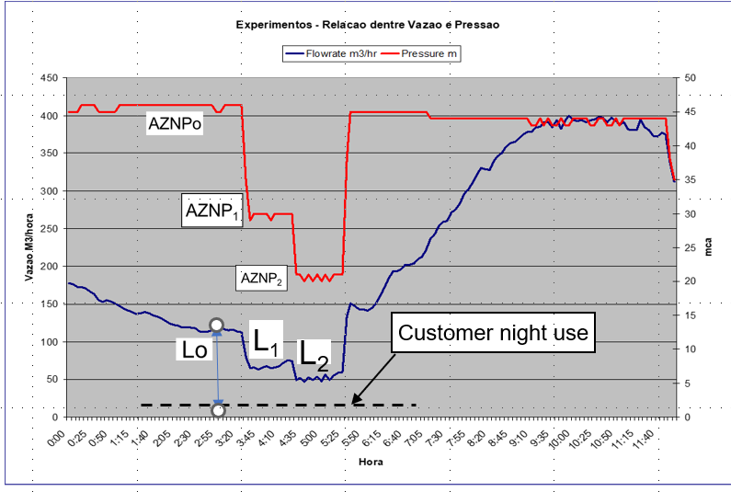
Assessing N1 from a night test
Some International N1 test values (1979-2005)
2-step N1 Night Test, SABESP, Brazil (1998)
Country | # of sectors tested | Mean N1 value | Range of N1 Values
Japan (1981) | 20 | 1.15 | 0.63 – 2.12
UK (TR154) | 17 | 1.13 | 0.70 – 1.68
Brazil (1998) | 13 | 1.15 | 0.52 – 2.79
UK (2003) | 75 | 1.01 | 0.36 – 2.95
Cyprus (2005) | 15 | 1.47 | 0.64 – 2.83
Sources of data:
OGURA, Japanese Water Works Association Journal, May 1981
Technical Report R154 data, WRC, Nov 1980, re-analysed for N1s mid=1990’s
BBL Ltda Brazil, private communication
UKWIR Report 03/WM/08
Charalambous, 2005 in Conference Proceedings of Leakage 2005, Halifax
------ Average Zone Night Pressure (m)
------ Zone inflow rate m³/hr
Pressures in the Zone are gradually reduced at night, until steady values of Average Zone Night Pressure AZNP and flow rate L have been reached.
N1 values can then be calculated from pairs of values, e.g. AZNPo and Lo, and AZNP₁ and L₁

Slide 7
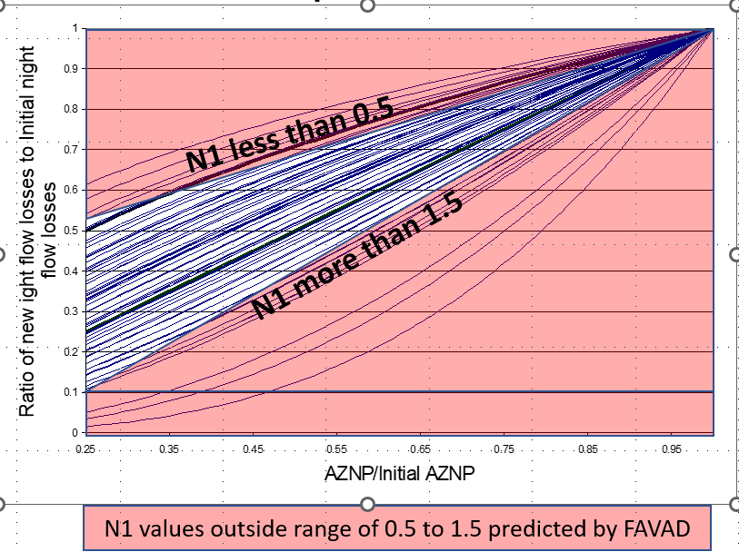
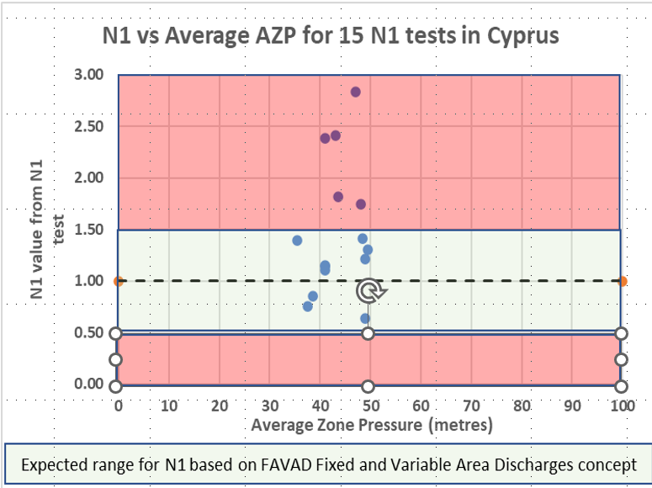
Most N1 tests yield N1 values between 0.5 and 1.5
In a 2003 UK study, only 11 out of 75 N1 values were outside FAVAD concept limits of 0.5 to 1.5
Only 5 of 15 N1 values for Cyprus (2005) were outside the FAVAD concept limits of 0.5 to 1.5
Known causes of doubtful N1 results which exceed expected FAVAD maximum N1 value of 1.5:
Don’t change night pressure before inflow and Average Zone Night Pressure have stabilised
Don’t calculate N1 changes for increases in pressure, as pressure increases may increase storage tank inflows
If there are significant differences between AZP and lowest ground level; or failure to measure at Average Zone Point

Slide 8
Be aware of possible problems in using a fixed average N1 value
Most practitioners currently assume a fixed N1 value from the N1 test, which does not vary with AZP (--------- red line)
This over-predicts N1s at lower AZPs with increasing errors at lower AZPs

Slide 10
Be aware of possible problems in using a fixed average N1 value
If AZPs were increased, N1 would increase to 1.40 at 100m AZP (curved ------red line), but more bursts would likely occur, further changing the N1 value)

Slide 11
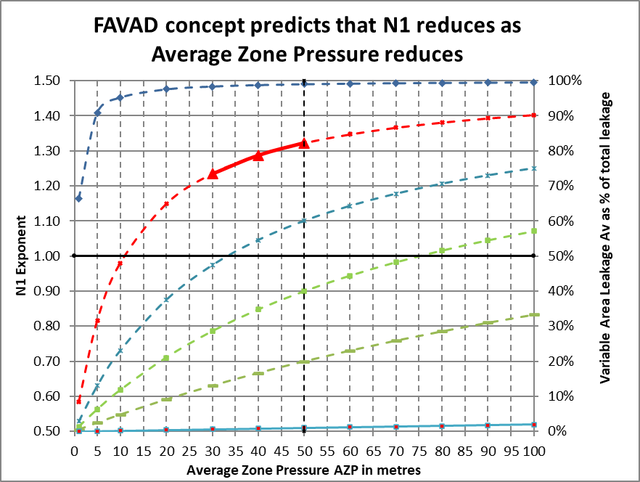
FAVAD analysis of a reliable N1 test is the key to improved system-specific DMA calculations
By quoting both the average N1 (1.29) and the corresponding average AZP (40.5 metres) together, you can derive the relationship between N1 and Average Zone Pressure AZP
You can also calculate ‘in your head’ the % of fixed or variable area leaks at current AZP, for example
when N1 = 1.29
% of variable area leaks = N1 – 0.50 = 0.79 =79%
% of fixed area leaks = 1.50 –N1 = 0.21 = 21%
So as the AZP reduces and N1 reduces, the % of Variable Area Leaks also reduces
WLR&A have been able to show that these curves are the key to more reliable system-specific calculations of pressure:leak flowrate relationships
All these methods have already been field tested and used on actual DMAs in operational systems in different countries
A reliable N1 test locates a point on a curve of AZP against N1, somewhere within a family of curves
Copyright WLR&A Ltd 2023

Slide 12
It’s time to put this N1 prediction method to bed!
This was the first simple initial N1 prediction method developed by Allan Lambert over 20 years ago
It was based on UARL parameters at an average pressure of 50 metres
before widespread pressure management was implemented
However as it has now become superseded by a better method Allan strongly advises practitioners not to use it now or in future
as it takes no account of the fact that N1 varies significantly with pressure

Slide 13
Full FAVAD analysis of N1 data - Key takeaways
Each N1 test produces an average N1 value at a specific Average Zone Pressure
Always quote N1 and AZP values together
For example N1 = 1.29 @ 40.5m AZP
At this pressure, % of Variable Area Leaks = N1 – 1.29 = 0.71 = 71%
% of Fixed Area Leaks = 1.5 – 1.29 = 0.21 = 21%

Slide 14
Thank you to Marco Fantozzi and the ISLE Italy team for inviting me to present at this event
Kate Stanton-Davies
Water Loss Research & Analysis Ltd
katesdavies@wlranda.com

