Slide 1
Understanding Low ILIs in Small Systems: Influences of FAVAD, pipe materials, pressure:burst frequency relationships
Will Jernigan, Cavanaugh, USA
Kate Stanton-Davies, Water Loss Research & Analysis, UK
Allan Lambert, Water Loss Research & Analysis Ltd, UK
Mark Shepherd, JOAT, South Africa

Slide 2
The International Evolution of UARL and ILI
The UARL equation and ILI were first published 20 years ago (Dec 1999), using
Component Analysis of leakage (Background and Bursts Estimates)
Fixed & Variable Area Discharges (FAVAD and N1) for pressure:leak flow rates
UARL simplifies the many inter-dependent factors in complex calculations
It predicts how low could you go with leakage in individual water supply systems with diverse characteristics (size, connections/mile, meter location, average pressure)
The UARL equation was originally limited (from 2002) to whole systems with > 5000 service connections
to try to ensure enough services and mains bursts for valid statistical sample in UARL calculations
Reference: https://www.leakssuitelibrary.com/uarl-and-ili/

Slide 3
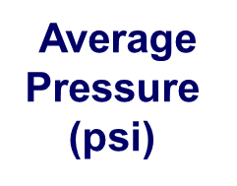
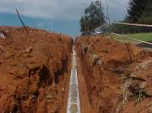
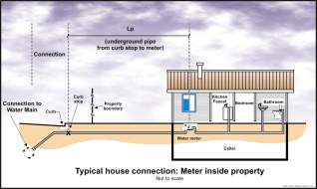
UARL equation allows for key system-specific factors
Unavoidable Annual Real Losses ‘per day’ equation (1999)
UARL (US gallons/day) =
( 5.41 x Lm + 0.15 x Nc + 7.5 x Lc ) x P
Number of conns (Nc)
main to curb stop
Length of underground private pipes (Lc),
curb stop to meter in miles
Main length (Lm) miles

Slide 4
Evolution of UARL and ILI in North America
UARL and ILI are now accepted internationally to compare leakage management performance (Ref: https://www.leakssuitelibrary.com/global-ilis/ )
but practitioners also use it for smaller systems and sub-systems (DMAs)
in some small systems, this results in calculated leakage (CARL) lower than UARL, and ILIs of less than 1, especially at lower pressures
There are some 50,000 systems in North America, of which 90% have less than 3000 service connections
AWWA Water Audit Software V5 (2014) does not calculate ILI if:
miles of mains x 32 + # services < 3000, or pressures < 35 psi
these lower limit criteria are currently under review by AWWA
meanwhile most North American systems cannot calculate UARL or ILI

Slide 5
Previous Research on low ILIs in small systems
2009: simplified linear pressure:leak flow rate relationship shown to over-predict UARL for low pressures and high %s of flexible pipes
2014: In systems where all leaks surface, UARL formula 25% too high
uncertainty of real losses calculations when ILI ~ 1 can be +/- 20% or more
if < 1000 service connections with night flows, unreported bursts can easily be identified and repaired faster than assumed in UARL equation
but Austrian data shows these situations can’t explain all low ILIs
including mains length in equation for lower size limit doesn’t solve the problem
2019: UARL equation needed to be customised to include:
relationship between pressure and average burst frequencies
an appropriate probability distribution for small burst numbers (rare events) in small systems
influence of pipe materials on Fixed and Variable Area leakage paths

Slide 6
Fixed and Variable Area Leakage Paths (1994)
Fixed area leakage
Leak flow rate varies with P^{0.5}
Includes ring cracks, corrosion holes …….
The sum of Fixed and Variable Area leak flow rates is often approximately linear, as assumed in the 1999 UARL equation
Variable area leakage
Leak area varies with P
Velocity varies with P^{0.5}
Leak flow rate varies with P^{1.5}
Includes splits in flexible pipes, background leakage at joints and fittings

Slide 7
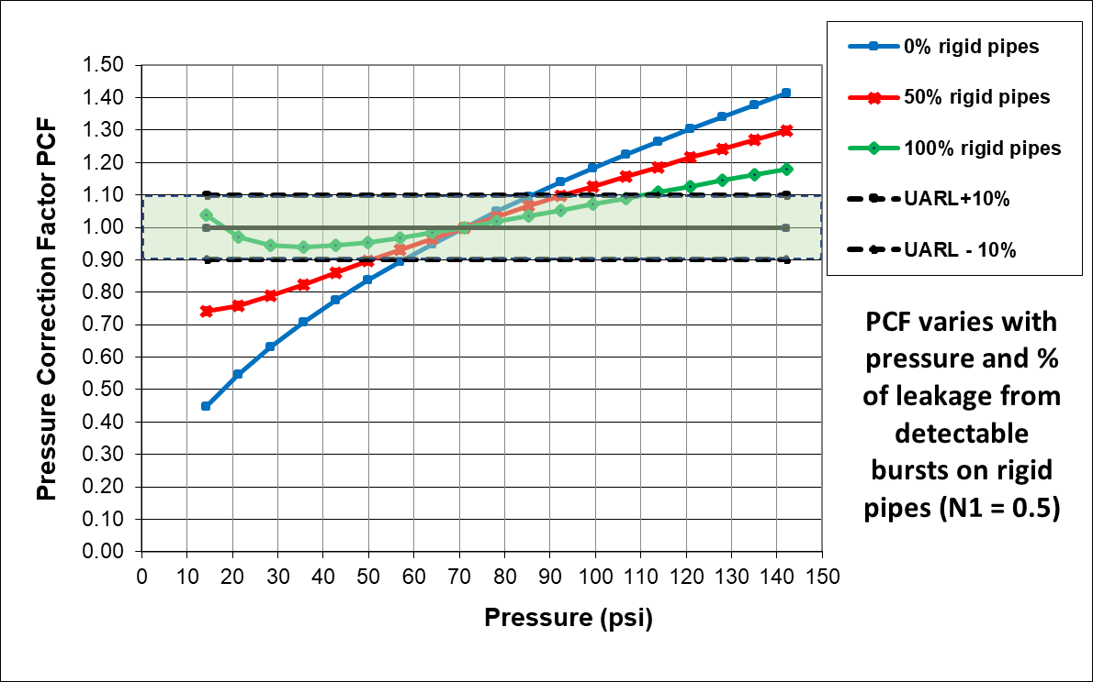
Pressure Correction Factor PCF (2009)
Corrects UARL equation for influence of fixed and variable area leak flow rates
Blue line:
0% rigid pipes (N1 = 1.5)
Basic UARL equation is valid within +/- 10% for pressures 58 to 86 psi
UARL is increasingly over-estimated as average pressure reduces
Green line:
100% rigid pipes
(N1 = 0.5)
Basic UARL equation is valid within +/- 10% for 10 to 110 psi pressure
Note: these PCFs for leak flow rates apply to ANY size of system
Typical burst frequencies at 70psi used, regardless of actual pressure

Slide 8
Low ILIs in very small Austrian systems
90% of Austrian systems have < 3000 connections, operating at average of 70 psi (40-140psi)
Data sets collected in 2007 and 2011 for systems with between 240-10000 service connections
As service connections progressively reduce below 5000, there is a greater chance of lower (or higher) UARLs
This is relevant for customising UARL equation to set targets for very small systems and sub-systems
Source: Lambert, Koelbl, Fuchs-hanusch (2014)

Slide 9
How can the UARL equation be further improved?
STEP 1
Modify to recognise the influence of a general relationship between pressure and burst frequency (available since 2012)
STEP 2
Adopt a more appropriate statistical approach (Poisson Distribution) for low burst numbers in small systems and use 50% chance (median) rather than average burst frequencies
STEP 3
Include influence of pipe materials (FAVAD) and N1 on leak flow rates
STEP 4
Derive customised Systems Correction Factor and apply to UARL equation

Slide 10
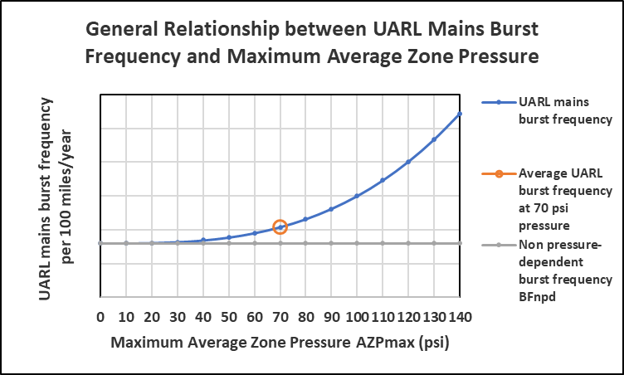
Step 1 : improve burst frequency assumptions
Step 1:
Modify UARL average burst frequencies at 70 psi for burst frequency at actual pressure - use international (2012) preferred practical approach to pressure:burst frequency relationships
UARL bursts frequency rises sharply above 70psi, and reduces towards non-pressure dependent burst frequency as pressure reduces below 70psi

Slide 11
Step 1 : improve burst frequency assumptions
In a small well-managed system with an ILI ~1, bursts are comparatively rare events -
Example: 3000 service connections, 75 miles of mains, 70 psi
UARL Average would be:
3.6 mains bursts/year (95% assumed reported, 5% assumed unreported)
9 service bursts/year (75% assumed reported, 25% assumed unreported)
But you can’t have a fraction of a burst……only a whole number (0,1,2,3 etc)
We can better predict low burst frequencies in small systems using a Poisson probability distribution

Slide 12
What is a Poisson Probability Distribution?
Used to predict probability of small numbers of isolated events occurring, when only the average number over several equal periods of time is known.
Example: goals conceded in a season of 38 soccer games, UK Premier League 2017-18
https://en.wikipedia.org/wiki/Poisson_distribution

Slide 13
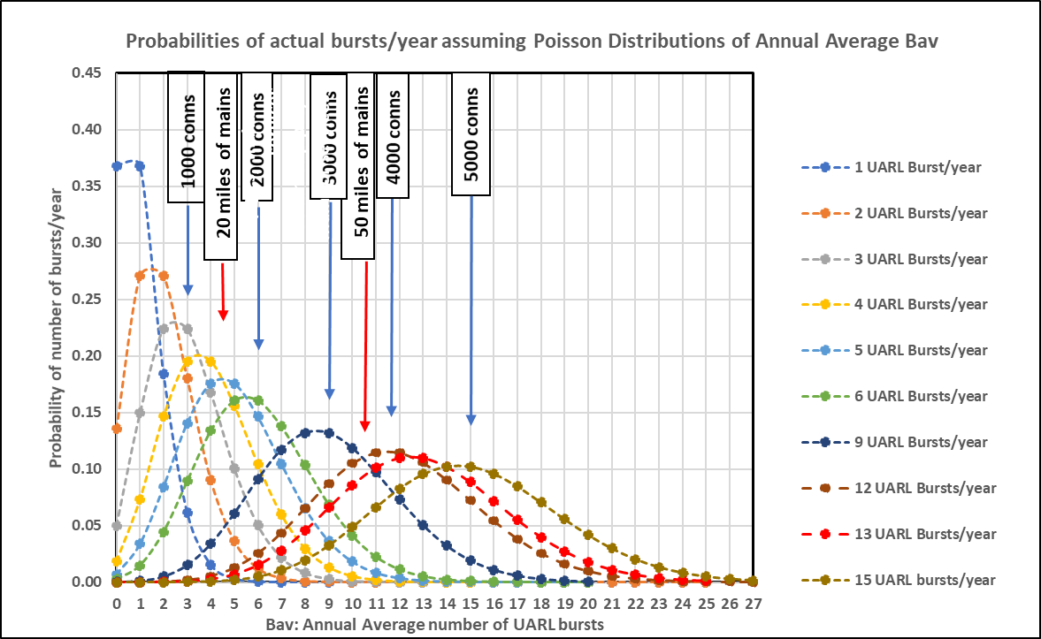
Application of Poisson Probability Distribution to burst statistics
Poisson distribution has now been applied to study of low annual numbers of UARL bursts in small systems
Graph shows how normal ‘bell-shaped’ distribution becomes more skewed as system size reduces

Slide 14
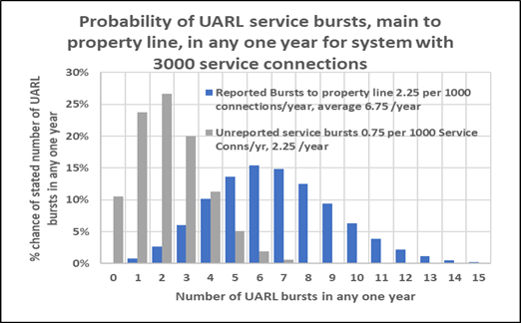
Step 2: improve burst frequency assumptions
Step 2:
Use median (50% chance) for annual burst frequencies based on Poisson Distribution for each of the 6 bursts components in UARL equation – (reported and unreported bursts for each of the 3 infrastructure components)
Poisson is a good approximation to the Normal (bell-shaped) distribution for larger systems with more bursts, but produces skewed distribution for smaller systems with fewer bursts

Slide 15
Steps 3 & 4 - then include influence of pipe materials and N1
Step 3: FAVAD: Fixed and Variable Area Discharges
Apply corrections to average flow rate for rigid and flexible pipe bursts at actual system pressure
Assume N1 = 0.5 for rigid pipe materials
Assume N1 = 1.5 for flexible pipe materials and unavoidable background leakage
Assess %s of rigid and flexible pipes on mains, on services up to curb stop, and on services curb stop to meter
Step 4: Derive customised System Correction Factor SCF
Customise standard linear UARL equation, using UARL with SCF software
UARL (US gallons/day) = SCF x (5.41 x Lm + 0.15 x Nc + 7.5 x Lc) x P

Slide 16
System Correction Factor results
Software outputs are presented as graphs and tables for any individual Zone or system as SCF vs Average Pressure for 3 sets of assumptions:
FAVAD only
allowing for the combined influence of pipe materials and pressure on leak flow rates
Poisson and FAVAD only
allowing for the influence of small systems on median numbers of bursts + the combined influence of pipe materials and pressure on leak flow rates
Pressure:Burst frequency + Poisson + FAVAD
allowing for the influence of pressure on burst frequency + the influence of small systems on median numbers of bursts + the combined influence of pipe materials and pressure on leak flow rates
UARL with SCF calculations in USG/day vs. Average Pressure
Unavoidable Background Leakage UBL in USG/day vs average pressure

Slide 17
UARL with SCF – Predicted breakdown of annual UARL bursts
EXAMPLE 1: 50 psi average pressure
3000 Service connections, 80% rigid pipes
50 feet/connection from curb stop to meter, 100% rigid pipes
36 miles of mains, 60% rigid pipes
FAVAD only SCF of 0.93 reduces to 0.81 for Poisson + FAVAD, or
0. 76 for Pressure:Bursts + Poisson + FAVAD
EXAMPLE 2: 50 psi average pressure
1000 Service connections, 80% rigid pipes
50 feet/connection from curb stop to meter, 100% rigid pipes
12 miles of mains, 60% rigid pipes
FAVAD only SCF of 0.93 reduces to 0.66 for Poisson + FAVAD, or 0.63 for Pressure:Bursts +Poisson +FAVAD

Slide 18
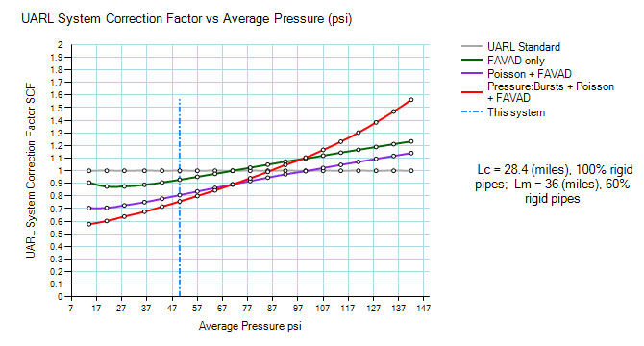
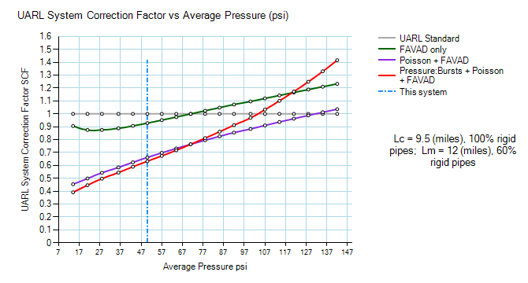
UARL with SCF vs. Average Pressure for 3000 and 1000 service connections
EXAMPLE 1: 50 psi average pressure
3000 Service connections, 80% rigid pipes
50 feet/connection from curb stop to meter, 100% rigid pipes
36 miles of mains, 60% rigid pipes
EXAMPLE 2: 50 psi average pressure
1000 Service connections, 80% rigid pipes
50 feet/connection from curb stop to meter, 100% rigid pipes
12 miles of mains, 60% rigid pipes
FAVAD only SCF of 0.93 reduces to 0.81 for Poisson + FAVAD, or
0. 76 for Pressure:Bursts + Poisson + FAVAD
FAVAD only SCF of 0.93 reduces to 0.66 for Poisson + FAVAD, or 0.63 for Pressure:Bursts +Poisson +FAVAD

Slide 19
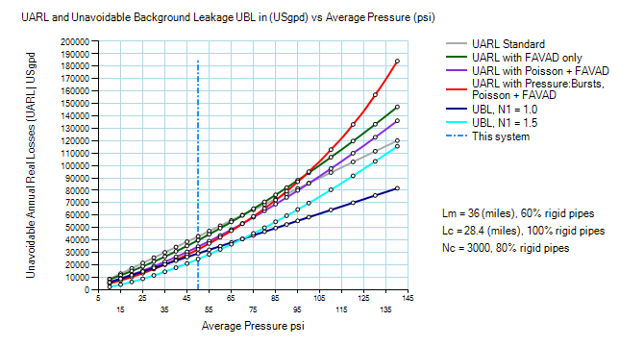
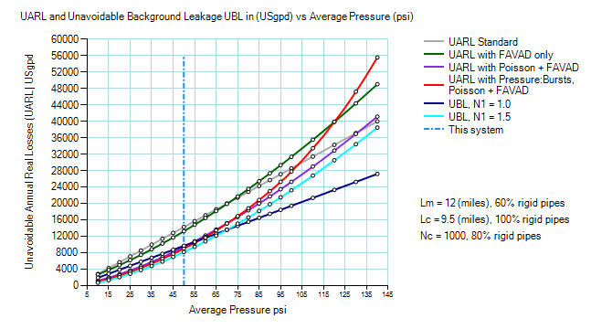
UARL and UBL in USg/day vs. Average Pressure for 3000 and 1000 service connections
EXAMPLE 1: 50 psi average pressure
3000 Service connections, 80% rigid pipes
50 feet/connection from curb stop to meter, 100% rigid pipes
36 miles of mains, 60% rigid pipes
EXAMPLE 2: 50 psi average pressure
1000 Service connections, 80% rigid pipes
50 feet/connection from curb stop to meter, 100% rigid pipes
12 miles of mains, 60% rigid pipes

Slide 20
Summary
UARL bursts in small systems can be considered as rare events
Poisson distribution helps understanding of how ILIs < 1 can occur
UARL with SCF software allows rapid analysis of individual small systems, allowing for multiple relevant local influences
for FAVAD only, Poisson + FAVAD, or Pressure:Bursts + Poisson + FAVAD
Standard UARL equation can be customised for individual small systems below lower size limits currently used in AWWA software
with more diagnostic allowance for pipe materials and higher pressures
Method can be applied at individual system, State or Nationally
Available online for Utilities and Consultants
and as a tool for co-operative State or National research studies

Slide 21
Thanks and Acknowledgements
Thanks to Will Jernigan and Cavanaugh for their participation in this joint presentation
Acknowledgements to all people and organisations internationally who have encouraged Allan Lambert and WLR&A Ltd to develop the UARL with SCF concept
Copies of this presentation may be accessed at https://www.wlranda.com/software/uarl-with-scf/
Email contacts
Allan Lambert – allanlambert@wlranda.com
Kate Stanton-Davies – katesdavies@wlranda.com
Will Jernigan - will.jernigan@cavanaughsolutions.com
Mark Shepherd - mark.shepherd@joat.co.za

