Slide 2
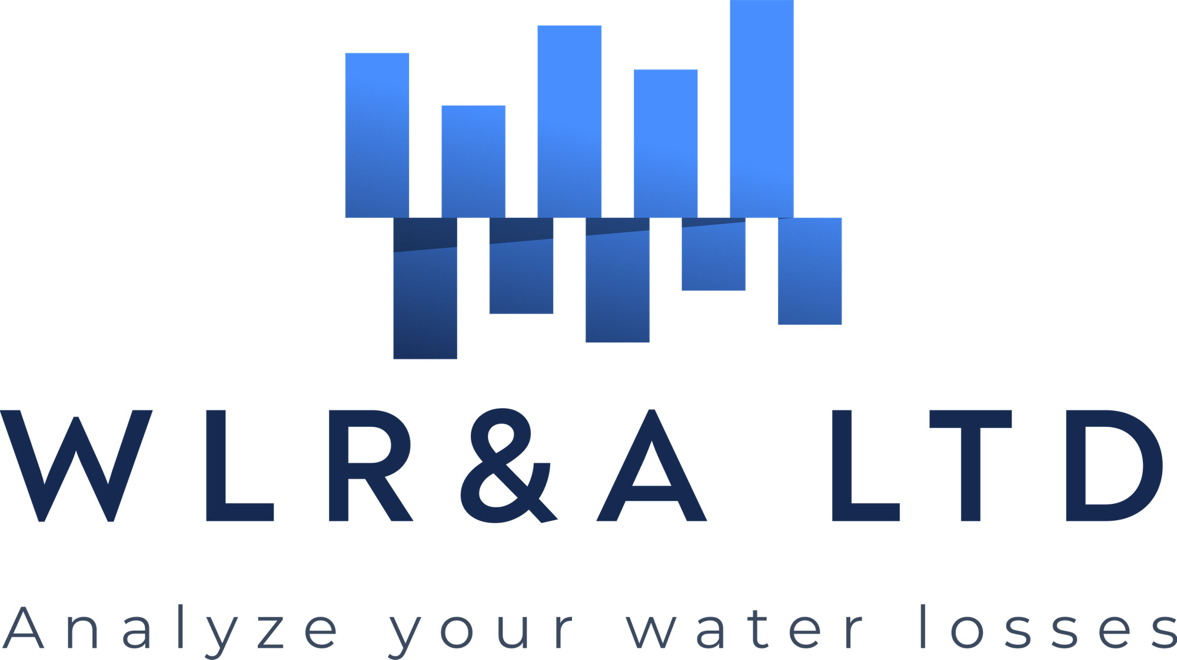
Low ILIs in small systems
Recent experience in implementing UARL System Correction Factors
Kate Stanton-Davies, Allan Lambert, Stuart Stanton-Davies

Slide 3
Agenda
1. UARL, ILI and System Correction Factors
Free Water Audit Software (v6) and Boundary Cases
What is a System Correction Factor?
2. Scenarios
Calculating a whole system Infrastructure Leakage Index (ILI)
Boundary Cases where a standard UARL equation over-predicts UARL volume
Boundary Cases where a standard UARL equation under-predicts UARL volume
3. Large Case Studies (2020, 2021)
Water Services Corporation (Malta, Europe)
Quebec Province (Canada)
Sydney Water (Sydney, Australia)
4. Summary

Slide 4
Calculating UARL, ILI and System Correction Factors
What, why and how?

Slide 5
Notes on UARL and ILI
(Free Water Audit Software v6 – Definitions Tab, UARL)
“This Free Water Audit software version 6 presents the calculated UARL and ILI for systems of all sizes and all pressures.
Some published research* is now available on predicting how UARL is likely to be modified when modelling low leakage limits in systems which are very small (< 3000 service conn), or have very low average pressures, or have very high pressures (aka boundary cases)
Inherent over- or –under estimation of UARL volume may exist in these boundary cases, as they operate at or near the limits of the UARL model assumptions.”
*https://www.leakssuitelibrary.com/low-ilis-and-small-systems/ (REF. 6 on Acknowledgements tab)

Slide 6
What is a “boundary case”?
A boundary case is considered to be a whole system, zone or DMA where:-
Number of service connections < 5000*
and/or
Average Zone Pressure < 64psi (45m) or > 85 psi (60m)
* UARL with SCF applies to small systems with <5,000 service connections, which includes very small systems with < 3,000 service connections

Slide 7
What is a System Correction Factor?
A System Correction Factor optionally customises the basic 1999 UARL equation for any System, Zone or DMA
UARL with SCF = SCF x UARL_{1999 volume}
Models the influences of specific characteristics of a System, Zone or DMA
from the smallest Utility or DMA to the largest Utility, System or Zone
ideal for the many small Utilities (over 90% with <5000 connections) in USA
Provides Utility with priority insights for leakage reduction and pressure management opportunities
UARL with SCF calculations are separate from the AWWA Free Water Audit Software (v6)

Slide 8
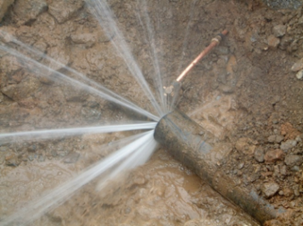
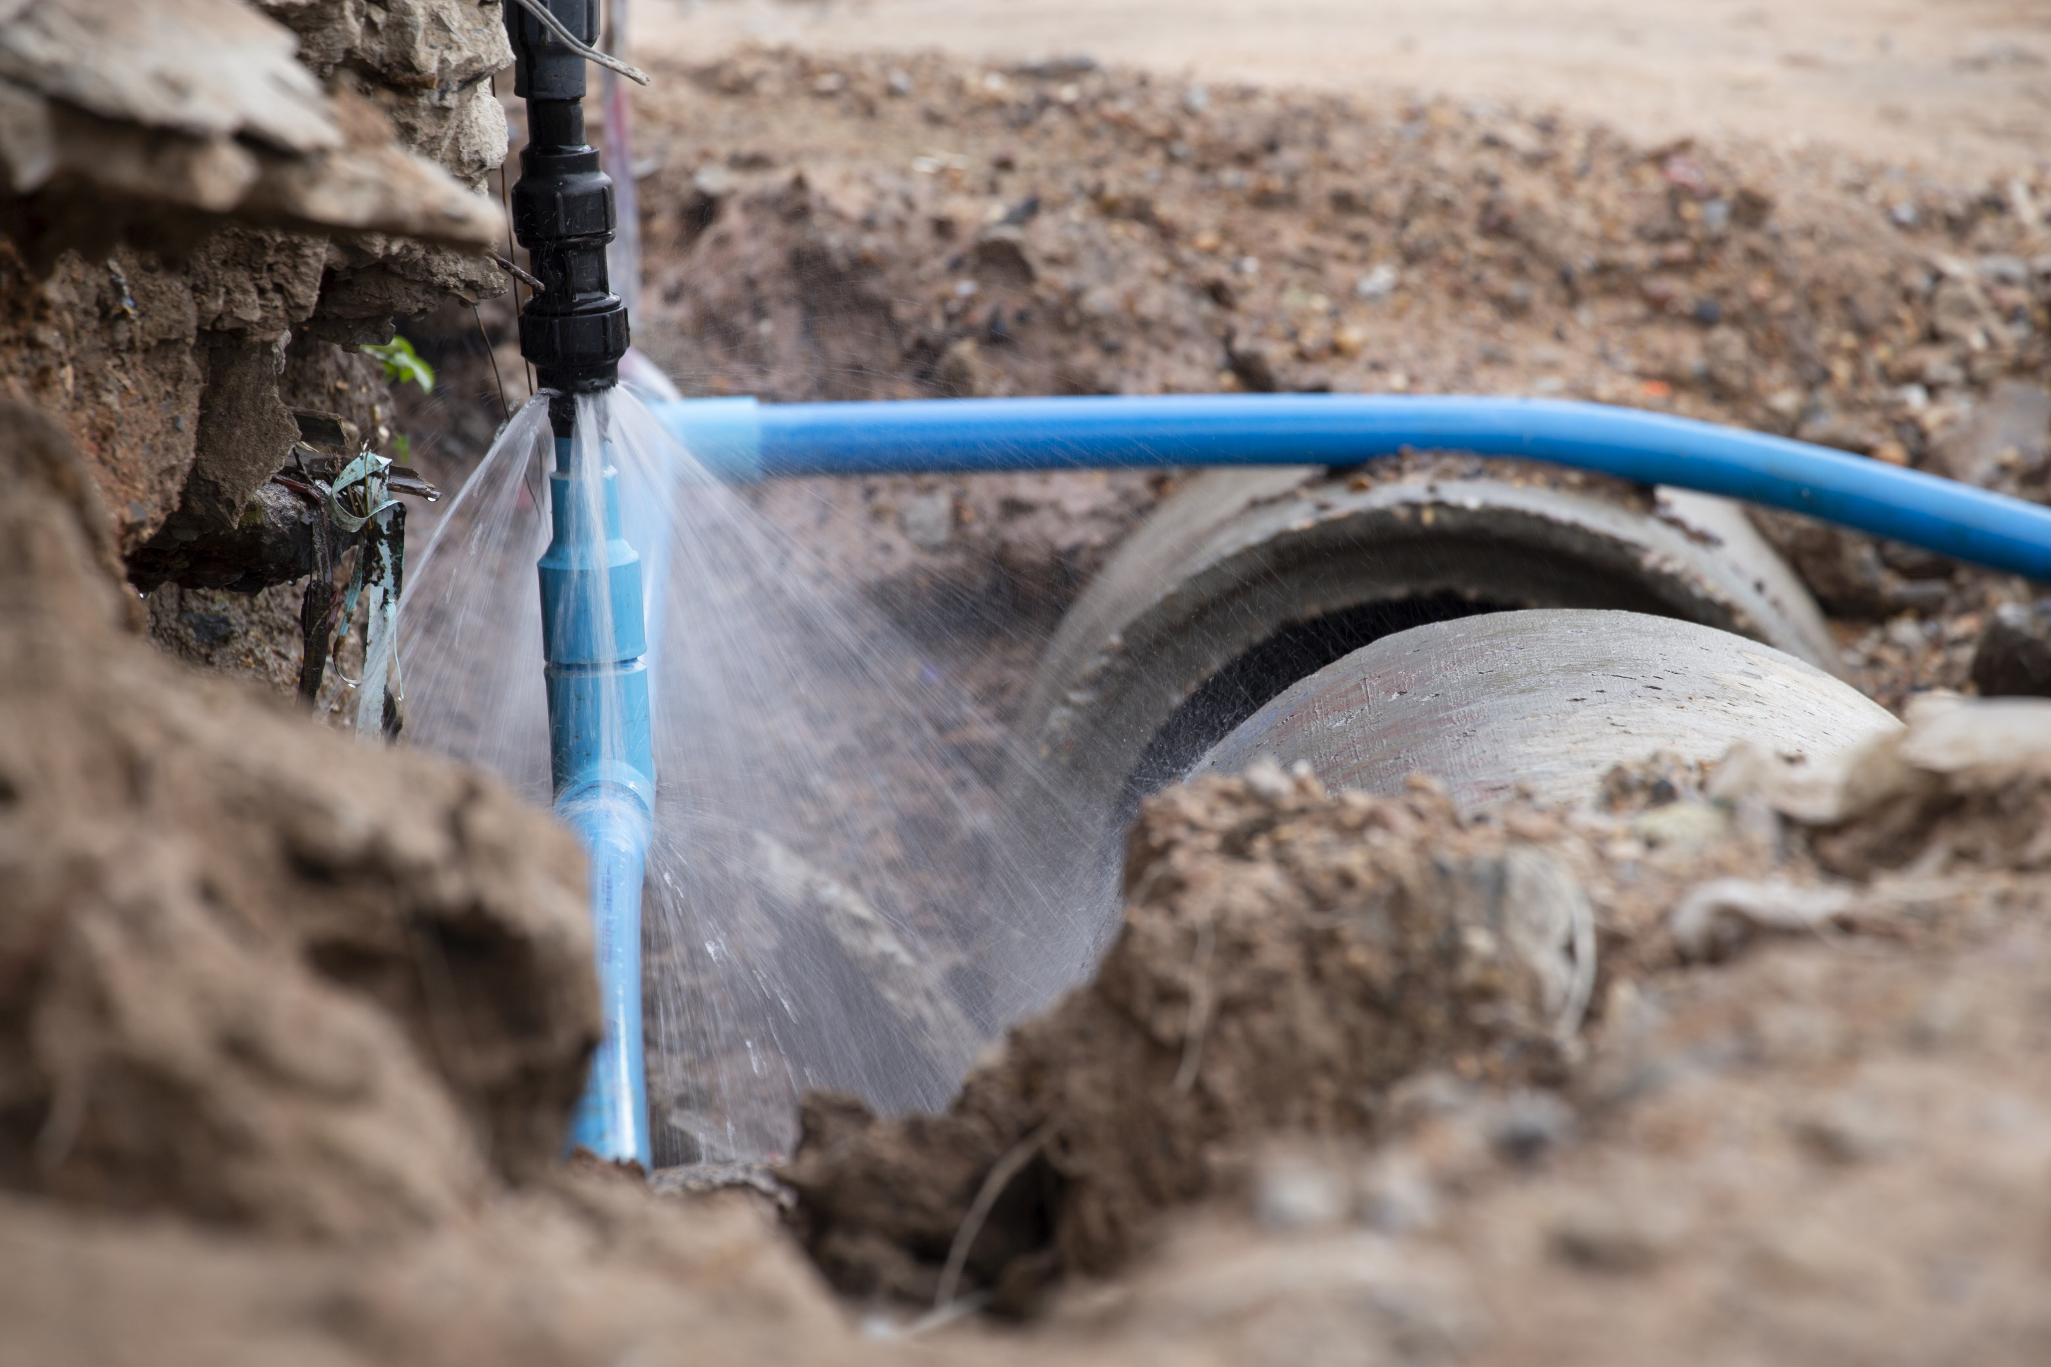
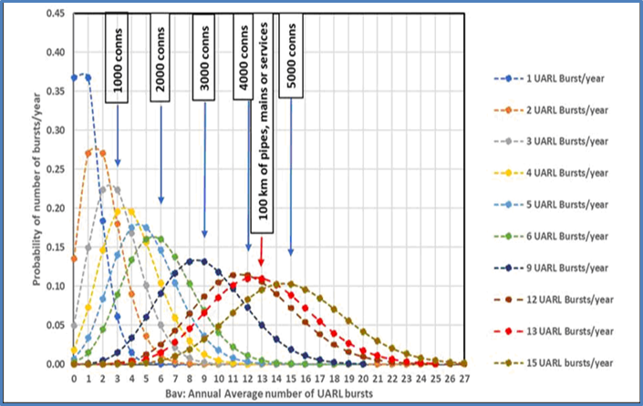
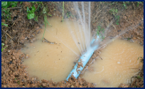
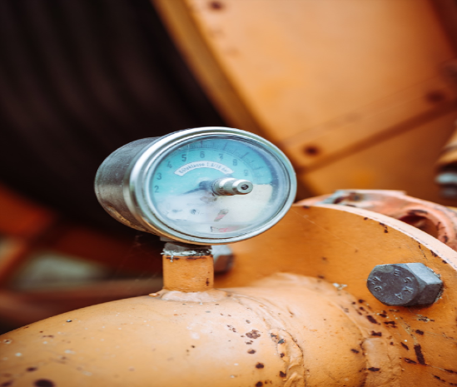
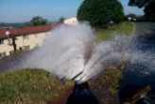
How is a UARL with SCF calculation different?
Shows combined influences on UARL volumes which were not modelled in the original 1999 UARL equation:
FAVAD
Fixed and Variable Area Discharges: influence of pipe materials on pressure: leak flow rates relationships
Uses N1=0.5 for fixed area leaks (rigid pipes), N1=1.5 for variable area leaks (flexible pipes and Unavoidable Background Leakage)
POISSON
For small systems, the median probability (50% chance of exceedance in any year) is more appropriate than the average UARL burst frequency.
A probability distribution (Poisson) which produces median values for UARL burst frequencies in small systems, and average values for large systems, is now used.
PRESSURE:BURSTS
Includes the influence of a general international relationship between pressure and burst frequency (not available prior to 2013)
Notes:
When a UARL with SCF calculation is performed, you can see the individual effects from FAVAD, Poisson (ie. the small systems effect on burst frequencies) and Pressure:bursts
Option 1: Calculate an SCF including the effect of FAVAD ONLY (pressure:leak flow rate relationships)
Include influence of pipe materials (Fixed and Variable Area Discharges) on pressure: leak flow rates relationships. Unavoidable background leakage, which makes up around 60% of UARL, behaves as a Variable Area discharge sensitive to pressure (N1 = 1.5)
Option 2: Calculate an SCF including the effect of POISSON + FAVAD
Adopt a more appropriate statistical approach (Poisson Distribution) for low burst numbers in small systems; use median (50% exceedance) probability as more representative than the average UARL burst frequencies
Option 3: Calculate an SCF including the effect of Pressure:bursts relationships + POISSON + FAVAD
Include the influence of a general international relationship between pressure and burst frequency (not available prior to 2013)

Slide 9
SCENARIOS
When to calculate a System Correction Factor

Slide 10
Scenario 1 – Calculating a whole system Infrastructure Leakage Index (ILI)
The Infrastructure Leakage Index (ILI) is the ratio of Current Annual Real Losses (CARL) to Unavoidable Annual Real Losses (UARL)
ILI = CARL/UARL₁₉₉₉
Always initially calculate a whole system ILI by using a UARL value based on the original 1999 equation – use the Free Water Audit Software!
If Nc < 5000 and/or Average Zone Pressure <64 psi or >85 psi, consider an online SCF calculation to identify:
How low UARL leakage could go for each whole system, zone or DMA
Identify how much UARL leakage could be saved by small reductions in operating pressure

Slide 11
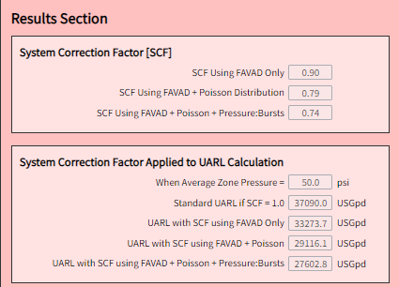
Scenario 2 – Identifying where a standard UARL equation over-estimates UARL leakage
Typical Zone, DMA or System characteristics
AZP | < 64 psi
Service Connections | <5000
Pipe Materials on services and mains | High %s of flexible pipe materials
Can result in ILIs of <1
EXAMPLE
Number of service connections=3000
Average length of private service pipe = 5ft/conn (from curb stop to meter)
Mains Length = 50 miles
Average Zone Pressure = 50 psi
60% rigid mains
40% rigid services (mains to curb stop)
30% rigid services (curb stop to meter)
SCF summary from UARL with SCF online software
In this example, a standard
1999 UARL calculation
over-estimates UARL volume by 26%

Slide 12
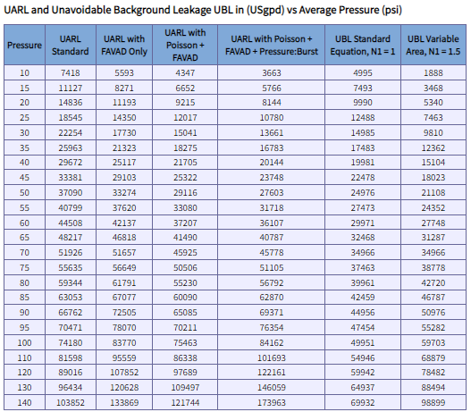
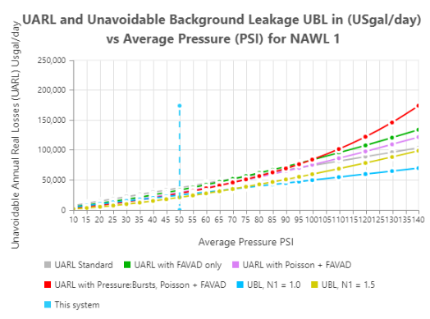
Scenario 2 – Identifying Zones where a standard UARL equation over-predicts UARL leakage
In this example, if AZP can be reduced by 1 psi
(from 50psi to 49 psi)
UARL volume can be reduced by 771 USG/day or 281 thousand USG/year

Slide 13
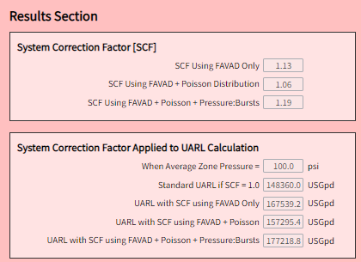
Scenario 3 Identifying where a standard UARL equation under-predicts UARL leakage
Typical Zone, DMA or System characteristics
AZP | > 85 psi
Service Connections | >5000
Pipe Materials on services and mains | High %s of flexible pipe materials
EXAMPLE
Number of service connections=6000
Average length of private service pipe = 5ft/conn (from curb stop to meter)
Mains Length = 100 miles
Average Zone Pressure = 100 psi
60% rigid mains
40% rigid services (mains to curb stop)
30% rigid services (curb stop to meter)
SCF summary from UARL with SCF online software
In this example, a standard
1999 UARL calculation
under-estimates UARL volume by 19%

Slide 14
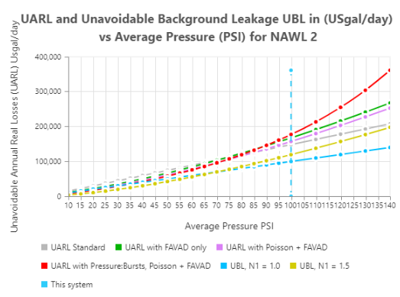
Scenario 3 Identifying Zones where a standard UARL equation under-predicts UARL leakage
For this system, UARL targets set using the 1999 UARL equation are unlikely to be achievable
However, if AZP can be reduced by 1 psi
(from 100 psi to 99 psi),
UARL volume can be reduced by 3,222 USG/day or 1.1 million USG/year

Slide 15
CASE STUDIES
Recent experiences in calculating SCFs in Europe, Canada and Australia

Slide 16
Case Study characteristics
Each case study is different :
Many small zones and DMAs
Whole Province survey (Canada) for many hundreds of individual utilities
Large state capital Utility with a 4 tiered system of organisation– pressure zones, supply zones, distribution systems and delivery systems
Wide range of size of individual zones, DMAs or whole systems
Wide range of operating pressures
Diverse mix of rigid and flexible pipes across services and mains
For each case study, SCF calculations have been used to get a bottom to top picture of a whole utility or province, drilling down to every individual zone or DMA
Allows target setting at different levels
Drives decisions about where to concentrate ALC and pressure management activities

Slide 17
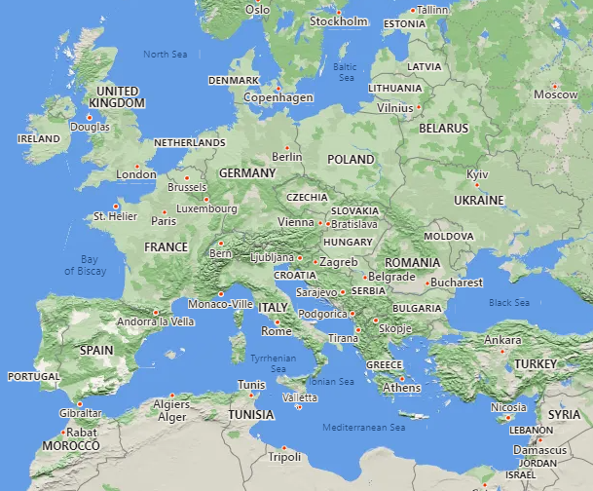
Case Study 1 - Water Services Corporation (Malta, Europe)
2 Mediterranean Islands (Malta and Gozo)
All properties supplied through roof storage tanks
57% of Malta’s potable water produced by 3 reverse osmosis plants; the remainder is pumped from underground aquifers.
130,000 service connections
1330 miles (2,141 km) mains
Average Pressure 45.5 psi (32m ,3.2 bar)
Customer meters are located at the curb stop
93% rigid mains, 5% rigid services (mains to curb stop)
320 UARL with SCF calculations to map all zones and DMAs across 4 regions
Latest ILI 1.8, reduced from ILI of approx. 20 in 2000
All data reproduced with kind permission of
Water Services Corporation, Malta

Slide 18
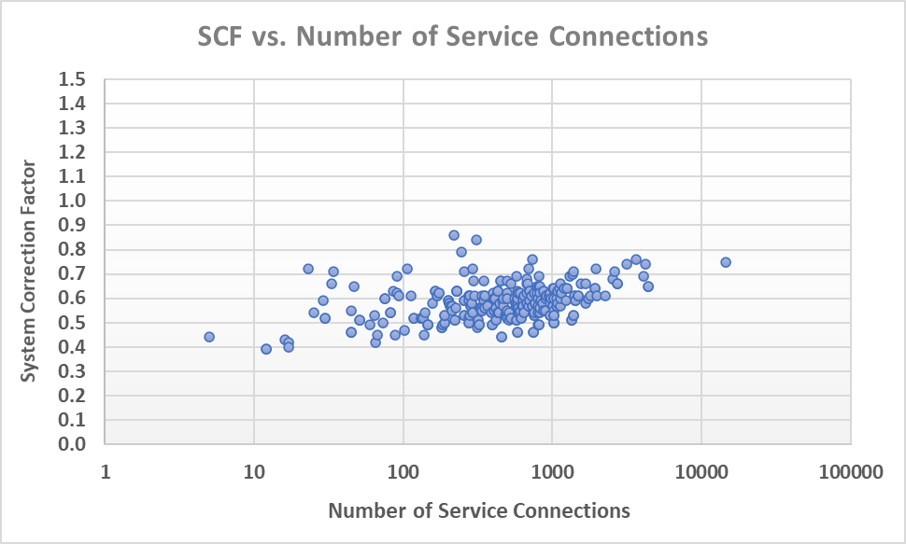
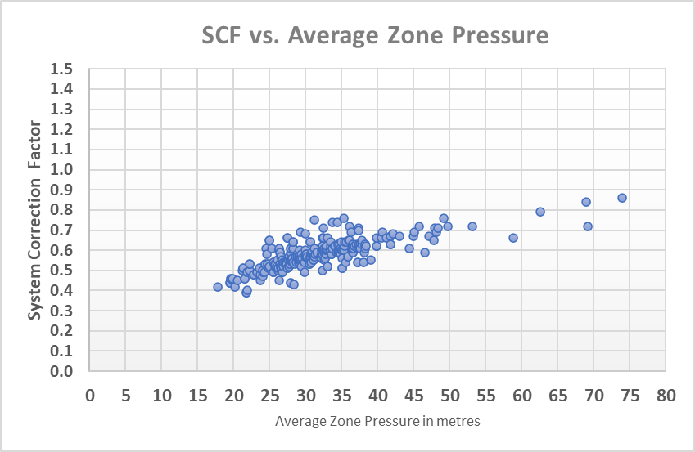
Case Study 1 - Water Services Corporation (Malta, Europe)
Case Study characteristics
Zone/System size | 5 – 14,000 service connections
Small Systems | >99% zones have <5,000 service connections
Managed AZP ranges | 24-105 psi (17-74 m)
All data reproduced with kind permission of Water Services Corporation, Malta

Slide 19
Case Study 1 - Water Services Corporation (Malta, Europe)
SCFs at current operating pressures range from
0.39 – 0.86
Standard UARL equation over-predicts UARL volumes in some zones by 61%-14%
A continuous program of Pressure Management over > 20 years
Why are these SCFs all < 0.9 ?
A large percentage (>99%) of small systems with less than 5,000 service connections
Mostly flexible materials on service connections
SCF calculation results are being used in conjunction with Snapshot ILI
to rapidly identify zones where lower leakage targets could be set ,
and to better quantify leakage and burst reductions
from further pressure management
How are WSC using SCF calculation results?
All data reproduced with kind permission of Water Services Corporation, Malta

Slide 20
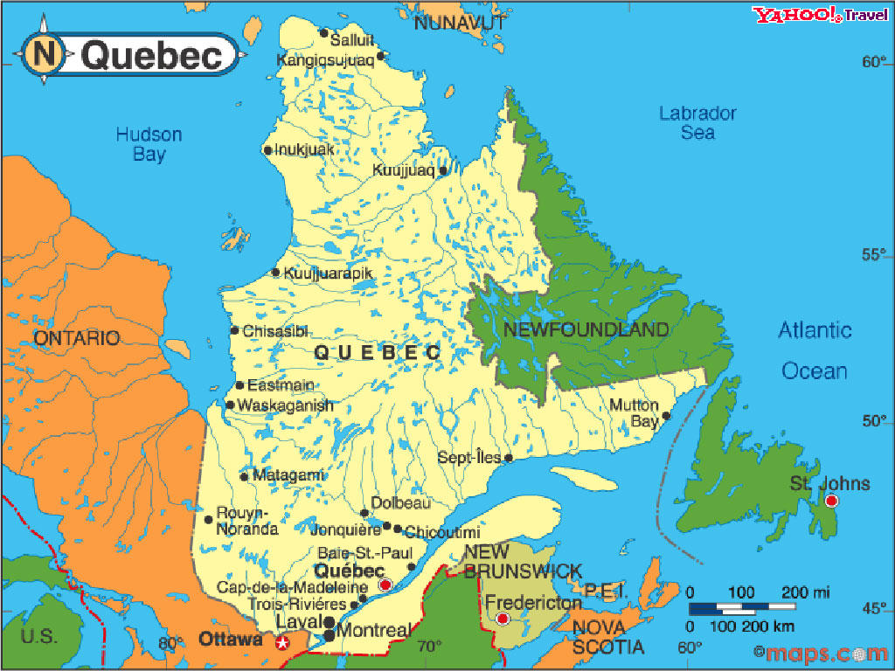
Case Study 2 - Quebec Province (Canada)
626 Individual water utilities
2,111,989 service connections
26,000 miles (41,429 km) mains
Average Pressure 70.7 psi (49.7 m)
Overall, 67% rigid mains, 95% rigid services (mains to curb stop), 95% rigid services (curb stop to meter)
855 UARL with SCF calculations to map DMAs and zones across 17 regions
Latest overall ILI 6.6 in 2019
65% of networks (in number, not length) achieved a low or moderate ILI of <4 in 2019
All data reproduced with kind permission of MAMH and
Reseau Environnement, Quebec

Slide 21
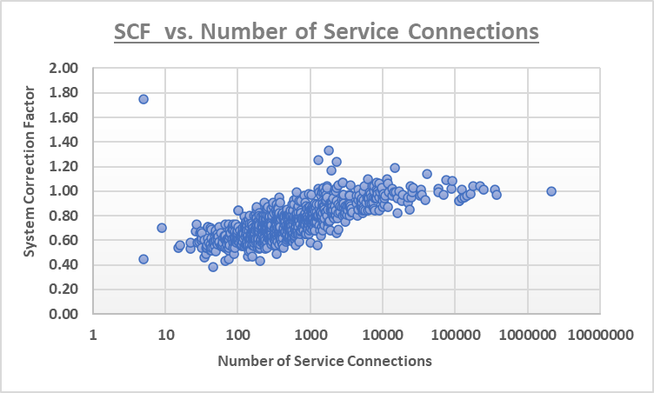
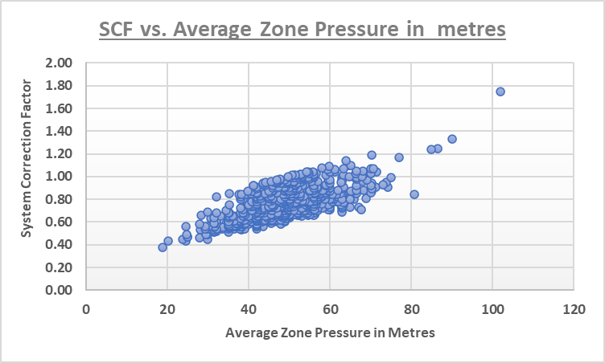
Case Study 2 - Quebec Province (Canada)
Case Study characteristics
Zone/System size | 5 – 377,362 service connections
Small Systems | >88% zones have <5,000 service connections
Managed AZP ranges | 25-145 psi (18-102 m)
All data reproduced with kind permission of MAMH and Reseau Environnement, Quebec

Slide 22
Case Study 2 - Quebec Province (Canada)
For some zones or regions, standard UARL equation
over-predicts UARL volumes by up to 62%
SCFs at current operating pressures range from
0.38 – 1.75
For some zones or regions, standard UARL equation
under-predicts UARL volumes by up to 75%
A large percentage (>88%) of small systems with less than 5,000 service connections
Why are these SCFs so varied ?
A wide variety of system/zone size
A wide range of operating pressures
Mostly rigid service connections
How are SCF calculation results being used?
SCF calculation results are being used so that
Quebec Efficiency Strategy has a better understanding of their systems and the way to reach their water loss objectives.
All data reproduced with kind permission of MAMH and Reseau Environnement, Quebec

Slide 23
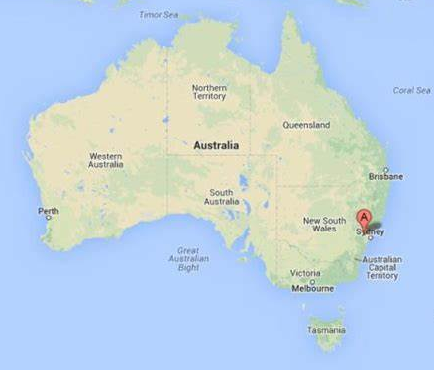
Case Study 3 – Sydney Water (Australia)
Sydney Water supply over 1.5 billion litres of drinking water to over 5.3 million people every day. Water is supplied from 11 major dams through 13 water delivery systems with:
1.37 Million service connections
12900 miles (20,800 km) mains
Average Pressure 75 psi (52.8m)
82% rigid mains, 85% rigid services (mains to curb stop)
248 reservoirs, 152 pumping stations
9 water filtration plants, Sydney Desalination Plant
655 UARL with SCF calculations to map all pressure zones, supply zones, and distribution systems across 13 water delivery systems
2020 ILI = 1.3
All data reproduced with kind permission of
Sydney Water, Australia

Slide 24
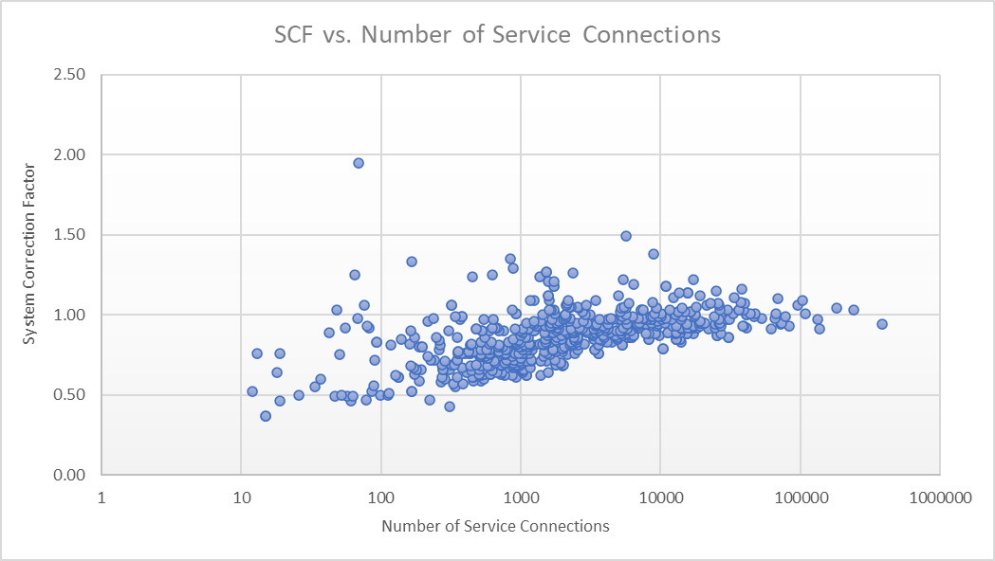
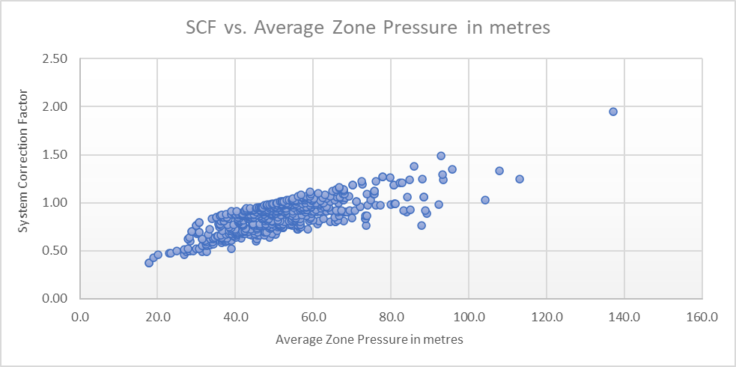
Case Study 3 – Sydney Water (Australia)
Case Study characteristics
Zone/System size | 12 – 384,864 service connections
Small Systems | >68% zones have <5,000 service connections
Managed AZP ranges | 21-195 psi (15-137 m)
0
All data reproduced with kind permission of Sydney Water, Australia

Slide 25
Case Study 3 – Sydney Water (Australia)
For some zones, standard UARL equation
over-predicts UARL volumes by up to 63%
SCFs at current operating pressures range from
0.37 – 1.95
For some zones, standard UARL equation
under-predicts UARL volumes by up to 95%
A wide range of operating pressures
Why are these SCFs so varied ?
A wide variety of system/zone size
Mostly rigid mains and service connections
How are Sydney Water using SCF calculation results?
Contributes to a complete assessment of all their pressure zones, supply zones, distribution zones and delivery systems -
this will be used for better targeting of further active leakage control
and pressure management activities
All data reproduced with kind permission of Sydney Water, Australia

Slide 26
Summary
There is now no practical lower or upper system size limits for a UARL with SCF calculation –
Practical Pressure range 10-200 psi
Ideal for the large numbers of small Utilities in the USA
Also suitable for very large utilities or for state-wide surveys
Use the Free Water Audit Software (v6) to calculate a whole system UARL
Consider SCF calculations for Boundary Cases
Use SCF to map all zones and systems within a Utility for a complete top down/bottom up view of your system
Where can UARL volume targets be reduced?
Where UARL volume targets may not be achievable?
Target zones or systems where further pressure management may be possible to reduce UARL volumes, with volume reductions quantified
Case studies show that even in utilities with low ILIs and low SCFs, further UARL volume reduction is possible
Latest research in 2021 - we can now use SCF to calculate a Power Law……new functionality coming to UARL with SCF in 2022!

Slide 27
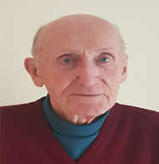
Thank You!
Kate Stanton-Davies
katesdavies@wlranda.com
Director
Water Loss Research
& Analysis Ltd
Allan Lambert
allanlambert@leakssuitelibrary.com
Director
Leakssuite Library Ltd
Stuart Stanton-Davies
stuart@codingdale.co.uk
Technical Director
Codingdale Ltd
www.wlranda.com
www.leakssuitelibrary.com

