Slide 1
System Correction Factors – SCFs in action in Europe, North America, UK and South Africa
Authors: Kate Stanton-Davies (WLR&A Ltd) & Mark Shepherd (GWF)
Notes:
Good morning and welcome to this presentation on UARL with SCF case study results in Europe, Canada, the UK and South Africa
Im Kate Stanton-Davies from WLR&A and I’m joined by Mark Shepherd from GWF

Slide 2
Agenda
1. UARL and System Correction Factors
Boundaries of the original 1999 UARL equation
What is a System Correction Factor?
2. Scenarios
Calculating a whole system Infrastructure Leakage Index (ILI)
Boundary Cases where a standard UARL equation over-predicts UARL volume
Boundary Cases where a standard UARL equation under-predicts UARL volume
3. Case Studies (2020-2022)
Water Services Corporation (Malta)
Quebec Province (Canada)
UK Proof of Concept programmes
Developing countries
Summary

Slide 3
UARL and System Correction Factors
What, why and how?

Slide 4
Boundaries of the original 1999 UARL equation
The original 1999 UARL equation was designed for whole systems, zones or DMAs with more than 5000 services connections, operating at mid-range Average Zone Pressures (45-60m)
If your whole system, zone or DMA is larger than 5000 service connections and/or has AZP of 45-60m, keep on using the standard UARL calculation to calculate UARL volumes.
Whole systems, zones or DMAs operating outside these boundaries can result in UARL calculations which over-estimate or under-estimate UARL volumes
An SCF calculation is recommended when a whole system, zone or DMA has the following characteristics:-
Number of service connections < 5000
and/or
Average Zone Pressure < 45m or > 60m

Slide 5
What is a System Correction Factor?
A System Correction Factor optionally customises the basic 1999 UARL equation for any System, Zone or DMA
UARL with SCF = SCF x UARL_{1999 volume}
Models the influences of specific characteristics of a System, Zone or DMA
from the smallest Utility or DMA to the largest Utility, System or Zone
Provides Utility with priority insights for leakage reduction and pressure management opportunities
UARL with SCF calculations are performed using online software

Slide 6
How is a UARL with SCF calculation different?
Shows combined influences on UARL volumes which were not modelled in the original 1999 UARL equation:
FAVAD
Fixed and Variable Area Discharges: influence of pipe materials on pressure: leak flow rates relationships
Uses N1=0.5 for fixed area leaks (rigid pipes), N1=1.5 for variable area leaks (flexible pipes and Unavoidable Background Leakage)
POISSON
For small systems, the median probability (50% chance of exceedance in any year) is more appropriate than the average UARL burst frequency.
A probability distribution (Poisson) which produces median values for UARL burst frequencies in small systems, and average values for large systems, is now used.
PRESSURE:BURSTS
Includes the influence of a general international relationship between pressure and burst frequency (not available prior to 2013)

Slide 7
Scenarios
When to calculate a System Correction Factor

Slide 8
Scenario 1 – Calculating a whole system Infrastructure Leakage Index (ILI)
The Infrastructure Leakage Index (ILI) is the ratio of Current Annual Real Losses (CARL) to Unavoidable Annual Real Losses (UARL)
ILI = CARL/UARL₁₉₉₉
Always initially calculate a whole system ILI by using a UARL value based on the original 1999 equation
If Nc < 5000 and/or Average Zone Pressure <45m or >60m consider an online SCF calculation to identify:
How low UARL leakage could go for each whole system, zone or DMA
Identify how much UARL leakage could be saved by small reductions in operating pressure

Slide 9
Scenario 2 – Identifying where a standard UARL equation over-estimates UARL leakage
Typical Zone, DMA or System characteristics
AZP | < 45m
Service Connections | <5000
Pipe Materials on services and mains | High %s of flexible pipe materials
Can result in ILIs of <1
SCF result | Standard UARL volume in m3/day | UARL with SCF volume in m3/day
0.74 | 123.4 | 91.0
In this example,
a standard 1999
UARL calculation
over-estimates
UARL volume by 26%
EXAMPLE
Number of service connections=3000
Average length of private service pipe = 3m/conn (from curb stop to meter)
Mains Length = 50 km
Average Zone Pressure = 35m
60% rigid mains
40% rigid services (mains to curb stop)
30% rigid services (curb stop to meter)

Slide 10
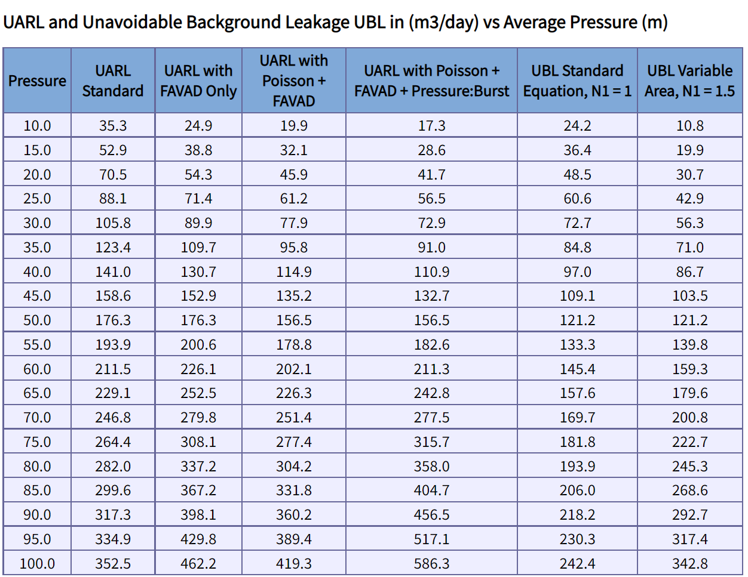
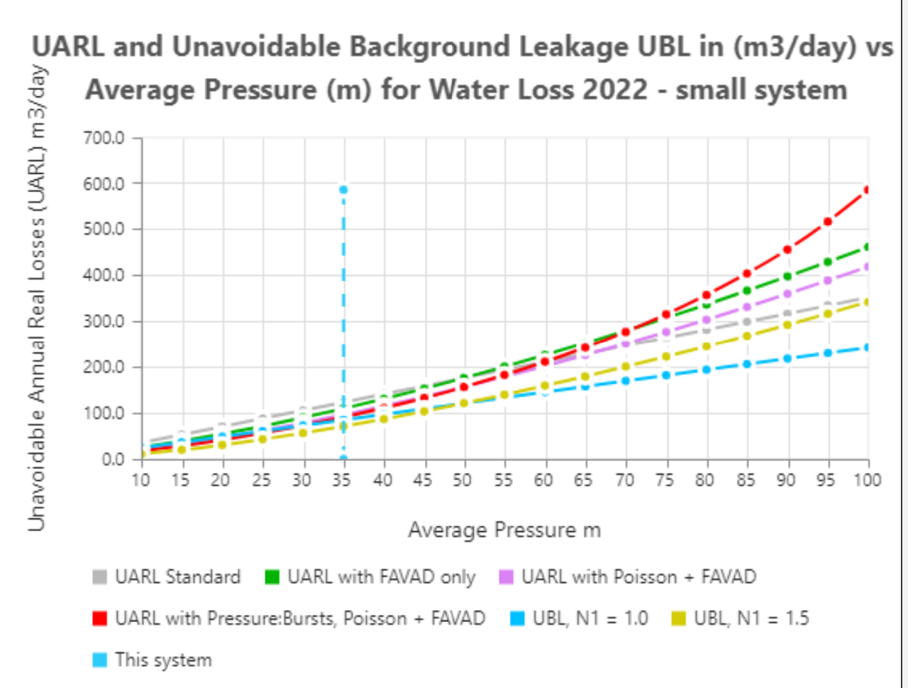
Scenario 2 – Identifying Zones where a standard UARL equation over-predicts UARL leakage
In this example, if AZP can be reduced by 1 m
(from 35m to 34m)
UARL volume can be reduced by 3.6m³/day or 1314m³/year

Slide 11
Scenario 3 Identifying where a standard UARL equation under-predicts UARL leakage
Typical Zone, DMA or System characteristics
AZP | > 60m
Service Connections | >5000
Pipe Materials on services and mains | High %s of flexible pipe materials
SCF result | Standard UARL volume in m3/day | UARL with SCF volume in m3/day
1.17 | 493.5 | 578.2
In this example,
a standard 1999
UARL calculation
under-estimates
UARL volume by 17%
EXAMPLE
Number of service connections=6000
Average length of private service pipe = 3ft/conn (from curb stop to meter)
Mains Length = 100 km
Average Zone Pressure = 70m
60% rigid mains
40% rigid services (mains to curb stop)
30% rigid services (curb stop to meter)

Slide 12
Scenario 3 Identifying Zones where a standard UARL equation under-predicts UARL leakage
For this system, UARL targets set using the 1999 UARL equation are unlikely to be achievable at this pressure
If AZP can be reduced by 1 m
(from 70m to 69m),
UARL volume can be reduced by approx. 15m³/day or 5475m³/year

Slide 13
Case Studies
Recent experiences calculating SCFs

Slide 14
Case Study characteristics
Each case study is different :
Wide range of size of individual zones, DMAs or whole systems
Wide range of operating pressures
Diverse mix of rigid and flexible pipes across services and mains
For large case studies SCF calculations have been used to get a bottom to top picture of a whole utility or province, drilling down to every individual zone or DMA
Allows target setting at different levels
Drives decisions about where to concentrate ALC and pressure management activities
For proof of concept programmes, small numbers of DMAs are targeted for calculation

Slide 15
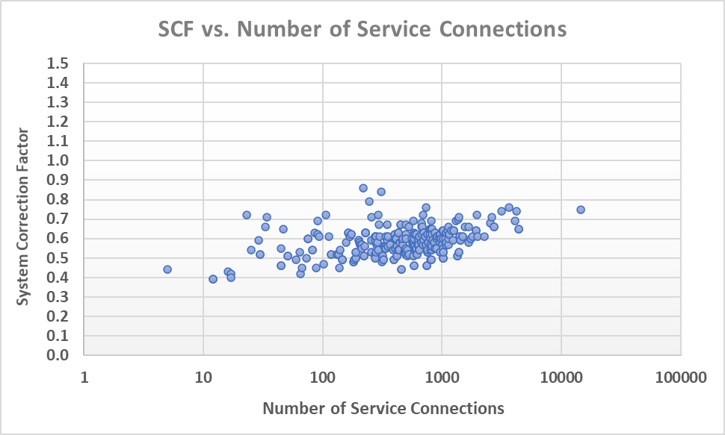
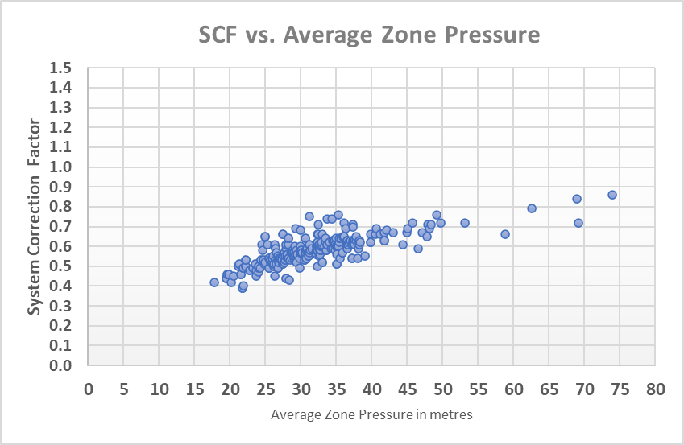
Case Study 1 - Water Services Corporation (Malta)
Utility information
Total service conns | 130000 (5% rigid)
Total length of mains | 2141km (93% rigid)
Weighted Average Zone Pressure | 32m
Case Study characteristics
Zone/System size | 5 – 14,000 service connections
Small Systems | >99% zones have less than 5,000 service connections
AZP ranges | 17-74 m
320 SCF calculations
Latest ILI = 1.8
All data reproduced with kind permission of Water Services Corporation, Malta

Slide 16
Case Study 1 - Water Services Corporation (Malta, Europe)
SCFs at current operating pressures range from 0.39 – 0.86
Standard UARL equation over-predicts UARL volumes in some zones by 61%-14%
SCFs for WSC are all less than 0.9 due to:
A continuous program of pressure management over > 20 years
A large percentage (>99%) of small systems with less than 5,000 service connections
Mostly flexible materials on service connections
SCF results are being used in conjunction with Snapshot ILI to rapidly identify zones where lower leakage targets could be set,
and to better quantify leakage and burst reductions
from further pressure management
How are WSC using SCF calculation results?
All data reproduced with kind permission of Water Services Corporation, Malta

Slide 17
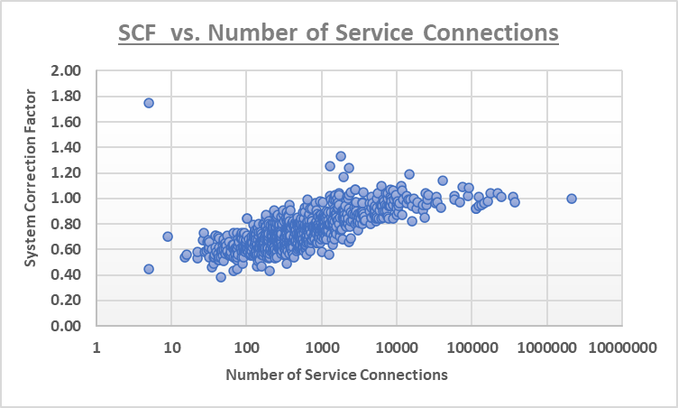
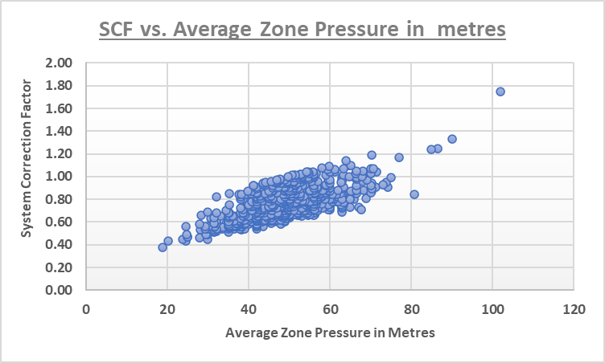
Case Study 2 – Quebec Province (Canada)
Province information (626 Utilities)
Total service conns | 2,111,989 service connections (95% rigid)
Total length of mains | 41,429 km mains (67% rigid)
Weighted Average Zone Pressure | 49.7m
Case Study characteristics
Zone/System size | 5 – 377,362 service connections
Small Systems | >88% zones have less than 5,000 service connections
AZP ranges | 18-102 m
855 SCF calculations
Latest ILI = 6.6 in 2019
All data reproduced with kind permission of MAMH and Reseau Environnement, Quebec

Slide 18
Case Study 2 – Quebec Province (Canada)
SCFs at current operating pressures range from 0.38– 1.75
For some zones or regions, standard UARL equation over-predicts UARL volumes by up to 62%
For some zones or regions, standard UARL equation under-predicts UARL volumes by up to 75%
SCFs for Quebec are so varied due to:
A large percentage (>88%) of small systems with less than 5,000 service connections
A wide variety of system/zone size
A wide range of operating pressures
How are SCF calculation results being used?
SCF calculation results are being used so that
Quebec Efficiency Strategy has a better understanding of their systems and the way to reach their water loss objectives
All data reproduced with kind permission of MAMH and Reseau Environnement, Quebec

Slide 19
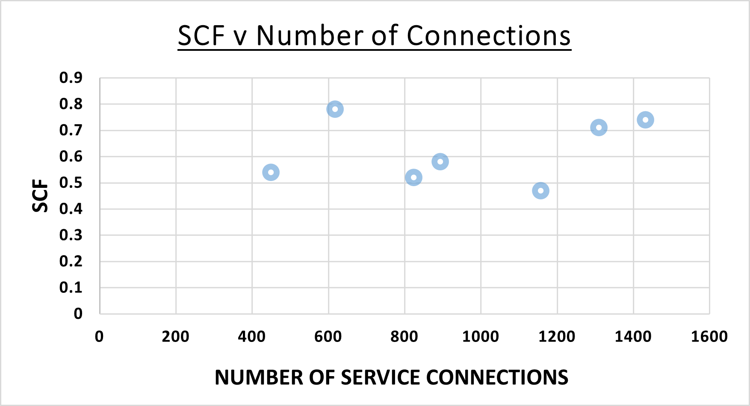
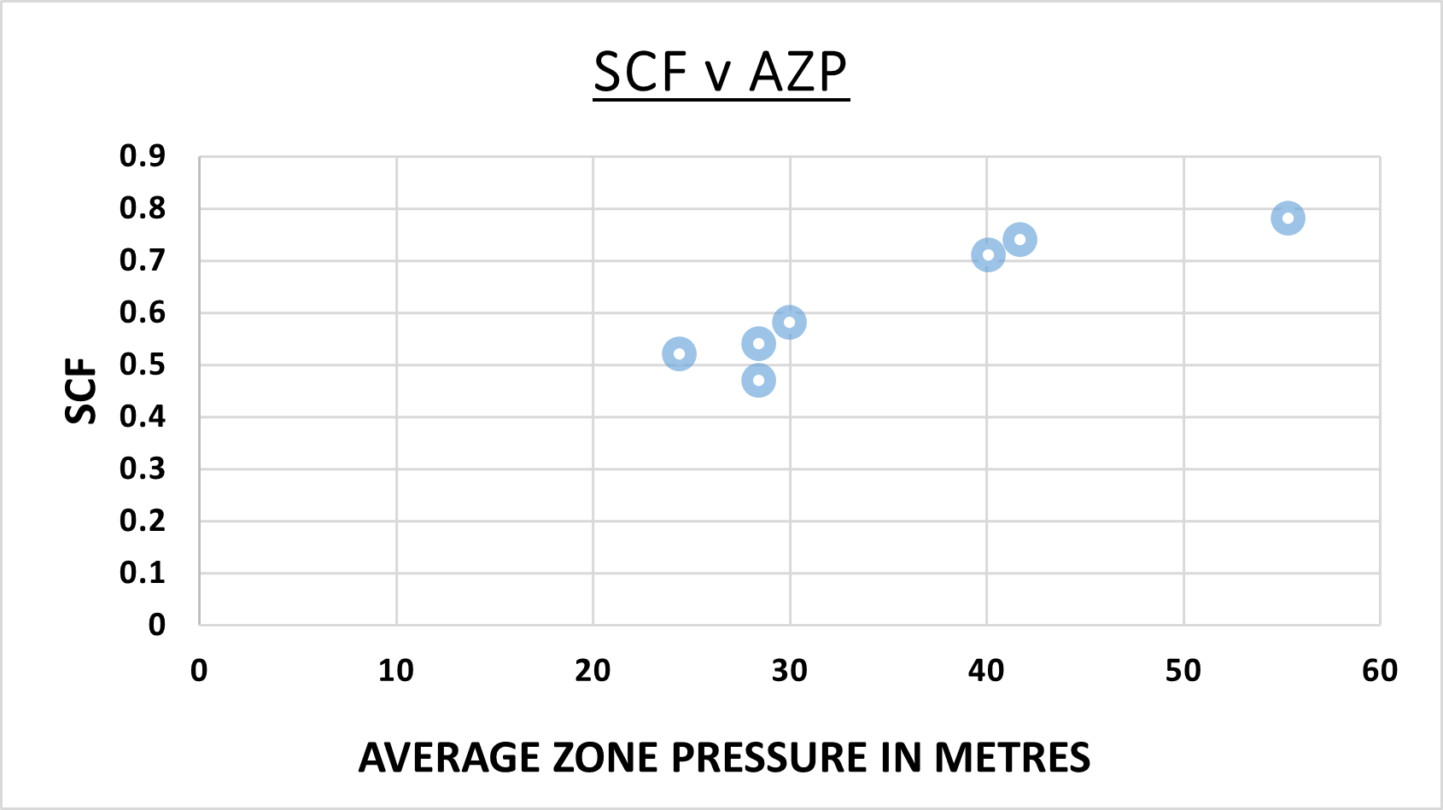
Case Study 3 – UK Utilities (proof of concept programmes)
Small DMAs –
450-1432 service connections
24-55m Average Zone Pressure
Varied % of rigid and flexible mains and services
Results show how standard UARL calculations over-estimate UARL volumes in these DMAs
SCFs range from 0.47 to 0.78
Lower UARL leakage volume targets ​are achievable

Slide 20
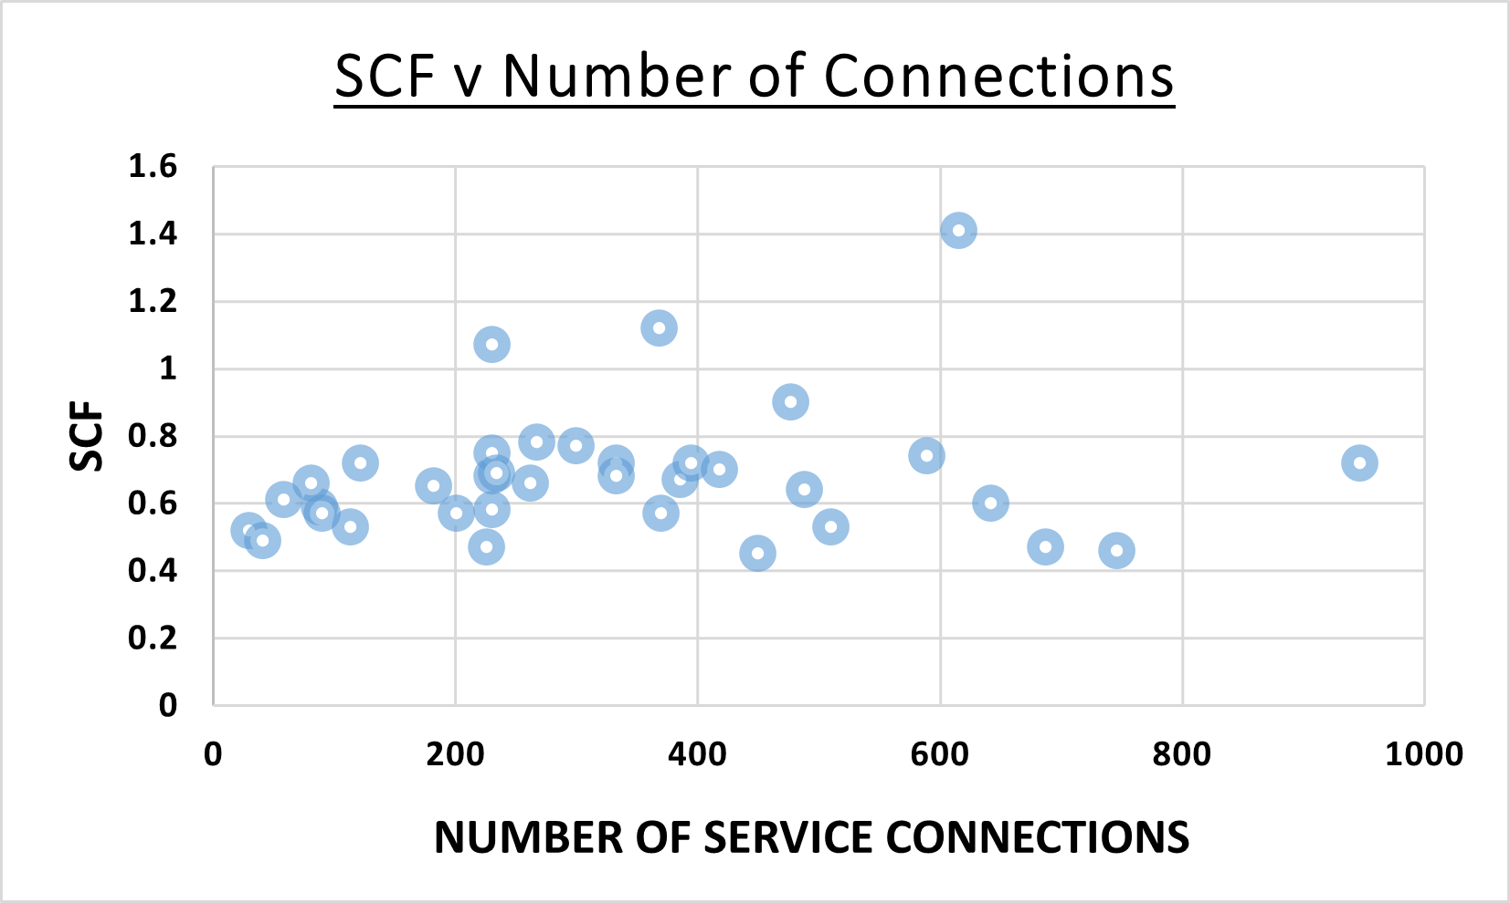
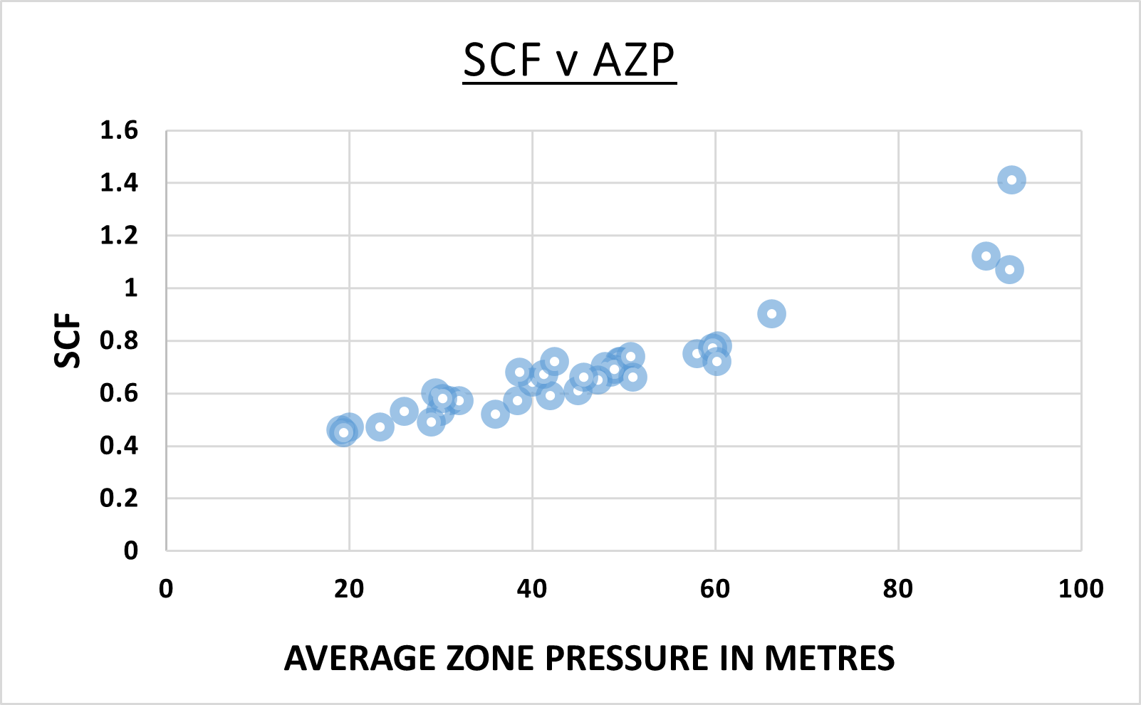
Case Study 4 – developing countries
Small DMAs –
30-947 service connections
19-92 m Average Zone Pressure
Varied % of rigid and flexible mains and services
Results show how standard UARL calculations over-estimate UARL volumes in many DMAs in the green zone and under-estimate UARL volumes in a small number of DMAS in the red zone
SCFs range from 0.45 to 1.41

Slide 21
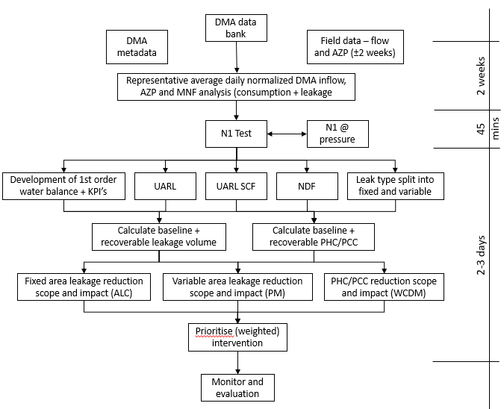
How GWF are using UARL with SCF calculations
GWF have taken the principles of the UARL with SCF calculations to develop a quick but accurate decision management tool (GWF BALANCE) that provides reporting/regulatory requirements and recommended and quantified intervention strategies.
The output from this approach assist water companies prioritise resources more effectively and efficiently (targeting areas with the correct intervention), reducing operational costs, leakage volume and per capita consumption

Slide 22
Summary
There is now no practical lower or upper system size limits for a UARL with SCF calculation –
Practical Pressure range 7 – 140m
Ideal for small Utilities in Europe
Also suitable for very large utilities or for province-wide surveys
Can be used in developed and developing countries
Use the original 1999 UARL equation to calculate a whole system UARL
Consider SCF calculations for Boundary Cases
Use SCF to map all zones and systems within a Utility for a complete top down/bottom up view of your system
Where can UARL volume targets be reduced?
Where UARL volume targets may not be achievable?
Target zones or systems where further pressure management may be possible to reduce UARL volumes, with volume reductions quantified
Case studies show that even in utilities with low ILIs and low SCFs, further UARL volume reduction is possible

Slide 23
Thank You!
Kate Stanton-Davies
katesdavies@wlranda.com
Director
Water Loss Research
& Analysis Ltd
Mark Shepherd
Mark.Shepherd@gwf.ch
Senior Advisor – Integrated Water Solutions
GWF MessSysteme AG
www.wlranda.com
www.gwf.ch

