Slide 1
Recent Practical Improvements in Pressure Management and UARL calculations
Caribbean Regional Conference
Water Loss 2023
21-23 March 2023 Port of Spain, Trinidad and Tobago
Paul Fanner, NRW Management Advisor, Fanner and Associates Ltd, UK
Kate Stanton-Davies, Managing Director, Water Loss Research & Analysis Ltd, UK
Allan Lambert, Technical Advisor, Leakssuite Library, UK

Slide 2
Presentation Introduction
The N1 value for a zone / DMA is normally assumed to be a fixed value
In fact N1 varies significantly with pressure
This is important to understand for Caribbean systems operating at either low or high average pressures
For accurate modelling of impact of pressure management on leakage levels
For correct determination of Night Day Factor (NDF)
High Caribbean NRW levels => Small DMAs for leakage management
Very useful to determine customized UARL (volume/day) at DMA level
But standard UARL calculations are not valid for small DMAs or DMAs with low or very high pressures
System Correction Factor (SCF) enables customisation of UARL for these DMAs
Improves targets, performance monitoring and identification of scope for pressure reduction

Slide 3
Progress in understanding, from N1 to FAVAD
Simple Power Law approach (1995 onwards)
Assume that leak flow rate (volume/hour) varies with average zone pressure AZP to the power N1
L = k x AZP^{N1}
The user chooses a fixed value for N1 between 0.5 to 1.5, preferably based on N1 tests
The parameter ‘k’ is not fixed but also varies with pressure. However, if changes in pressure are small ‘k’ can to be assumed to be approximately constant

Slide 4
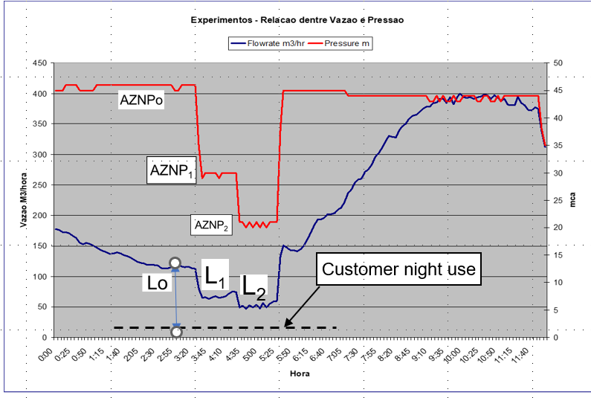
Assessing N1 from a night test
2-step N1 Night Test, SABESP, Brazil (1998)
Some International N1 test values (1979-2005)
Country | # of sectors tested | Mean N1 value | Range of N1 Values
Japan (1981) | 20 | 1.15 | 0.63 – 2.12
UK (TR154) | 17 | 1.13 | 0.70 – 1.68
Brazil (1998) | 13 | 1.15 | 0.52 – 2.79
UK (2003) | 75 | 1.01 | 0.36 – 2.95
Cyprus (2005) | 15 | 1.47 | 0.64 – 2.83
Sources of data:
OGURA, Japanese Water Works Association Journal, May 1981
Technical Report R154 data, WRC, Nov 1980, re-analysed for N1s mid=1990’s
BBL Ltda Brazil, private communication
UKWIR Report 03/WM/08
Charalambous, 2005 in Conference Proceedings of Leakage 2005, Halifax
Average Zone Night Pressure (m)
Zone inflow rate m³/hr
Pressures in the Zone are reduced at night, until steady values of Average Zone Night Pressure AZNP and Leak flow rate L have been reached. N1 values can then be calculated from pairs of values, e.g. AZNPo and Lo, and AZP1 and L₁

Slide 5
FAVAD concept provides a deeper understanding of Pressure: Leak Flow Rate Relationships
FAVAD = Fixed and Variable Area Discharge Paths
(John May, 1994)
The FAVAD concept has been used to explain diverse results from pressure/leak flow rate field tests in many countries
Velocity of leakage paths V = Cd x (2gP)^{0.5}
Cd is a discharge coefficient, typically 0.6
g is acceleration due to gravity (9.81 m/s²)
If Area of leakage paths = A, then leak flow rate L = V x A = Cd x A x (2gP)^{0.5}
Effective area (Cd x A) of some types of leakage paths are fixed; effective areas of other types of leakage paths vary linearly with pressure
N1 for fixed area leakage paths is 0.5 (least sensitive to changes in pressure)
N1 for variable area leakage paths is 1.5 (much more sensitive to changes in pressure)

Slide 6
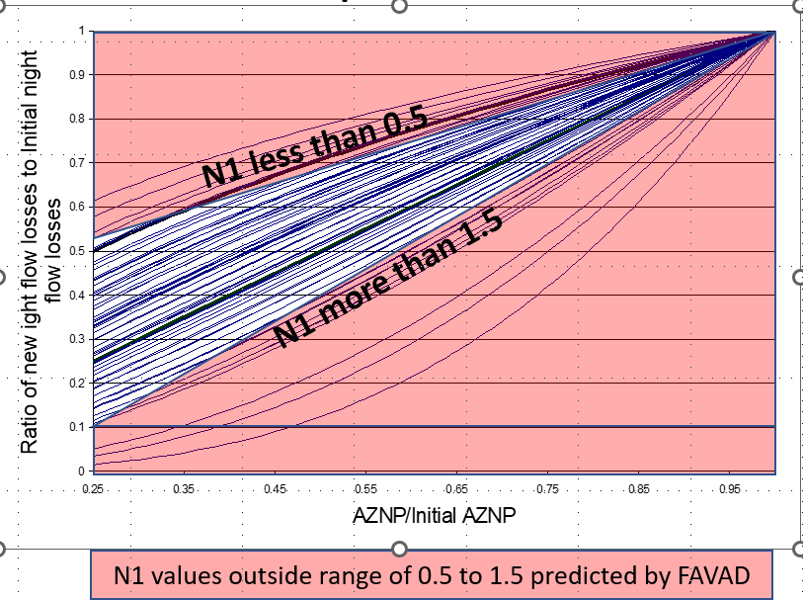
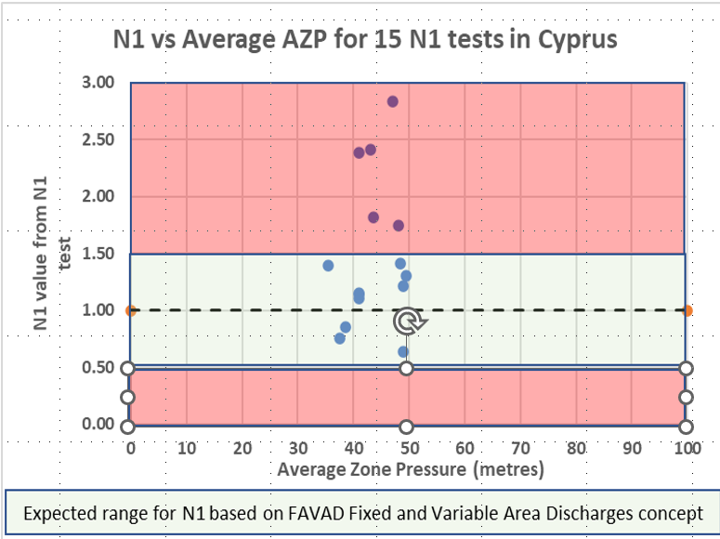
Most N1 tests yield N1 values between 0.5 and 1.5
In a 2003 UK study, only 11 out of 75 N1 values were outside FAVAD concept limits of 0.5 to 1.5
Only 5 of 15 N1 values for Cyprus (2005) were outside the FAVAD concept limits of 0.5 to 1.5
Some known causes of doubtful N1 results which exceed expected FAVAD maximum N1 value of 1.5:
Changes in night pressure started before night consumption and Average Zone Night Pressure stabilised
Don’t calculate N1 changes for increases in pressure, as pressure increases may increase storage tank inflows
Significant differences between AZP and lowest ground level; or failure to measure at Average Zone Point

Slide 7
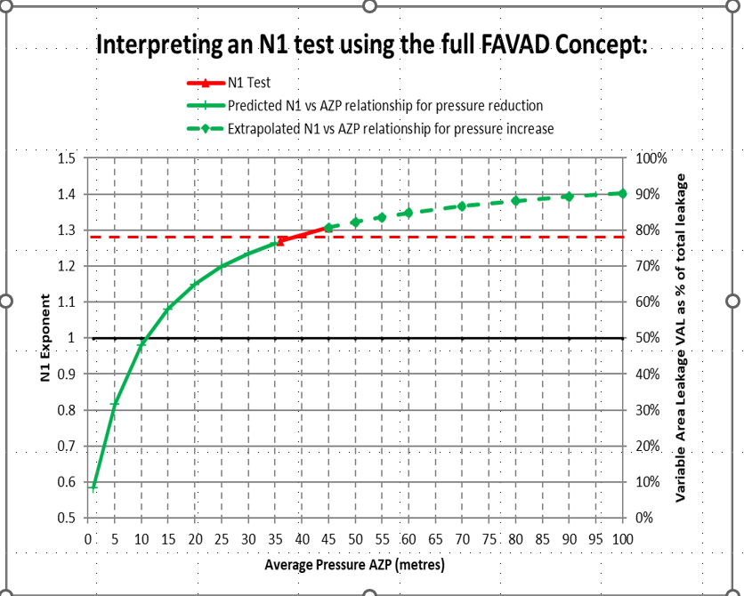
Be aware of possible problems in using a fixed average N1 value
The short red line shows an N1 test where AZPs were reduced from 45 to 36 metres, with an average N1 of 1.29 metres at 40.5m Average Zone Pressure
FAVAD concept shows that:
if AZPs were further reduced, N1 would fall to 0.80 at 5m AZP (curved green line)
If AZPs were increased, N1 would increase to 1.40 at 100m AZP (dashed green line), but more bursts would likely occur, further changing the N1 value
Most practitioners currently assume a fixed N1 value from the N1 test, which does not vary with AZP (dashed red line)
this over-predicts N1s at lower AZPs with increasing errors at lower AZPs

Slide 8
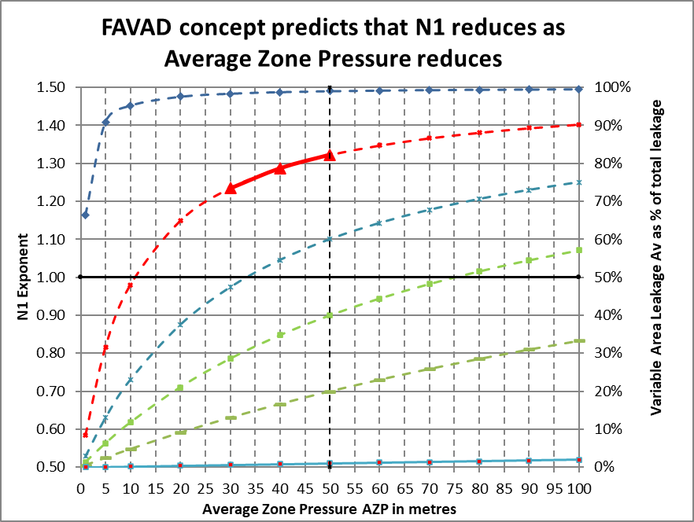
FAVAD analysis of a reliable N1 test is the key to improved system-specific DMA calculations
A reliable N1 test locates a point on a curve of AZP against N1, somewhere within a family of curves
By quoting both the average N1 (1.29) and the corresponding average AZP (40.5 metres) together, you can derive the relation between N1 and Average Zone Pressure AZP
You can also calculate ‘in your head’ the % of fixed or variable area leaks at current AZP, for example
when N1 = 1.29
% of variable area leaks = N1 – 0.50 = 0.79 =79%
% of fixed area leaks = 1.50 –N1 = 0.21 = 21%
These curves are the key to more reliable system-specific calculations of pressure:leak flowrate relationships
For example, Night-Day Factors, AZP vs leak flow rate relationships, and real-time separation of DMA inflows into leakage and consumption
All these methods have already been field tested and used on actual DMAs in operational systems in different countries

Slide 9
Time to put this N1 prediction method to bed!
This was the first simple initial N1 prediction method developed by Allan Lambert over 20 years ago
It was based on UARL parameters at an average pressure of 50 metres
before widespread pressure management was implemented
However as it has now become superseded by a better method Allan strongly advises practitioners not to use it now or in future
as it takes no account of the fact that N1 varies significantly with pressure

Slide 10
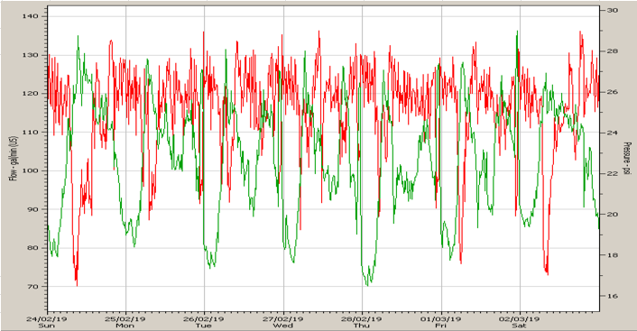
Pressure-variable N1s based on FAVAD also improves the reliability of Night-Day Factor (NDF)
Multiply night leakage rate NLR in m³/hr by NDF in hours/day to get leakage in m³/day
Daily leakage = NLR x NDF
Leak flow rates in DMAs vary with variations in average zone point pressures during each 24 hours
How to assess the value of Night Day Factor?
Simplest approximate method: NDF in hours/day = 24 x (AZPave/AZPmnf)^{N1} assuming fixed N1
Using the above equation, a UK study in 2017 concluded that:
if N1 is assumed fixed at 1.0, then NDF = 24 x (AZPave/AZPmnf)
for fixed N1 values between 0.8 and 1.2, and AZPave/AZPmnf ratios between 0.7 and 1.2, calculated NDFs will be limited to a range of 15 to 30 hours per day.
However, internationally derived N1 and AZPave/AZPmnf values can have wider ranges than the above UK limits, particularly at lower pressures, leading to a larger range of NDF values. Bahamas Water and Sewerage Corporation kindly permitted some of their data sets to be included to demonstrate this.
Fast track method: N1 Triage Approach
Use N1 and ratio of Average daily AZP pressure: Average AZP pressure at time of MNF

Slide 11
N1 Triage and UARL with SCF
1. Establish
Average Zone Point:
Measure Pressure Profiles at AZP point
2.1
Calculate customised UARLs with System Correction Factor SCF
1.1 Assess N1:
Do I need an N1 test?
Yes No
1.2
Analyse N1 test, identify N1 at Average Zone Pressure
1.3
Derive relationship between N1 and pressure at Average Zone Point and NDF
2.1
Set customised UARL with SCF volume targets for each DMA and Zone, and for whole system
2.2
Identify zones for UARL volume reductions and further pressure management benefits

Slide 12
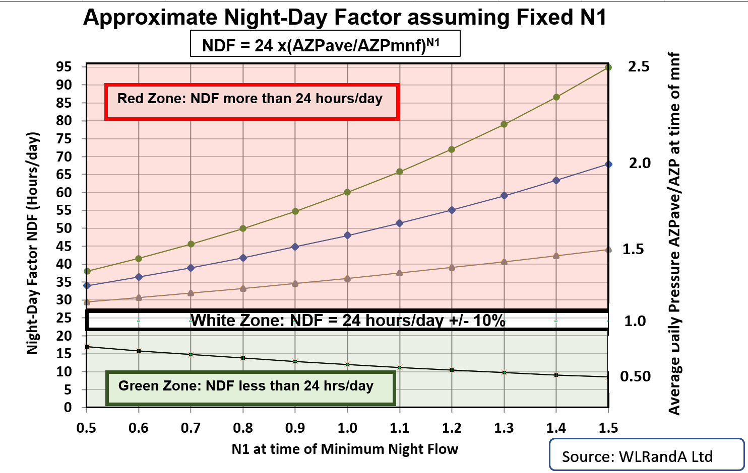
WLR&A N1Triage approach: Step 1.1
STEP 1.1 – DO I NEED TO DO AN N1 TEST?
Make sure you are measuring AZP at the Average Zone Point in the zone or DMA
If result of Triage (AZP_{ave}/AZP_{mnf}) is between 0.9-1.1 (“White Zone”), no N1 test is necessary
If result of Triage is >1.1 (“Red Zone”) or < 0.9 (“Green Zone”), an N1 test is recommended.

Slide 13
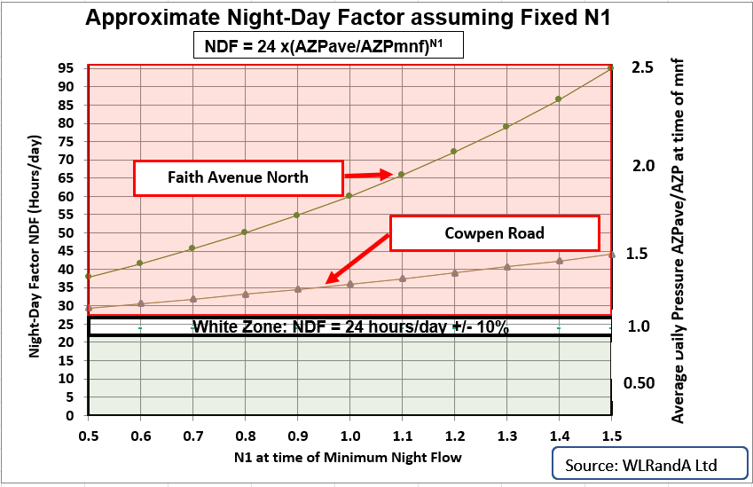
WLR&A Triage approach applied to Caribbean data
DMA Name | Triage Result | AZP_{ave} | AZP_{mnf} | Ratio of AZP_{ave}/AZP_{mnf} | Range of possible values for NDF if N1 is between 0.5 and 1.5 | N1 test recommended?
Faith Avenue North | Red Zone | 26.2 | 10.69 | 2.45 | 37.6 – 92.5 | Yes
Cowpen Road | Red Zone | 17.14 | 12.33 | 1.39 | 28.3 – 39.4 | Yes
Eastern Road | White Zone | 24.27 | 25.28 | 0.96 | 22.7 – 23.6 | N1 test not necessary
Lower operating pressures and higher N1s in the Bahamas than in UK result in ratios of AZPave/AZPmnf higher than UK, and NDFs of 90 hours/day, 3 times as large as in the 30 hrs/day in the UK 2017 study
This simple approach underestimates the higher NDFs at mid-range N1 values, but is sufficiently reliable to assess if an N1 test is needed to define if the NDF lies within a white zone with some pre-selected +/-% limits
+/- 10% is shown as an example

Slide 14
Full FAVAD analysis of N1 data Key takeaways
Any N1 value derived from an N1 test is not fixed
N1 reduces as pressure reduces
Rates of change in N1 are greatest at lower pressures
Each N1 test produces an average N1 value at a specific Average Zone Pressure
For example N1 = 1.29 @ 40.5m AZP
Always quote N1 and AZP values together
Reliable N1 test leads to further important calculations
Derive
relationship between N1 and AZP
Calculate Night-Day Factors relating Night Leakage Rate to daily leakage
Derive relationship between AZP and leak:flow rate
Real-time separation of DMA inflows into leakage and consumption

Slide 15
UARL with System Correction Factor?
1999 UARL equation tends to overestimate UARL for small systems with high % flexible pipes at low pressures (<45m (64psi)) and underestimate UARL for larger higher pressure systems (>60m (85psi))
A System Correction Factor optionally customises the basic 1999 UARL equation for any System, Zone or DMA
UARL with SCF = SCF x UARL_{1999 volume}
Models the influences of specific characteristics of a System, Zone or DMA
from the smallest Utility or DMA to the largest Utility, System or Zone
Provides Utility with priority insights for further leakage reduction and pressure management opportunities

Slide 16
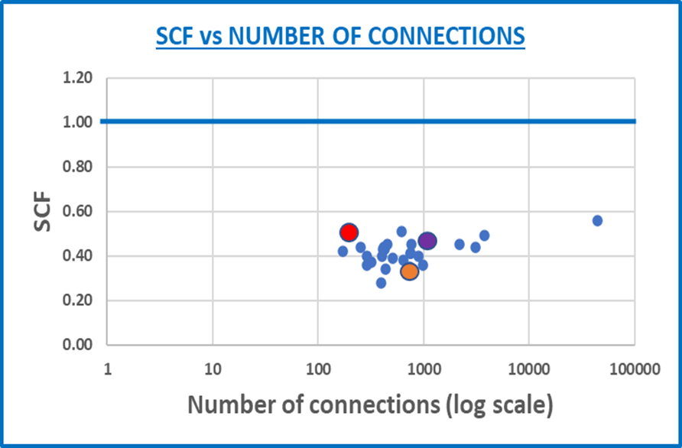
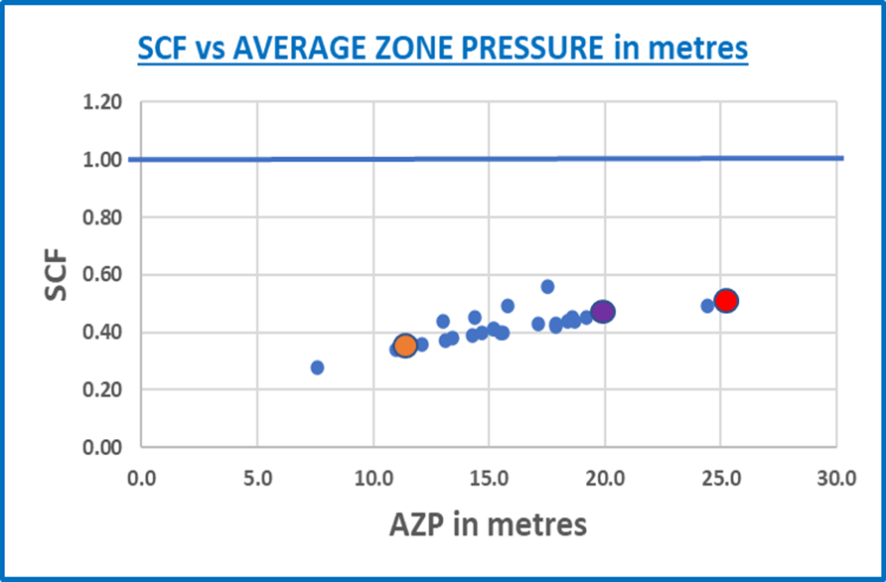
System Correction Factor (SCF) calculations for
Bahamas Water and Sewerage Corporation
CHARACTERISTIC | DETAIL
Zones and DMAs | 24 DMAs and 3 Pressure Zones sampled
System Size | 173-3743 service connections
Mains Length | 1.3-30km
AZP | 7.6-25.1m (10.6-35.1 psi)
SCF range | 0.28 – 0.51
SCF=1 equivalent to a standard ₁₉₉₉ UARL calculation

Slide 17
SCF Summary Results for 3 DMAs in Bahamas WSC
DMA Name | # Service conns mains to property line or curb stop Ns | Mains Length Lm (Km) | Average Zone Pressure AZP in metres (psi) | STANDARD UARL in m³/day | UARL with SCF in m³/day | STANDARD UARL OVERESTIMATES UARL VOLUME BY | UARL with SCF in m³/day if pressure reduced by 1m (1.4 psi)
Fox Hill North | 1127 | 7.50 | 20.0 (28.4) | 21.3 | 10.1 | 11.2m³ | 9.4m³
Cowpen Road | 995 | 7.18 | 11.7 (16.6) | 11.1 | 4.0 | 7.1m³ | 3.5m³
Eastern Road | 633 | 7.14 | 25.1 (35.7) | 16.3 | 8.3 | 8.0m³ | 7.8m³
Use SCF calculations to:-
Set more meaningful volume targets for all sizes of system
Identify where to target pressure reduction activities
Quantify UARL volume reductions from pressure management activities
UARL with SCF part of ISO 24528 standard on Water Loss (ISO - ISO 24528:2021 - Service activities relating to drinking water supply, wastewater and stormwater systems — Guideline for a water loss investigation of drinking water distribution networks) and referenced in AWWA Free Water Audit Software v6

Slide 18
Conclusions
Measuring pressure at the AZP is foundation of these methods
Essential for effective pressure management and performance indicators
FAVAD analysis of a reliable N1 test is the key to improved system-specific DMA calculations
UARL with SCF enables improved analysis of small systems, zones or DMAs with low or very high pressures
Caribbean water utilities can benefit from using these tools.

Slide 19
References
AWWA NAWL 2019 – Research on UARL with SCF
https://www.wlranda.com/wp-content/uploads/2020/01/NAWL-Presentation-Nashville-USA-December-2019.pdf
AWWA NAWL 2021 – practical applications of SCF
https://www.wlrandacalc.com/videos/nawl/Low%20ILIs%20in%20Small%20Systems.mp4
LEAKSSUITE LIBRARY
https://www.leakssuitelibrary.com/low-ilis-and-small-systems/
WATER LOSS RESEARCH & ANALYSIS LTD
UARL With SCF (Metric Units) | Water Loss Research & Analysis Ltd (wlranda.com)
ASCE JOURNAL OF HYDRAULIC ENGINEERING
Realistic Modeling of Leakage and Intrusion Flows through Leak Openings in Pipes
J. E. van Zyl, Ph.D., M.ASCE; A. O. Lambert; and R. Collins, Ph.D.
https://ascelibrary.org/doi/full/10.1061/%28ASCE%29HY.1943-7900.0001346

Slide 20
Thank You!
Paul Fanner
NRW Management Advisor
Fanner & Associates Ltd.
www.fannerassociates.com
paulf@fannerassociates.com
Kate Stanton-Davies
Managing Director
Water Loss Research & Analysis Ltd
www.wlranda.com
katesdavies@wlranda.com
Allan Lambert
Specialist Advisor
Leakssuite Library
www.leakssuitelibrary.com

